Slide 1

Data Curation
google_speech_commands
keywords_curated
backward (1664 files)
dataset_curation.py
_noise (1500 files)
bed (2014 files)
_unknown (1500 files)
bird (2064 files)
hello (1500 files)
cat (2031 files)
stop (1500 files)
...
target
keywords
_background_noise_ (6 files)
custom_keywords
hello (50+ files)

Slide 2

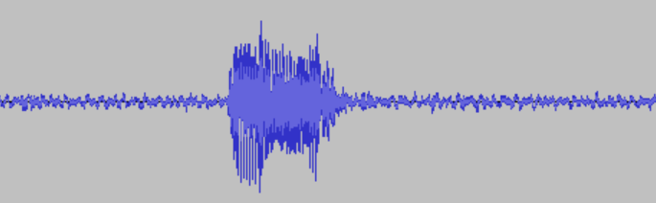
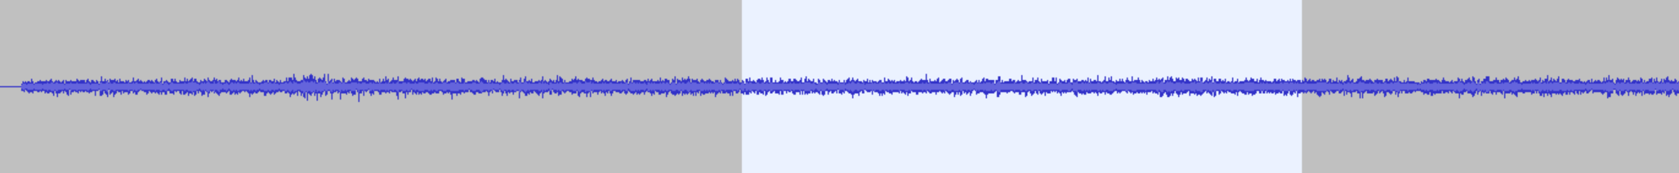
Data Augmentation
“stop” (google_speech_commands)
“stop” (keywords_curated)
+
doing_the_dishes (_background_noise_)

Slide 3
Sample Matching
Sample rate
Bit depth
Length
1 second of audio at 16 kHz and 16 bits = 16,000 samples (16 bits each)

