Slide 1
From DNN to CNN
Enhancing Computer Vision with Convolutions
Laurence Moroney, Google

Slide 2
mnist = tf.keras.datasets.fashion_mnist
(training_images, training_labels),
(val_images, val_labels) = mnist.load_data()
training_images=training_images / 255.0
val_images=val_images / 255.0
model = tf.keras.models.Sequential([
tf.keras.layers.Flatten(),
tf.keras.layers.Dense(20, activation=tf.nn.relu),
tf.keras.layers.Dense(10, activation=tf.nn.softmax)
])

Slide 3
mnist = tf.keras.datasets.fashion_mnist
(training_images, training_labels),
(val_images, val_labels) = mnist.load_data()
training_images=training_images / 255.0
val_images=val_images / 255.0
model = tf.keras.models.Sequential([
tf.keras.layers.Flatten(),
tf.keras.layers.Dense(20, activation=tf.nn.relu),
tf.keras.layers.Dense(10, activation=tf.nn.softmax)
])

Slide 4
mnist = tf.keras.datasets.fashion_mnist
(training_images, training_labels),
(val_images, val_labels) = mnist.load_data()
training_images=training_images / 255.0
val_images=val_images / 255.0
model = tf.keras.models.Sequential([
tf.keras.layers.Flatten(),
tf.keras.layers.Dense(20, activation=tf.nn.relu),
tf.keras.layers.Dense(10, activation=tf.nn.softmax)
])

Slide 5
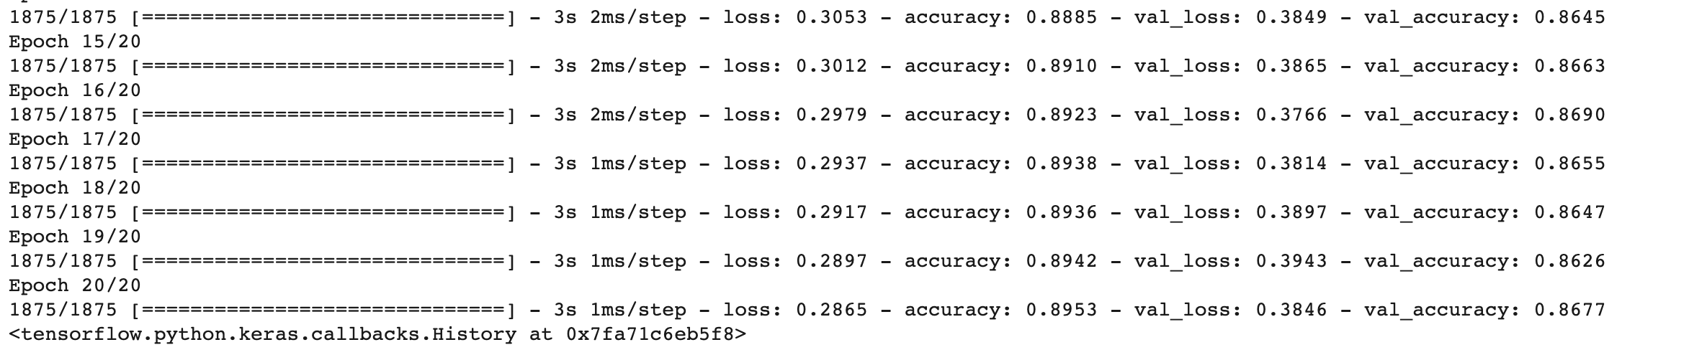

Slide 7
model = tf.keras.models.Sequential([
tf.keras.layers.Conv2D(64, (3,3), activation='relu', input_shape=(28, 28, 1)),
tf.keras.layers.MaxPooling2D(2, 2),
tf.keras.layers.Conv2D(64, (3,3), activation='relu'),
tf.keras.layers.MaxPooling2D(2,2),
tf.keras.layers.Flatten(),
tf.keras.layers.Dense(128, activation='relu'),
tf.keras.layers.Dense(10, activation='softmax')
])

Slide 8
model = tf.keras.models.Sequential([
tf.keras.layers.Conv2D(64, (3,3), activation='relu', input_shape=(28, 28, 1)),
tf.keras.layers.MaxPooling2D(2, 2),
tf.keras.layers.Conv2D(64, (3,3), activation='relu'),
tf.keras.layers.MaxPooling2D(2,2),
tf.keras.layers.Flatten(),
tf.keras.layers.Dense(128, activation='relu'),
tf.keras.layers.Dense(10, activation='softmax')
])

Slide 9
model = tf.keras.models.Sequential([
tf.keras.layers.Conv2D(64, (3,3), activation='relu', input_shape=(28, 28, 1)),
tf.keras.layers.MaxPooling2D(2, 2),
tf.keras.layers.Conv2D(64, (3,3), activation='relu'),
tf.keras.layers.MaxPooling2D(2,2),
tf.keras.layers.Flatten(),
tf.keras.layers.Dense(128, activation='relu'),
tf.keras.layers.Dense(10, activation='softmax')
])

Slide 10
model = tf.keras.models.Sequential([
tf.keras.layers.Conv2D(64, (3,3), activation='relu', input_shape=(28, 28, 1)),
tf.keras.layers.MaxPooling2D(2, 2),
tf.keras.layers.Conv2D(64, (3,3), activation='relu'),
tf.keras.layers.MaxPooling2D(2,2),
tf.keras.layers.Flatten(),
tf.keras.layers.Dense(128, activation='relu'),
tf.keras.layers.Dense(10, activation='softmax')
])

Slide 11
model = tf.keras.models.Sequential([
tf.keras.layers.Conv2D(64, (3,3), activation='relu', input_shape=(28, 28, 1)),
tf.keras.layers.MaxPooling2D(2, 2),
tf.keras.layers.Conv2D(64, (3,3), activation='relu'),
tf.keras.layers.MaxPooling2D(2,2),
tf.keras.layers.Flatten(),
tf.keras.layers.Dense(128, activation='relu'),
tf.keras.layers.Dense(10, activation='softmax')
])

Slide 12
model = tf.keras.models.Sequential([
tf.keras.layers.Conv2D(64, (3,3), activation='relu', input_shape=(28, 28, 1)),
tf.keras.layers.MaxPooling2D(2, 2),
tf.keras.layers.Conv2D(64, (3,3), activation='relu'),
tf.keras.layers.MaxPooling2D(2,2),
tf.keras.layers.Flatten(),
tf.keras.layers.Dense(128, activation='relu'),
tf.keras.layers.Dense(10, activation='softmax')
])

Slide 13
model = tf.keras.models.Sequential([
tf.keras.layers.Conv2D(64, (3,3), activation='relu', input_shape=(28, 28, 1)),
tf.keras.layers.MaxPooling2D(2, 2),
tf.keras.layers.Conv2D(64, (3,3), activation='relu'),
tf.keras.layers.MaxPooling2D(2,2),
tf.keras.layers.Flatten(),
tf.keras.layers.Dense(128, activation='relu'),
tf.keras.layers.Dense(10, activation='softmax')
])

Slide 14
model = tf.keras.models.Sequential([
tf.keras.layers.Conv2D(64, (3,3), activation='relu', input_shape=(28, 28, 1)),
tf.keras.layers.MaxPooling2D(2, 2),
tf.keras.layers.Conv2D(64, (3,3), activation='relu'),
tf.keras.layers.MaxPooling2D(2,2),
tf.keras.layers.Flatten(),
tf.keras.layers.Dense(128, activation='relu'),
tf.keras.layers.Dense(10, activation='softmax')
])

Slide 15
model = tf.keras.models.Sequential([
tf.keras.layers.Conv2D(64, (3,3), activation='relu', input_shape=(28, 28, 1)),
tf.keras.layers.MaxPooling2D(2, 2),
tf.keras.layers.Conv2D(64, (3,3), activation='relu'),
tf.keras.layers.MaxPooling2D(2,2),
tf.keras.layers.Flatten(),
tf.keras.layers.Dense(128, activation='relu'),
tf.keras.layers.Dense(10, activation='softmax')
])

Slide 16
Your turn!

