Slide 1


Linked Data Theatre
Slide deck

Slide 2

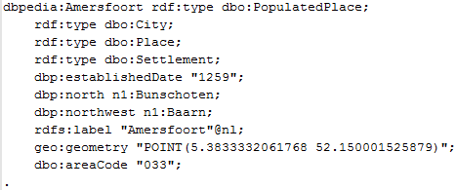
The challenge
We love our Linked Data!
But it doesn’t look good
Linked Data
Turtle representation

Slide 3
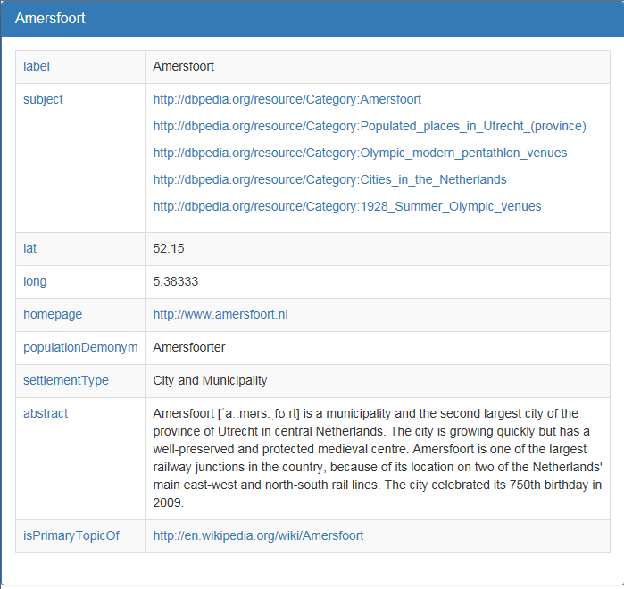
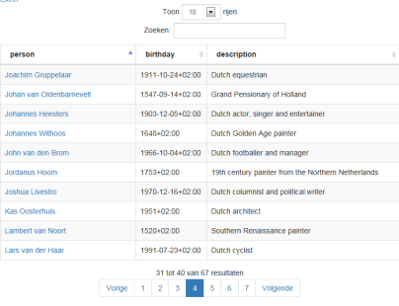
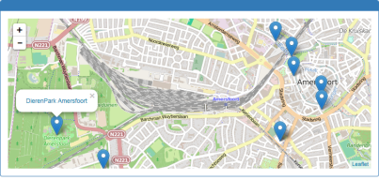
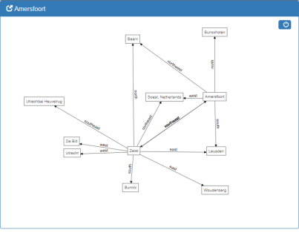
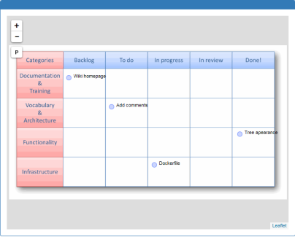
The Challenge
We want some easy to use front-end application that automatically presents our Linked Data in the prettiest way possible

Slide 4
The Linked Data Theatre
Responsive UI based on Bootstrap;
Rich user interface, using jQuery, D3.js and Leaflet.js
Zero-coding: configuration is 100% Linked Data;
Multi-channel: PC, smartphone and tablet support;
Multi-format: html, xml, json, pdf, svg, etc, etc
Geospatial and graphical support;
Uses standard web infrastructuur, available for Docker;
100% Open source, available on Github, GNU license.

Slide 5

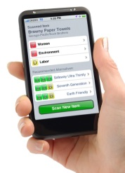



Architecture
json
html
(website)
xml, json, turtle, …
SPARQL
endpoint
REST
API
RDF(a)
website

Slide 6

From request to response
Requested URL pattern
“http://mysite/query/places”
Resource IRI pattern
“http://dbpedia.org/resource/”
Resource profile
“[rdf:type dbo:City]”
Configuration
(using a Linked Data Vocabulary
for Declarative Linked Data Apps)
Data
Response
XML
HTML
JSON
TTL
CSV
XLSX
GraphML

Slide 7
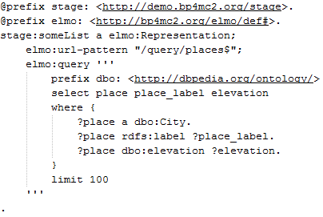
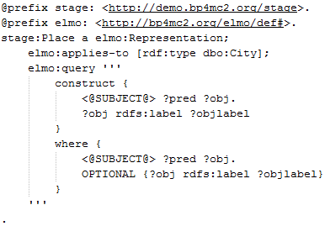
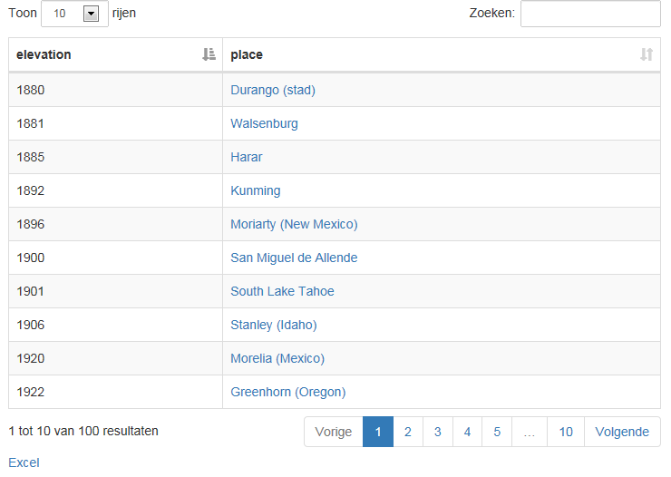
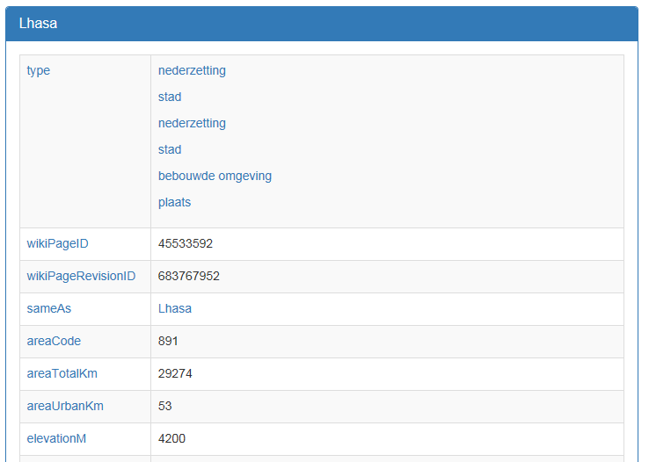
Two (basic) examples

Slide 8




Under the hood
Linked
Data
Theatre
The LDT itself is constructed out of XPL declarations, XSLT transformations, some java for integration purposes and javascript for the UI.
Orbeon
Open Source
LDT itself is an application with orbeon. It uses the XPL pipeline language to declare “pipelines” from request to response.
Tomcat
Open Source
LDT is deployed as a WAR within a Tomcat
application server. Other application servers are possible as well
Java
Tomcat uses the Java runtime Environment

Slide 9
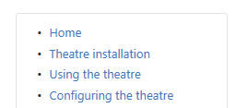
Links
Main github location:
https://github.com/architolk/Linked-Data-Theatre
Documentation:
https://github.com/architolk/Linked-Data-Theatre/wiki
More links (wiki sidebar):
Installation instructions
}
How-to guides

Slide 10
Requests
http://dbpedia.org/resource/Amersfoort
“Dbpedia, do you have some information about Amersfoort?”
http://mysite/resource?subject=http://dbpedia.org/resource/Amersfoort
“Mysite, do you have some information about Amersfoort?”
http://mysite/query/birthplaceOf?subject=http://dbpedia.org/resource/Piet_Mondrian
“Mysite, could you give me some information about the birthplace of Piet Mondrian?”

Slide 11
LDT overview
Browser
/ client
1. http request
LDT
4. http response
2. Fetch Configuration
3. Fetch data
Linked Data
Configuration

Slide 12
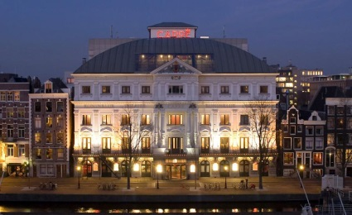
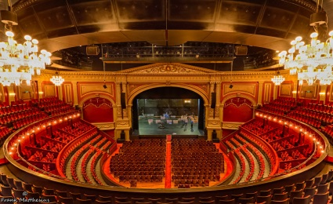
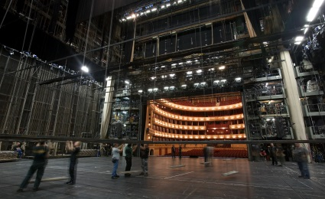
Site, stage and backstage
A Theatre (site)
http://demo.bp4mc2.org
Mainstage &
second stage
http://demo.bp4mc2.org
http://demo.bp4mc2.org/secondStage
Backstage
http://demo.bp4mc2.org/backstage

Slide 13
Styling
Response
http://site-A.org/resource
HTML
CSS
Site
configuration
Response
http://site-B.org/resource
Response
HTML
CSS
HTML
Configuration
Same data, different site,
different styling

Slide 14
Configuration overview
URI
Representation
Appearance
Webpage
Fragment

Slide 15
Content appearance
A content appearance is used to represent the result of a CONSTRUCT-query. The resulting triples are displayed using a two-column table per unique subject. The first column contains the property-label, the second column the object-value.

Slide 16

Table appearance
A table appearance is used to represent the result of a SELECT-query. The resulting rows are displayed in paged table. Every variable is displayed as a column.

Slide 17
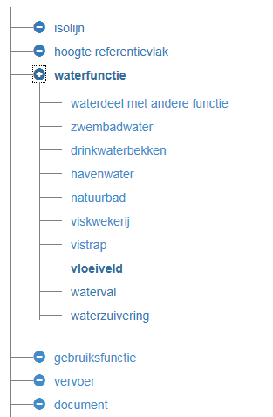
Tree Appearance
A tree appearance can be used to create a tree of resources, using the link between resources (from a CONSTRUCT query), for example a taxonomy of concepts.

Slide 18

Graph appearance
The graph appearance creates a graphical representation of the linked data, using rectangles for items and arrows for the relations between the items. Users can expand the graph by selecting an item. All relations to and from that item will appear.

Slide 19

Geo appearance
The geo appearance shows a map of the world, including reference points from the query result.

Slide 20

Image appearance
The image appearance uses a custom image as the background instead of a map of the world.
It can also be used to edit the locations of polygons
Export to PDF and PNG is also supported

Slide 21
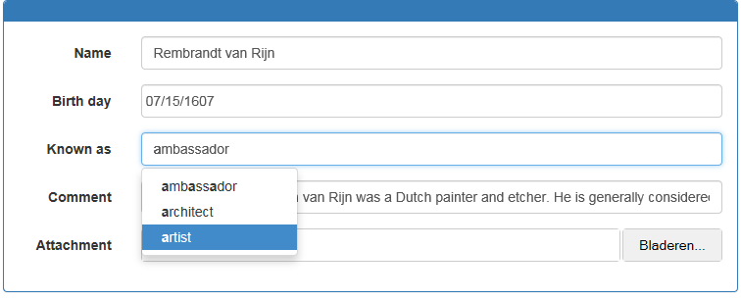
Form appearance
A form appearance is used to give a user the opportunity to enter data. Support is available for various data types, such as date pickers, text input, file upload and selecting a value from a list.

Slide 22
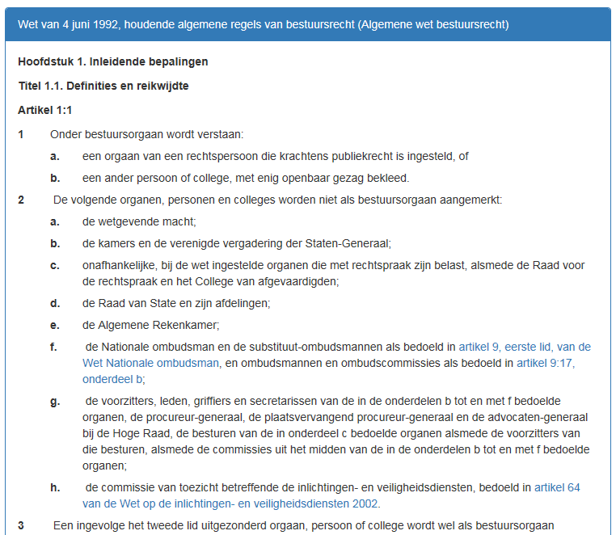
Text Appearance
For displaying “regular” documents, a text appearance is available.

Slide 23
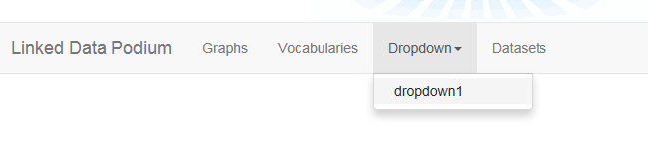
Navbar appearance
A navbar appearance creates a navbar with drop down menus and menu-items.

Slide 24

Search appearance
A search appearance is normally used with a navbar appearance, and creates an appearance that contains a search entry-field, plus the functionality to retrieve search results from the entered search query.

Slide 25
Typical pipeline
Request
Pageflow.xml
Query.xpl
Response
rdf2html.xsl
Call SPARQL
endpoint
XML
rdf2json.xsl
Call REST API
rdf2ttl.xsl

Slide 26
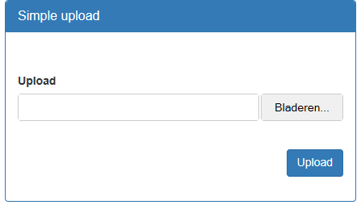
Containers
Named graph:
http://mysite/container/c1
http://mysite/container/c1
A container is a Linked Data Platform (LDP) resource.
A container can be used to upload linked data to a specific graph.
Upload can be performed via the User Interface, or via a PUT/POST request to the specific container URL

Slide 27
Containers & Transformers
Simple container
No transformer, uploaded data should be linked data (xml, json, ttl, etc)
CSV/Excel translator
Upload of CSV or excel data, translated to tabular linked data
Excel translator
Special excel file which transforms the excel data to a specific linked data structure
XMI translator
Upload of a XMI file (for example: an UML class diagram), which is transformed to the RDF equivalent
Custom translators
Developers can add new translators: just put the corresponding XSL file in the /translators directory

