Slide 1
Migrate applications to Azure using
Azure Site Recovery

Slide 2
Migrate Applications to Azure
Plan the Azure infrastructure
Replicate data to Azure
Test applications in Azure before migration
Reduce downtime of production workload during migration
Key Considerations
→
→
Plan
→
Replicate
→
Test
Migrate

Slide 3


Migration using Site recovery
Azure’s flagship migration/BCDR tool
Migrate from multiple environments
VMware, Hyper-V, physical, Azure and Amazon Web Services
Migrate any workloads
Support for both Linux and Windows workloads
No-impact migration testing
When replicating workloads into Azure, execute tests to
ensure readiness
Move applications with near-zero downtime
Move a single application or an entire datacenter to the cloud with minimal impact to production users
Value Props
→
→
→
→
→

Slide 4
Migration using Site recovery
Licensing & Pricing
No Site Recovery charges for Migration (first 31 days). $16/month per instance if instances are protected thereafter.
Billing unit is the average daily number of instances/month. For example, if you consistently protected 20 instances for the first half of the month, and none for the second half, the average daily number of protected instances would be 10 for that month.
HUB (Hybrid Use Benefit)
Move Windows Server licenses covered under Software Assurance to Azure
Value Props
→
→

Slide 5
ASR Support Matrix
Support for Azure Platforms
  Supports Classic and ARM resources.
Networking
  IPV6 for Host/Guest not supported
  NIC Teaming not supported when migrating Physical Machines/Guest
Operating Systems
  Multiple Windows (min Win Server 2008 R2 + SP1) & Linux Distributions
  UEFI partitions are now supported
Storage
  Host
  NFS, SMB 3.0, SAN (ISCSI), Multi-Path (MPIO)
  Guest/Physical
  VMDK, VHD/VHDX, Gen 2, EFI/UEFI (Hyper-V), RDM (Vmware/Physical) are supported
  Disk only upto 4095 GB (4TB) supported
  Shared Cluster disk, Encrypted Disk, NFS, SMB 3.0 are not supported
For the latest list refer to the support matrix at https://docs.microsoft.com/en-us/azure/site-recovery/site-recovery-support-matrix
→
→
→
→
→

Slide 6
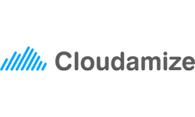
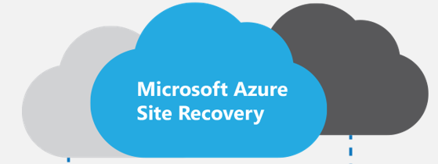
Migrations offering for CSP Partner
Assessment
Migrate
Manage
Portfolio Assessment, TCO Analysis, Security Requirements. Application Dependency Mapping
Create Azure environment. Replicate via ASR, POC, Integrate applications and networks, User Acceptance
Backup, Disaster Recovery, Monitoring

Slide 7
Start
Step 1: Review architecture and deployment components
Understand the on-premises and Azure architecture and the replication flow
Step 7: Set up a Recovery
services vault
Set up a vault and specify what you want to replicate and where you want to replicate it too.
Step 2: Review deployment
prerequisites
Verify requirements for Azure,
on-premises virtualization servers and VMs
Step 8: Set up source and
target resources
Set up source and target replication settings. Setting up source settings includes running Unified Setup to install the on-premises Site Recovery components.
Step 3: Do capacity planning for full deployment
For a full deployment, figure out your capacity and scability requirements. For a quick proof of concept you can skip this step.
Step 9: Set up a
replication policy
Configure a policy that contains replication settings for VMware in the vault
Step 4: Do network planning
Understand network requirements for failover and how IP addresses are allocated to Azure VMs after failover
Step 10: Enable replication
Enable replication for VMs.
Step 5: Prepare Azure resources
Set up Azure networks and storage in preparation for deployment
Step 11: Failovers
After initial replication, run a test failover to check everything’s working and once validated execute Final Failovers
Step 6: Prepare VMware
Prepare an account to automatically discover VMware VMs. Prepare an account to install the Mobility service agent on VMs.

Slide 8
Migration assessment & Planning

Slide 9

Migration Assessment
Migration planning assessment set out to answer three questions
What are ripe targets for lift and shift to Azure IaaS?
What are the costs and configuration to run the targets on Azure?
What are the ripe targets for migration
1
2
3
$

Slide 10
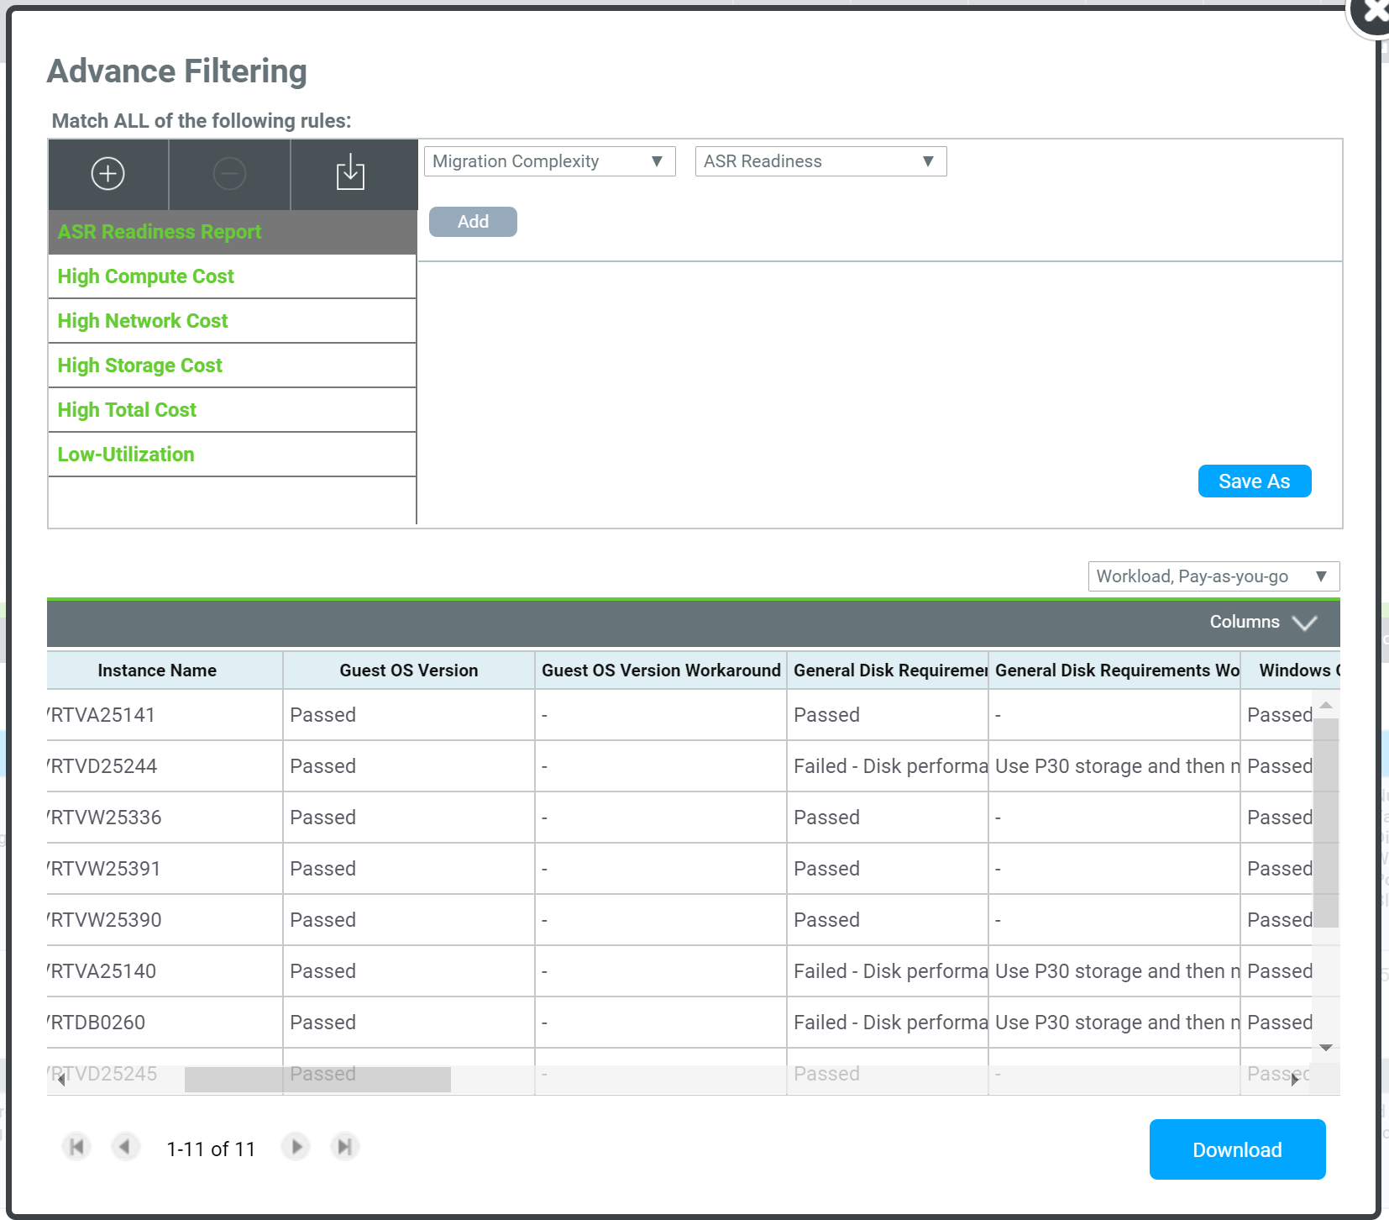
ASR Readiness Report
→
Validation against ~20 checks to see if the target is ready for ASR migration and divides outcome into Success/Warning/Critical.
Provides workaround for the machines that are identified with “Warning”
Example checks:
  General Disk Requirements
  Windows OS Requirements
  Hypervisor Requirements
  Disk Space Requirements
  .NET Version Requirements
  Boot Software Requirements
  Linux System Requirements
→
→
Disk’s performance requirement failed but can be achieved by striping data across several disks.
Work around: Use P30 and migrate to RAID 0 after migration
Download detailed analysis

Slide 11
Deployment Planning
Estimate network bandwidth required for initial and delta replication
Identify Azure storage type (standard or premium) required for virtual machines
Estimate the total number of standard and premium storage accounts that need to be provisioned
Estimate the total number of Configuration and Process Servers that need
to be deployed while protecting VMware workloads
Run virtual machine eligibility assessment based on number of disks,
size of the disks and IOPS
Profile the actual churn on the source virtual machine without any impact
to the production workload
→
→
→
→
→
→

Slide 12
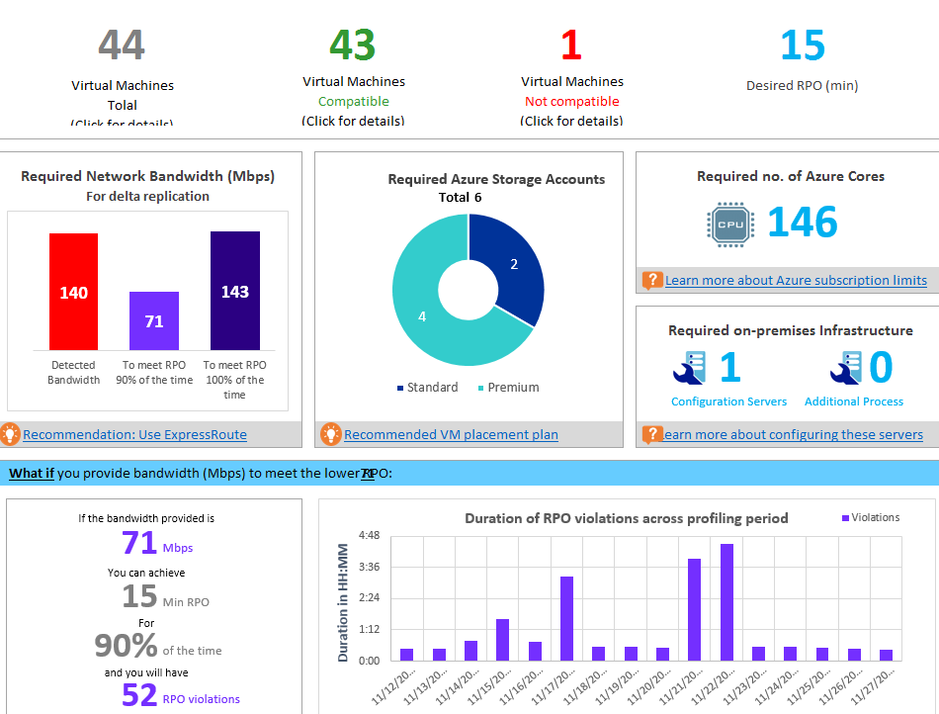
Deployment Planner Recap
It is recommended to use a three character prefix for storage account names for performance and scalability optimization | https://aka.ms/storage-performance-checklist
Naming convention | https://aka.ms/guidance-naming-conventions
SQL Server workload | https://aka.ms/azure-storage-scalbility-performance
Other high performance workloads | https://aka.ms/azure-storage-scalbility-performance
Storage scalability and performance | https://aka.ms/azure-storage-scalbility-performance

Slide 13
ASR Hyper-V Architecture

Slide 14
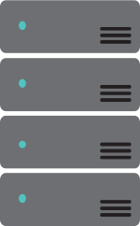

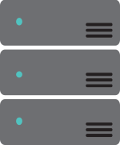







Migrate Hyper-V to Azure
Hyper-V
Server
OMS Site Recovery
Microsoft Azure
Data Channel
Source: Hyper-V VMs
Microsoft Azure Recovery Services Agent
Replicates data to Azure

Slide 15
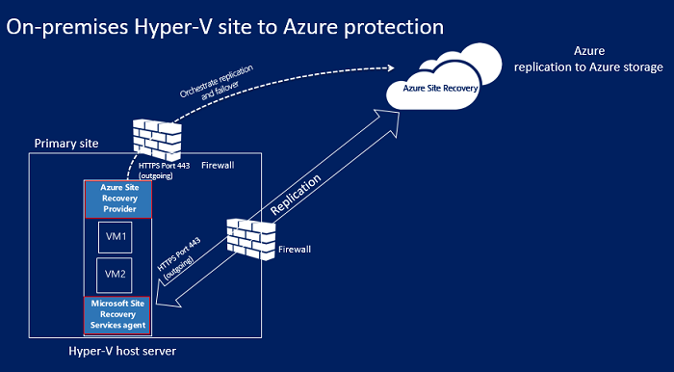
ASR setup for Hyper-V

Slide 16
ASR VMWare/Physical Architecture

Slide 17




Migrate VMware and Physical Servers to Azure
Config
Server
Process
Server
OMS Site Recovery
Microsoft Azure
Source: VMware VMs
& Physical Servers
Data Channel
Process Server
Used for caching, compression, and encryption
Configuration Server
Used for centralized management
Mobility Service Captures all data writes from memory

Slide 18
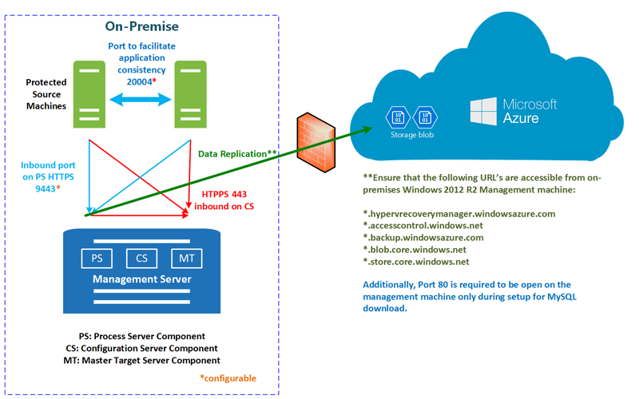
ASR setup for VMWare/Physical Server

Slide 19
ASR Multi-Tenant Migration Scenarios

Slide 20
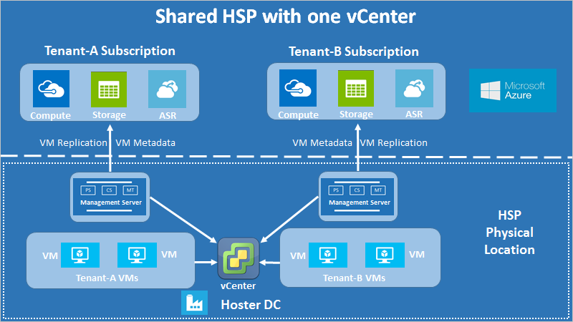
Multi-Tenant Migration Scenarios
Shared Hosting Services Provider (HSP)
The partner owns the physical infrastructure and uses shared resources (vCenter, datacenters, physical storage, Etc.)
Host multiple tenants’ VMs on the same infrastructure.
The partner can provide
disaster-recovery management as a managed service, or the tenant can own disaster recovery as a
self-service solution.
→
→
→

Slide 21
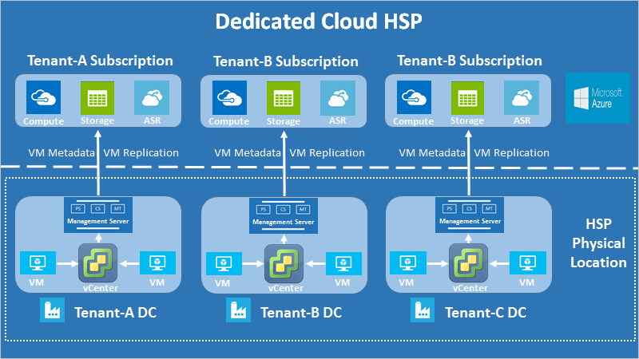
Multi-Tenant Migration Scenarios
Dedicated Hosting Services Provider
Partner owns the physical infrastructure
Dedicated resources (multiple vCenters, physical datastores, and
so on) are used to host each tenant’s VMs on a separate infrastructure.
The partner can provide disaster-recovery management as a managed service, or the tenant can own it as a self-service solution.
→
→
→

Slide 22
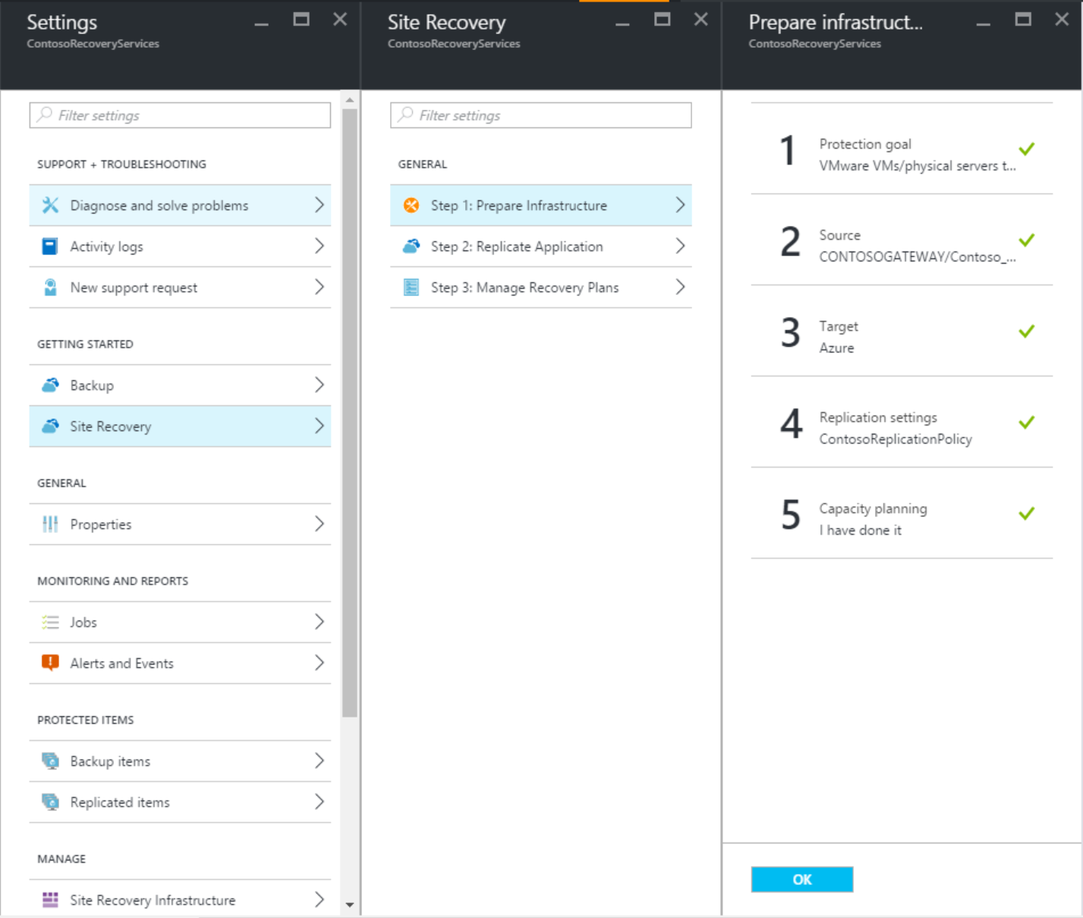
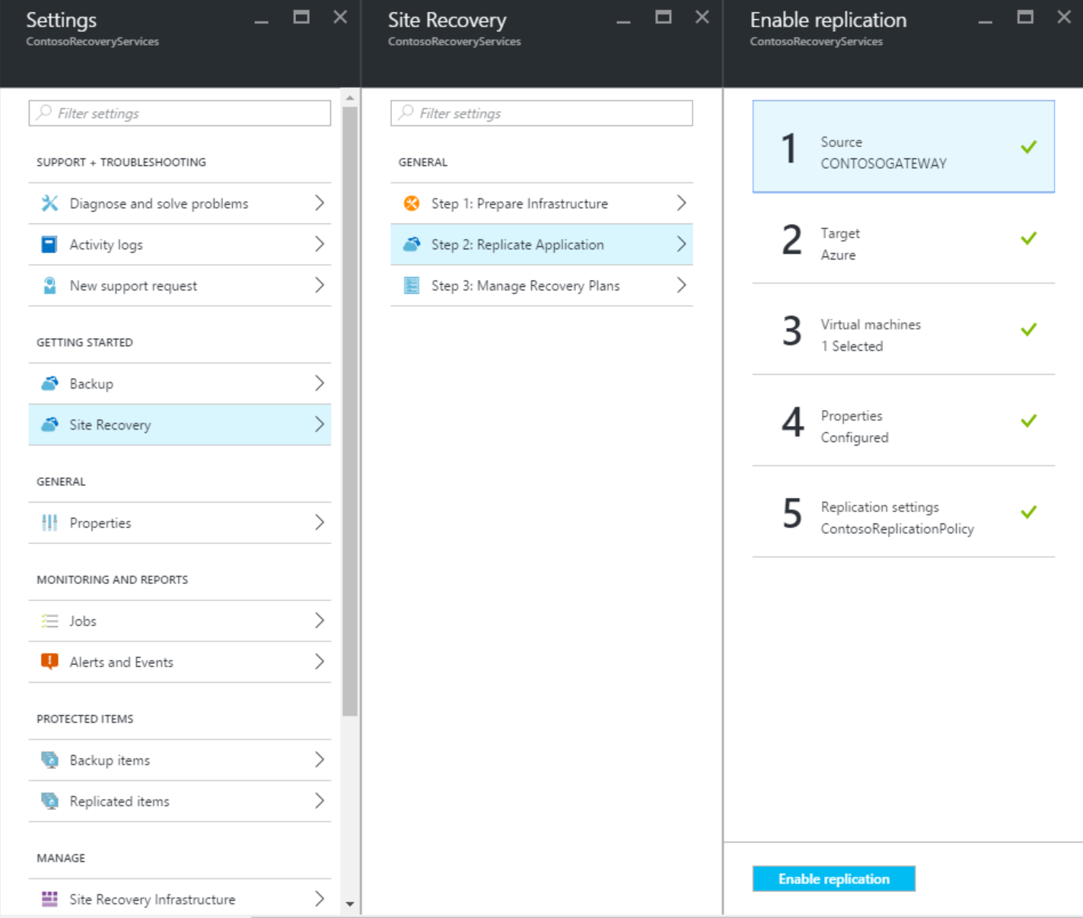
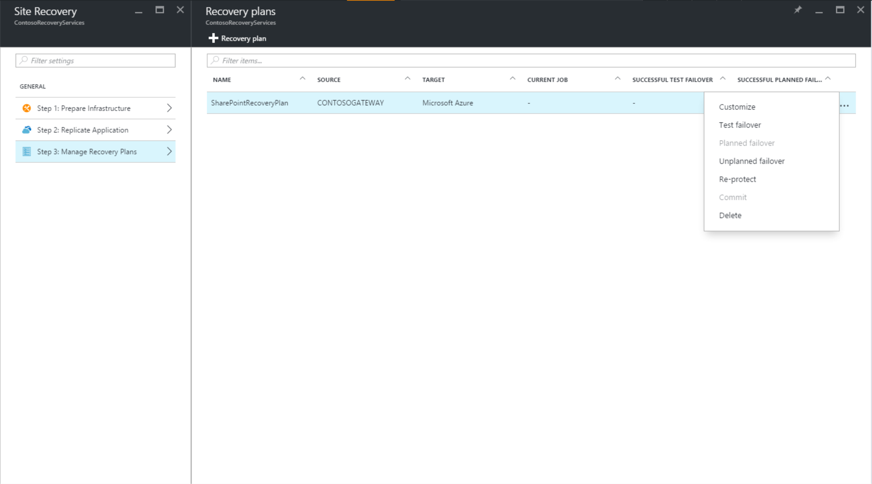
Deployment Steps
1
2
3
Prepare on-premises infrastructure
Replicate Application
Manage Recovery Plan
Always perform a Test Failover to validate
Perform Failover to recover application in Azure

Slide 23
Additional Bandwidth Considerations

Slide 24
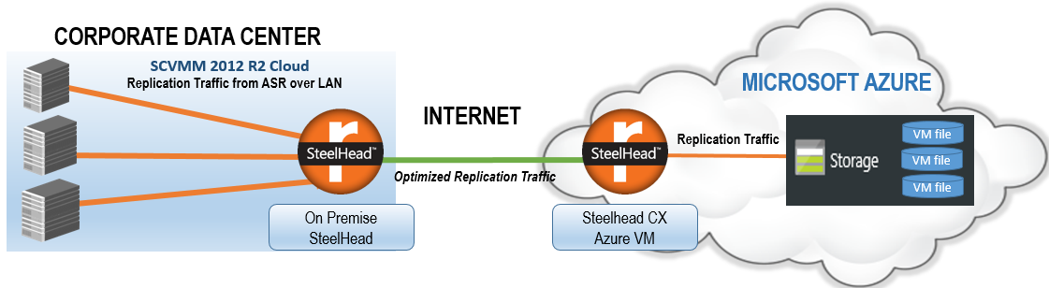
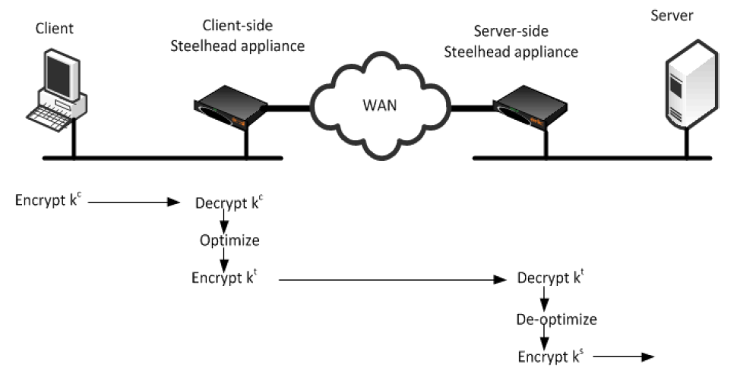
ASR with Riverbed
Data Reduction | Average: 72.1%
 | Peak: 99.7%
 | 3.6x capacity increase
LAN Throughput | Total: 95.4 GB
WAN Throughput | Total: 26.6 GB
8 hours
2 hours 49 min
95 GB
26 GB
Source: Microsoft and Riverbed whitepaper: https://gallery.technet.microsoft.com/Optimizing-Azure-Recovery-8da50893

Slide 25
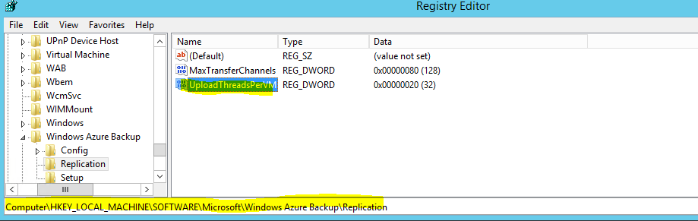
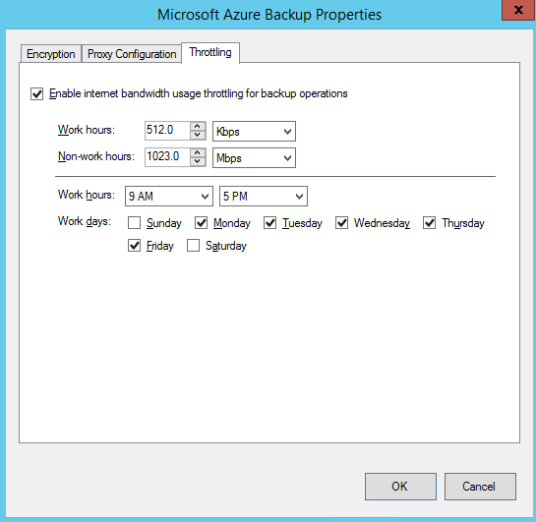
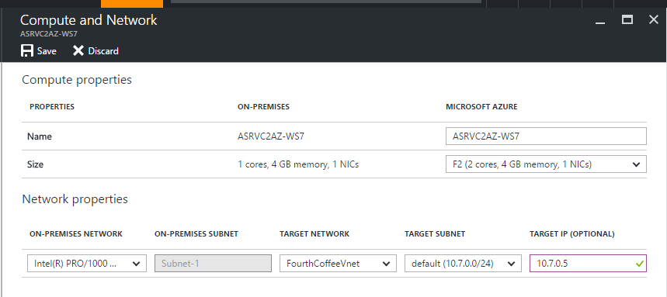
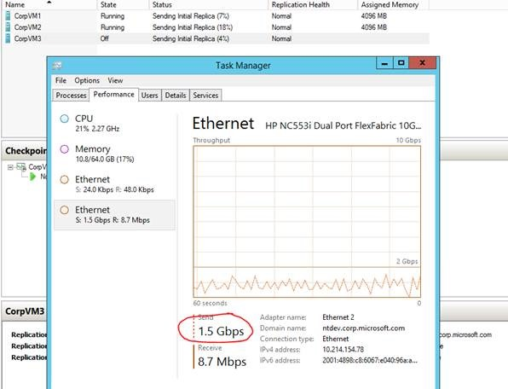
Networking
Saturate Available bandwidth
Throttling
    More details
Retain IP vs. Change IP
    With full subnet failover → Retain IP
    For partial subnet failovers → Change IP
    More details
Client routing
    ASR + Azure Traffic Manager
    More details
→
→
→
→

Slide 26
Migrating Complex Applications

Slide 27

Application DR with ASR
Azure Site Recovery
DR Orchestration
DR Orchestration
DB Tier
SQL Availability Group
IaaS VM
App Tier
Web Tier
ASR Replication
Azure Storage
AD & ASR Replication
Active Directory
IaaS VM
S2S VPN
Primary Site
Azure

Slide 28
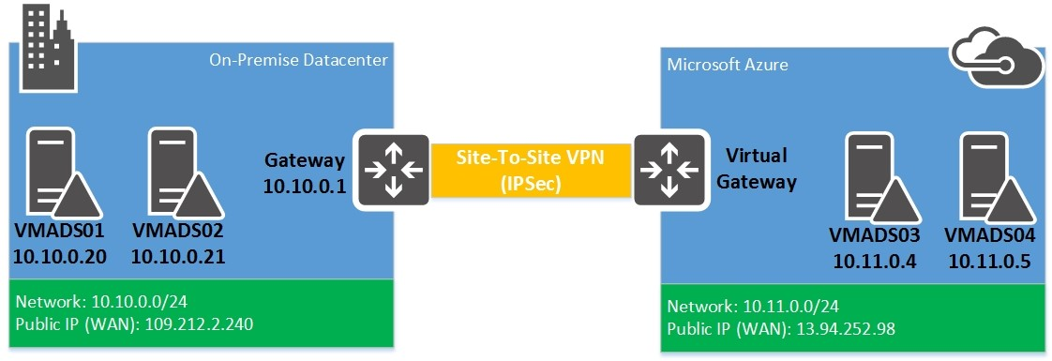
Active Directory + DNS
Single domain controller environment (no S2S)
Few applications and a single domain controller.
If you can failover the entire site to Azure.
Replicate workload using ASR.
During failovers use the same CIDR for Azure VNET as on-premises network and retain the same IP address when failing over.
Update the DNS settings to the IP of the failed over VM in the
VNET settings.
Any new VM’s created in this VNET can be domain joined and also communicate with your DNS.
Multiple domain controllers/Large scale deployment (need S2S)
Multiple applications & domain controllers are present on-premises.
Plan to fail over a few applications at a time (typically the case).
We will be extending the AD infrastructure to Azure so connectivity back
to on-premise is a must.
Provision new Azure VM’s, install and configure domain controllers as
a part of the on-prem forest.
On-premises workloads can now be replicated & failed over to Azure
on their own timelines.
These workloads will also be accessible from on-premises.
→
DR Orchestration
Azure Site Recovery
DR Orchestration
→
On-prem Active Directory
IaaS VM
ASR Replication

Slide 29
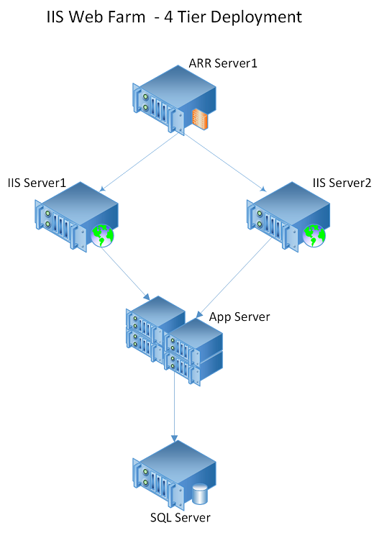
Multi Tier IIS based web applications
Replicate ALL the virtual machines to Azure using ASR
Create a recovery plan to sequence the failover of various tiers of the web application hence, maintaining application consistency.
Add the database tier VMs under Group 1, to ensure that they are shutdown last and brought up first.
Add the application, web & ARR tier under Group 2/3/4
respectively such that they are failed over/brought online after the subsequent tier.
Add scripts to your recovery plan to complete any pre & post failover options like:
Update DNS – If dynamic DNS update is enabled, this can
be skipped.
Connection string in an application’s web.config.
Site bindings for the application.
Creating & updating the configuration of a new load balancer.
Any additional dependencies.
→
→
→

Slide 30
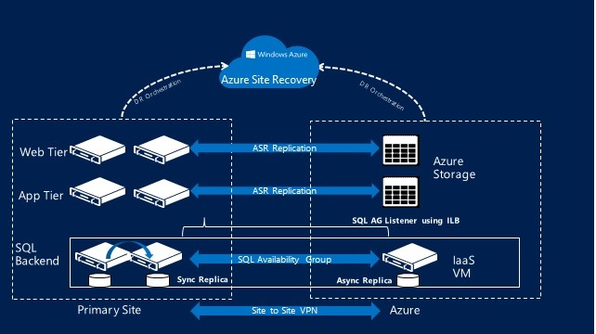
SQL Server Availability Groups (AG)
Azure VNET provisioned with S2S connectivity back to on-premises
IaaS VM with SQL server installed is ready.
Extend/Include new VM to an existing AG and configure instance as an asynchronous replica in Azure.
Update the availability group listener, to include new VM.
Test failovers
Backup the SQL AG replica VM in Azure using Azure backup.
Restore VM to an isolated VNET.
Force a quorum on the restored VM and update the listener IP to an available IP from the VNET.
Bring the listener back online and validate connectivity.
Complete test failover of the other application tiers (web/app) to this VNET.
Final failover
Add ASR-SQL-FailoverAG.ps1 to the recovery group as the pre-migration step. This script takes the path to the Availability Group on the Azure replica and fails it over to that replica instance.
This script will be passed to the SQL replica VM for execution via the Custom Script Extension.
Other application tiers are failed over as a part of the recovery plan.
→
→

Slide 31
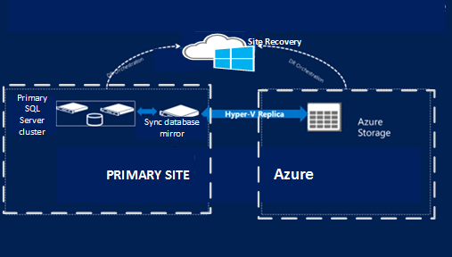
SQL Server Cluster: SQL 2008 R2/Standard
If using SQL Server Standard edition, or SQL Server 2008 R2, Site recovery does not provide guest cluster support when replicating to Azure. ☹
The recommendation is to protect the on-premises SQL Server cluster to a standalone SQL Server, and recover it in Azure.
Configure an additional standalone SQL Server instance on the on-premises site and configure it to server as the mirrored instance (high safety mode).
Configure Site Recovery on the on-premises site.
Using ASR, replicate the mirrored SQL Server instance to Azure. Since it's a high safety mirror copy, it will be synchronized with the primary cluster, that will be replicated to Azure.
Recover the SQL server in Azure and cleanup configuration.
→
→

Slide 32
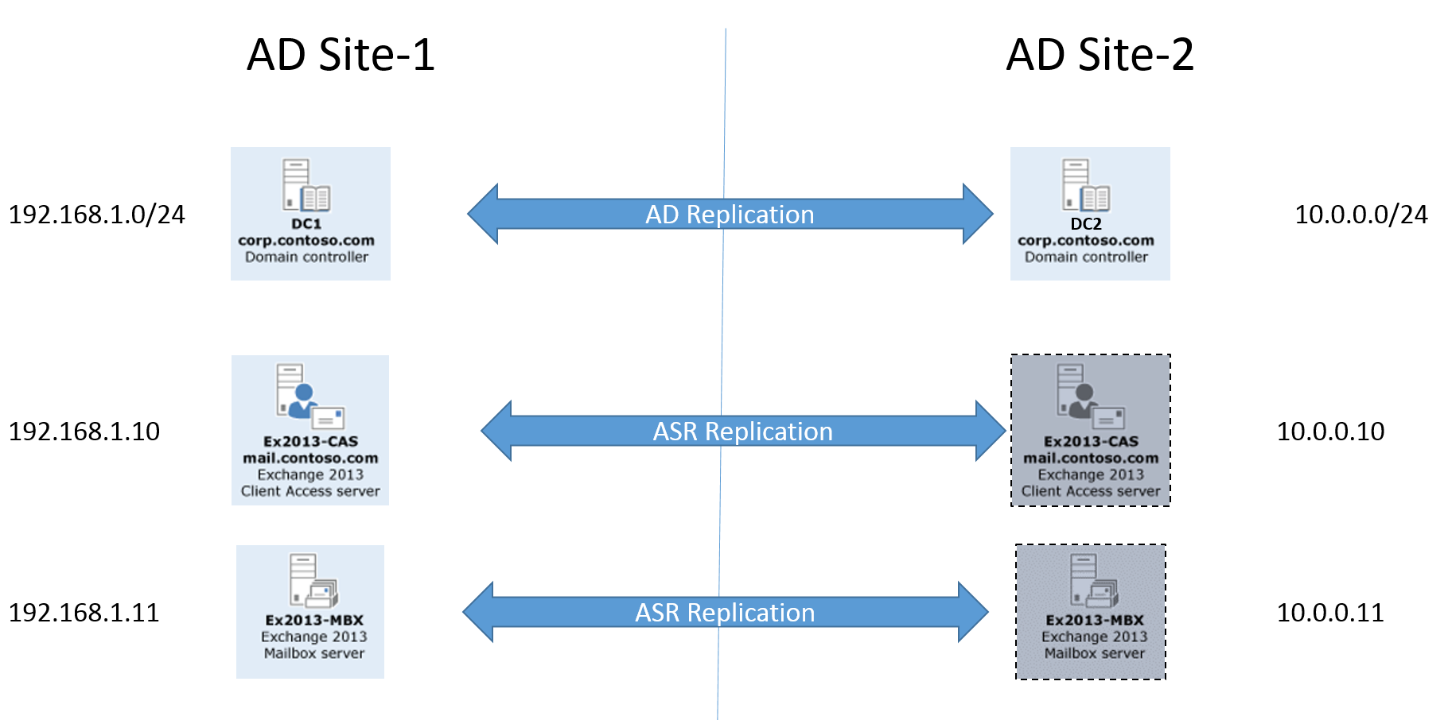
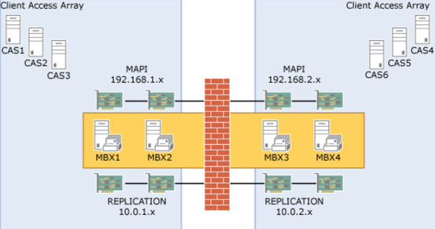
Exchange Server(s)
Standalone deployments/Small scale deployments
Either multiple roles deployed on the same server or can have dedicated servers for each role.
Ensure AD connectivity from Azure either using S2S back to on-premises or dedicated AD presence in Azure.
Protect ALL servers using ASR.
Apply the standard failover procedures (Test & Final).
Large scale deployments/DAGs
Dedicated servers for each server roles.
MBX servers are a part of a Database Availability
groups (DAG).
Connectivity back to on-premise is a must.
Provision new Azure VM, install exchange and configure
the required server roles.
Add the new MBX server role Azure VM’s as a replica to
the existing DAG (extending DAG into Azure).
Initiate failovers from on-premises MBX servers to Azure.
Decommission the on-premises environment.
→
→

Slide 33
Appendix
Azure Site Recovery – https://docs.microsoft.com/en-us/azure/site-recovery/site-recovery-overview
ASR capacity planner – https://docs.microsoft.com/en-us/azure/site-recovery/site-recovery-capacity-planner
  For VMWare – https://docs.microsoft.com/en-us/azure/site-recovery/site-recovery-
  deployment-planner
Azure VM readiness assessment – https://www.microsoft.com/enus/download/confirmation.aspx?id=40898

Slide 34
Other Labs
Access the lab at – https://www.microsoft.com/handsonlabs
ARM Templates – https://www.microsoft.com/handsonlabs/Account/SignIn?redirect=/handsonlabs/SelfPacedLabs?storyGuid=814abf23-b1c6-45f2-956d-6adf6daf7dbc
Deploy VM using ARM Templates – https://www.microsoft.com/handsonlabs/Account/SignIn?redirect=/handsonlabs/SelfPacedLabs?storyGuid=6b7f1175-b87d-4aa8-8bf1-388625d35304
Config Management & DR – https://www.microsoft.com/handsonlabs/Account/SignIn?redirect=/handsonlabs/SelfPacedLabs?storyGuid=54d579f7-eeee-4586-8d83-08ae7386e001
Azure Backup & Site Recovery – https://www.microsoft.com/handsonlabs/Account/SignIn?redirect=/handsonlabs/SelfPacedLabs?storyGuid=7e32a9c5-84d3-4b76-b953-5f3e0f35ebbf
→
→
→
→

