Slide 1
Azure Storage Overview
Notes:
IMPORTANT NOTE:
Microsoft Ready will utilize Windows 10 and the new PowerPoint 2016, as well as PowerPoint 2013 on all event machines. Please build your slides utilizing the appropriate Template and utilize the version of PowerPoint that works best.
Windows 10 devices now connect remotely through VPN using the PIN with Passport for Work. Speakers needing to use VPN in a demo, will need to have registered for Phone Authentication at https://phoneregistration.microsoft.com. Additional details are also available here: https://microsoft.sharepoint.com/sites/itweb/securelogon/Pages/FAQ.aspx

Slide 2
Azure Storage
Foundational Building Block of Azure
  Azure Services: SQL Data Warehouse, HDInsight, Data Lake Store, Event Hubs, IoT Hubs…
  Microsoft Services: Office 365, OneDrive, XBox, Skype…
Hyper Scale
  >40 million transactions per second, >150 Trillion objects
Durable
  Never lose your data. Multiple redundancy options. Automatic data checks
Secure
  Encryption at Rest. Client side Encryption. Integration with KeyVault
Highly Available
  Fault tolerance to hardware/software issues. Automatic load balancing
Open
  REST API, Open sourced Client Libraries – .NET, Java, C++, Python, Node.js, iOS, Android, Xamarin…
Hybrid
  Extensive partner ecosystem. Azure Stack for private/hosted clouds.

Slide 3
Azure Storage Services
IaaS
PaaS
Virtual
machines
Existing
frameworks
Web
and mobile
Microservices
Serverless
Compute
Storage
Networking
Disks
Persistent disks for Azure IaaS VMs
Premium Storage Disks option: SSD based, high IOPS, low latency
Files
Fully Managed File Shares in the Cloud
SMB and REST access
“Lift and shift” legacy apps
Blobs
Highly scalable, REST based cloud object store
Block Blobs: Sequential file I/O
Cool Tier Available
Page Blobs: Random-write pattern data
Append Blobs
Tables
Massive auto-scaling NoSQL store
Dynamic scaling based on load
Scale to PBs of table data
Fast key/value lookups
Queues
Reliable queues at scale for cloud services
Decouple and scale components
Message visibility timeout and update message to protect against unreliable dequeuers
Built on a unified Distributed Storage System
Durability, Encryption at Rest, Strongly Consistent Replication, Fault Tolerance, Auto Load-Balancing
Notes:
AZURE STORAGE SERVICES
We can break them out broadly into the 2 deployment models, IaaS where you’re running your own infrastructure or PaaS where you are using higher level services and applications which are developed against the public cloud infrastructure.
On the Infrastructure side (IaaS) we provide DISKS and FILES, Disks are single instance Disks which are attached to VMs. There are two flavors, Standard and Premium. And Files are shared storage over SMB. Both of these are provided as services to your VMs.
For PaaS we have three core objects which are Objects, Tables and Queues.
Our unstructured Object Store (or Blob Storage) offers Exabyte scale and the ability to store trillions of objects across different tiers. Our current tiers are Hot storage for higher performance and frequently accessed data and Cool storage for less active & archived data.
Tables is our massively scalable NoSQL key-value store for structured and semi-structured data.
Queues service for reliable intra and inter-service communications, great for decoupling your work flows.
All of these services are built on the common unified distributed storage system. So all of the capabilities we talked about previously are available to all of these services.

Slide 4
Azure Storage
Disk Storage
Object Storage
File storage
Premium
Standard
Azure Blobs
Azure Files
Azure NetApp Files
Reliable, persistent, high performing storage for Virtual Machines
Secure, centralized storage target for backup/disaster recovery
Lift and shift of legacy applications that require file shares to the cloud
Data Transport
Hybrid Storage
Azure Import/Export
Azure DataBox
Azure StorSimple
Azure File Sync
Avere
Move or migrate data into Azure
Secure, intelligent data tiering between on-premises and cloud storage

Slide 5

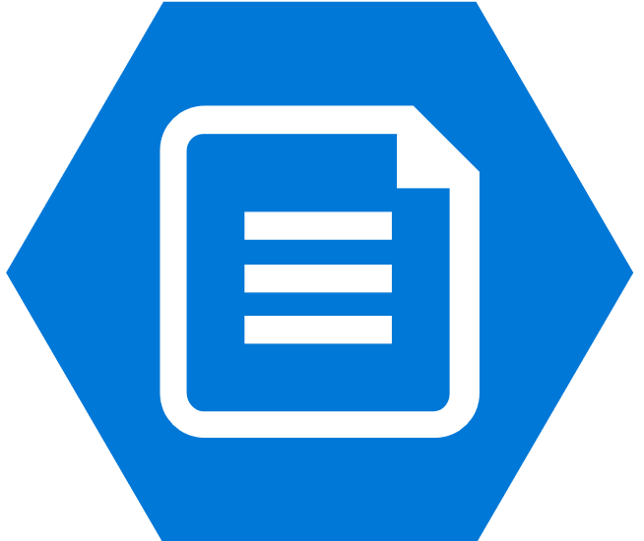


Helping customers choose the right storage
Azure Blobs
Azure Files
SharePoint Online
On-premises
Windows Server
Azure Compute +
Disks

Slide 6
Azure Disks
Industry leading ZERO % Annual Failure Rate
Performance Tiers
Management Options
Enterprise grade durability with 3 replicas
Resource Group
< 1ms latency for cached operations
Managed Disks
Highly available
and manageable
Blob Cache technology
Up to 160,000 IOPS
Premium Disks
SSD based, provisioned performance
Standard Disks
HDD based,
cost effective
Best in class
High IOPS/BW
80,000 IOPS & 2,000 MB/s
Disk throughput per VM

Slide 7




What are Managed Disks?
Managed by Azure
Simple - Abstracts storage accounts from customers
Granular access control – Top level ARM resource, apply
Azure RBAC
Better performance - Storage account limits do not apply
Big scale - Up to 10,000 disks
per region per subscription
OS disk
PAGE BLOBS
Data disk
Managed Storage accounts

Slide 8
What are Managed Disks
Managed by Azure
OS Disk
Data Disk
VHDs
Managed Storage Accounts
Simple – Abstracts storage accounts from customers
Granular access control – Top level ARM resource, apply Azure RBAC
Storage account limits do not apply – No throttling due to storage account IOPS limits
Big scale – 20,000 disks per region per subscription
Better Storage Resiliency – Prevents single points of failure

Slide 9
Better Storage Resiliency with Managed Disks
Unmanaged ARM Availability Set
VS
Managed ARM Availability Set
FD0
FD1
FD2
FD0
FD1
FD2
Storage account 1
Storage account 2
Storage account 3
Managed Storage
account 1
Managed Storage
account 2
Managed Storage
account 3
Storage Stamp 1
Storage Stamp 0
Storage Stamp 1
Storage Stamp 2
VMs susceptible to single storage stamp failures
Disks on separate storage stamps & aligned with VM fault domains

Slide 10


Managed Disks: Improve availability
Unmanaged ARM Availability Set
Managed ARM Availability Set
VS
FD0
FD1
FD2
FD0
FD1
FD2
Storage account 0
Storage account 1
Storage account 2
Storage Stamp 0
Storage Stamp 0
Storage Stamp 1
Storage Stamp 2
VMs susceptible to single storage stamp failures
Disks on separate storage stamps & aligned with VM fault domains

Slide 11

Managed Disks: Reusable custom images
Capture a VM
VM-1
Create multiple VMs in same region & subscription
VM-2
Create image
VHD files
Storage account
VM-N

Slide 12






Single ARM VM conversion to Managed Disks
Run the conversion command using PowerShell/CLI
Automatic Reboot
Stop the VM
< 5 minutes
Supported within same storage type
Standard unmanaged to Standard Managed
Premium unmanaged to Premium Managed
Unmanaged Disks in Storage accounts
Managed Disks

Slide 13
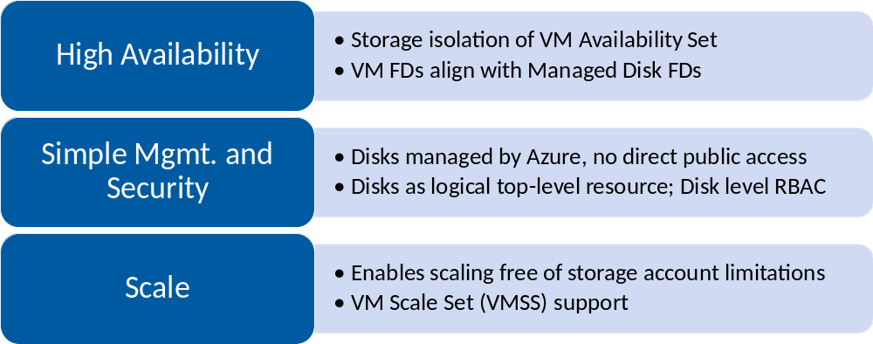
Managed Disks – Value Proposition

Slide 14
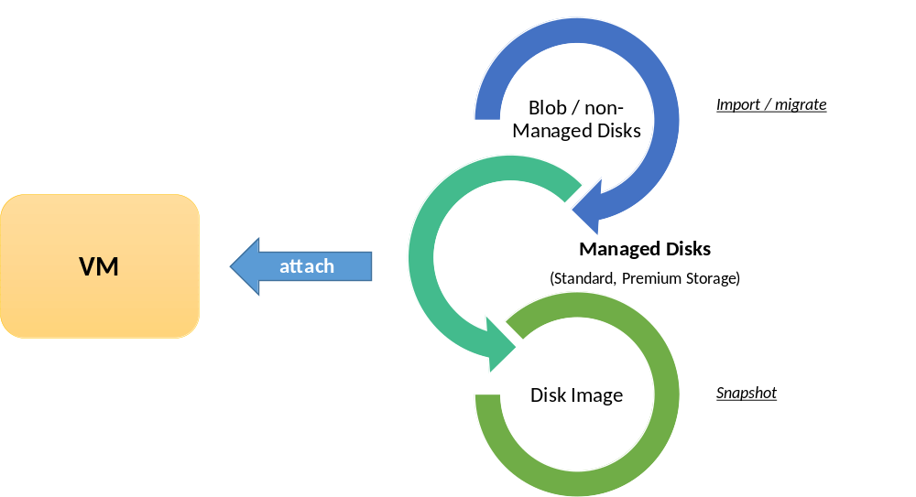

Managed Disks
Disks as logical top-level resource
Supports both Standard & Premium Disks
Back-up as Disk Image/Snapshot

Slide 15
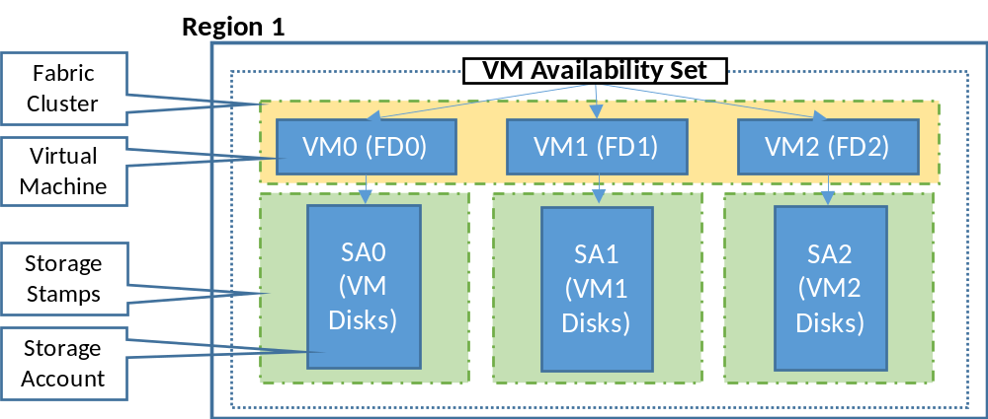
Enhanced fault isolation with Managed Disks
Storage isolation of VM Availability Set ; VM FDs align with Managed Disk FDs

Slide 16
Disks - Best Practices
Always* use Premium Disks for Production workloads
Managed Disks only for new workloads
  Upgrade legacy unmanaged to managed when possible
RAID for redundancy is not necessary
  RAID for performance as needed
  Durability doesn’t remove the need for backups
Performance
  Local ssd is definitely temporary, use if you can tolerate loss
  Enable read caching where appropriate for better perf
  Understand VM limits vs Disk limits for perf

Slide 17
Azure Files

Slide 18






What is Azure Files?
Cloud file shares that are…
Easily managed
Secure
No servers required
Data encrypted at rest and in transit
Cross-platform
Built for a hybrid world
Mount on Windows, Linux, and macOS
Access data where you want to,
how you want to
Smart
Harmonious
Make the most of limited networks
with intelligent caching
Migrate applications to the cloud
without the headaches

Slide 19



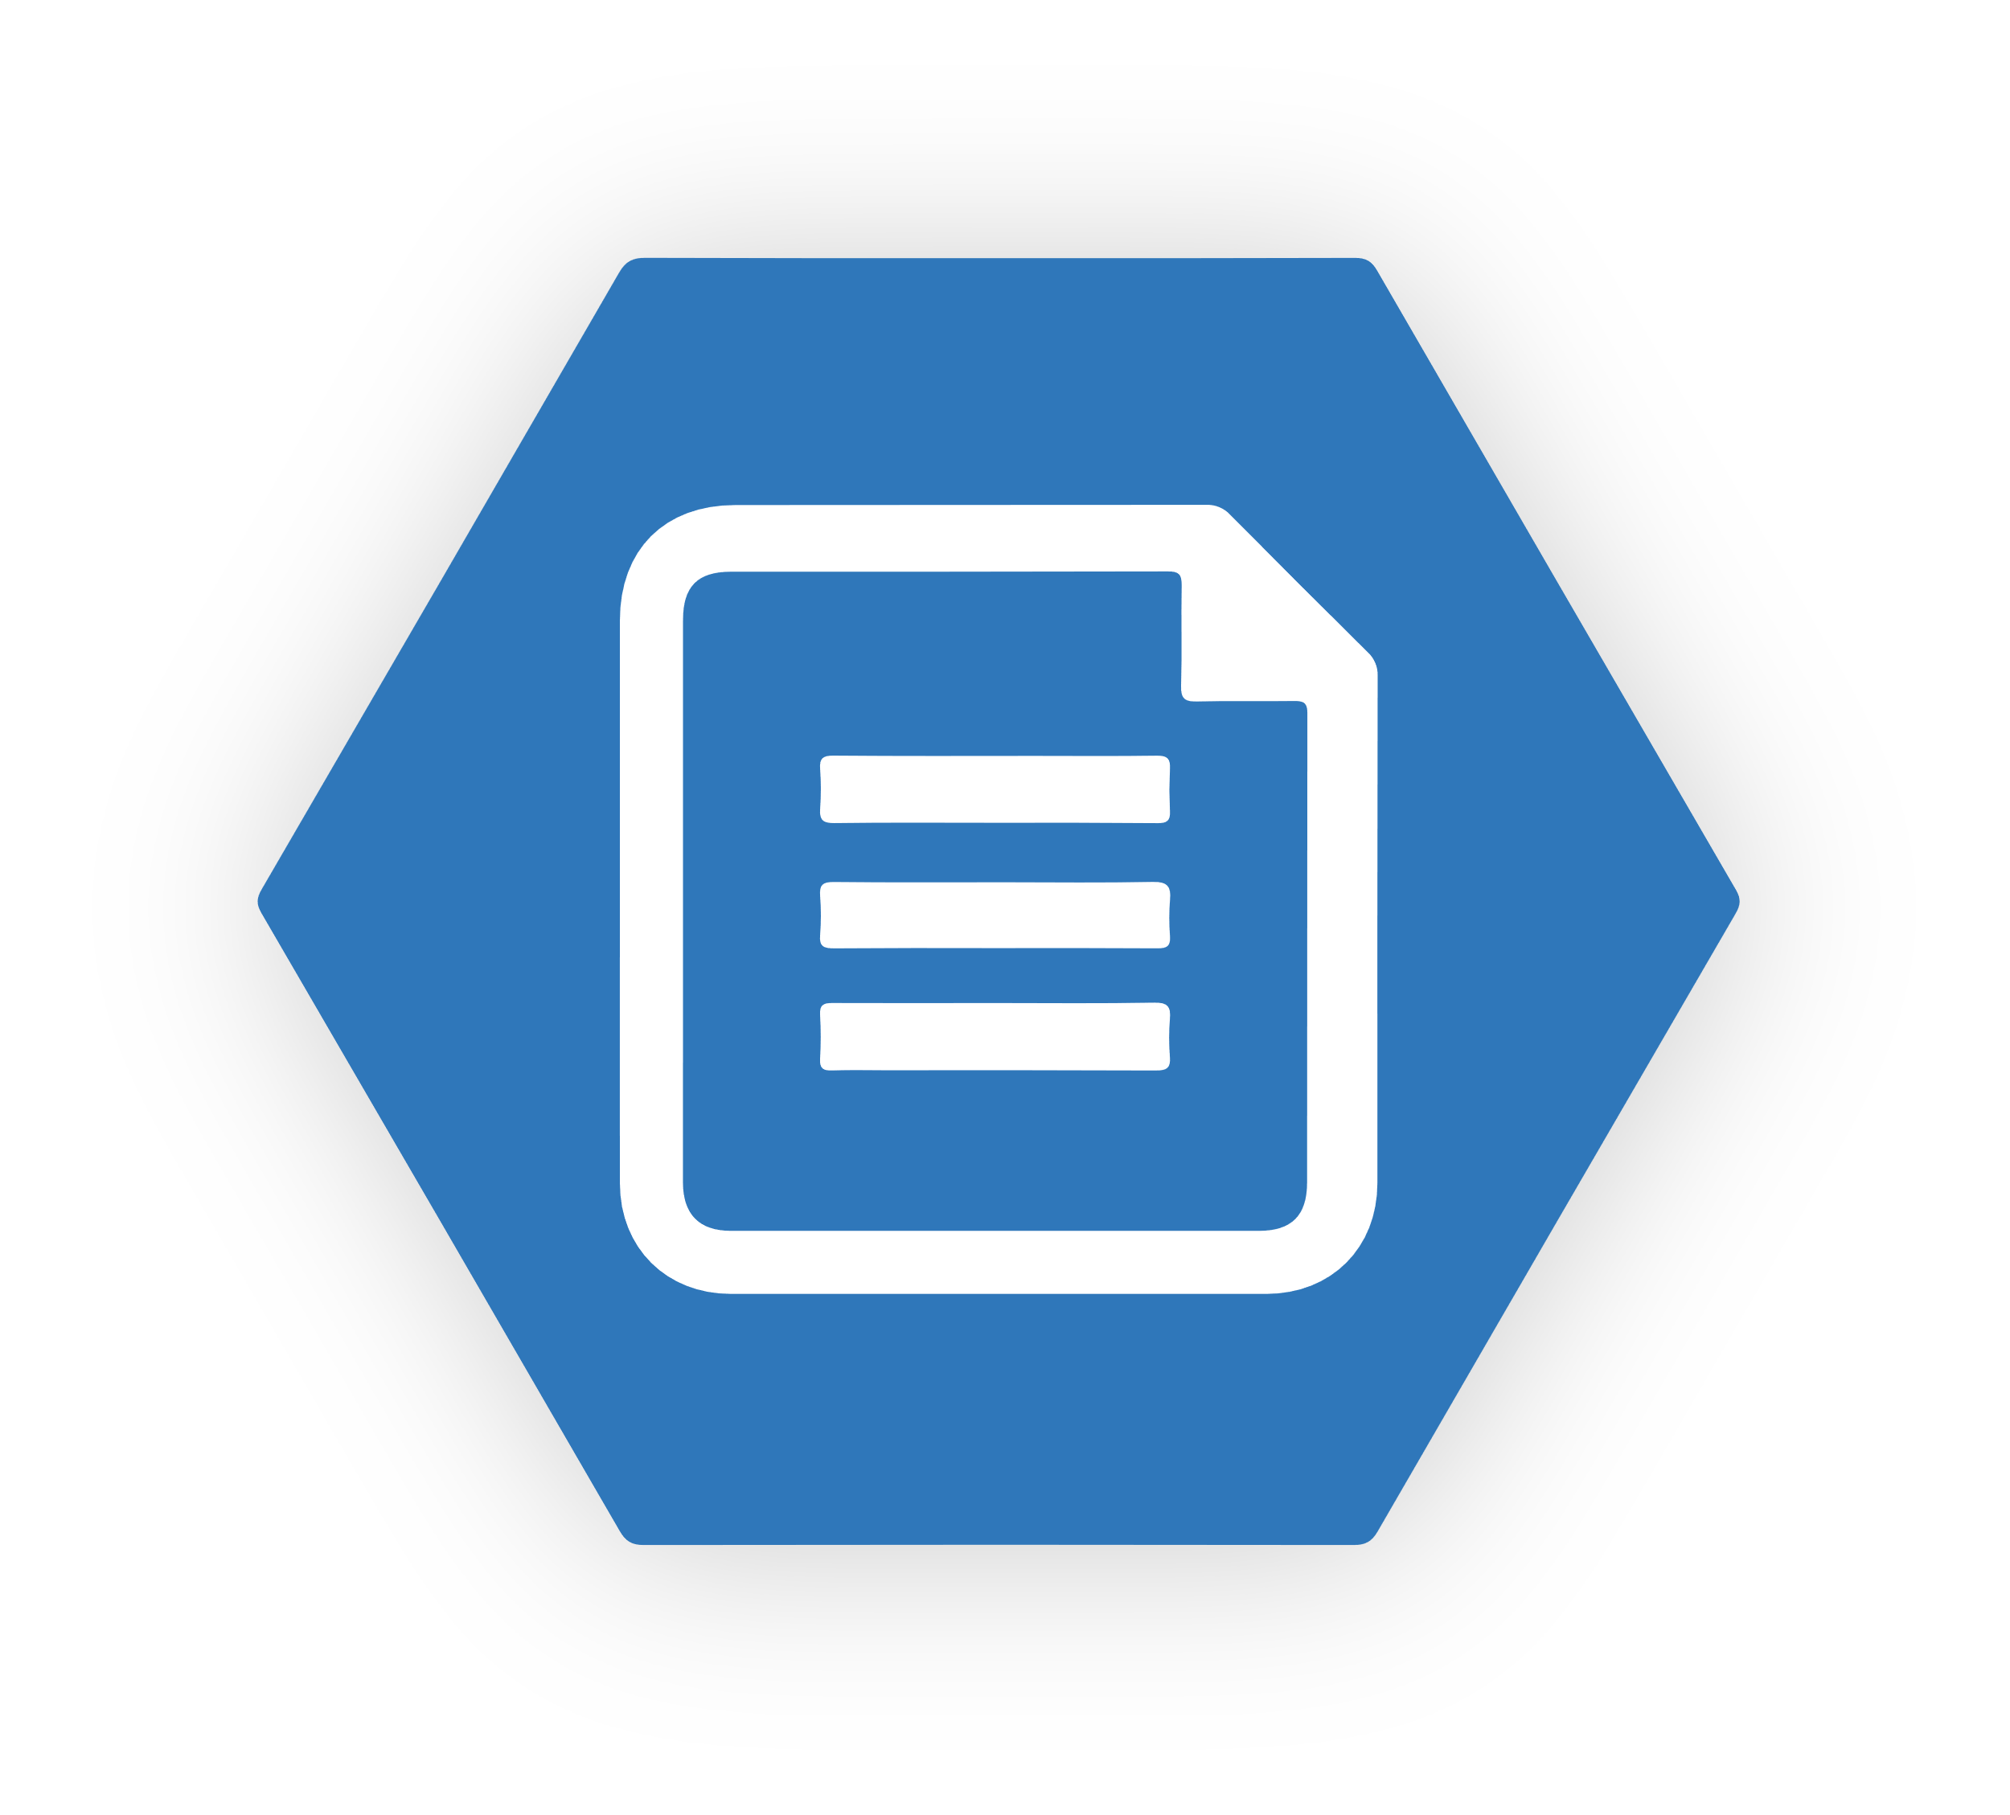


Use Case 1: General Purpose Files as-a-service
Centralize General Purpose File Services (GPFS)
Multi-site sync for distributed access
Cache for fast, local performance
Utilize cloud-based backup and fast DR
Azure Backup Vault
file sync
file sync
Branch
file sync
Branch
HQ Cluster

Slide 20
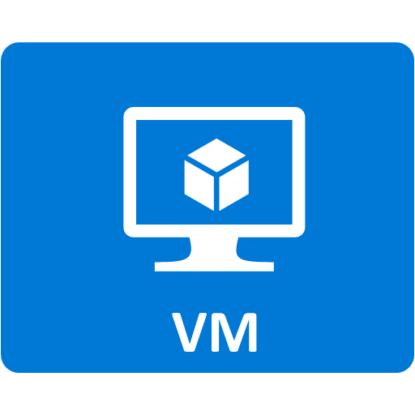

Use Case 2: Migrate applications to the cloud
Migrate on-premises file or share based apps often with no code changes
Test migration in stages – first move data, then move application
Interact with app data from on-prem securely
Reuse ISVs existing file based data access layers in your cloud apps
SMB3.0
On-premises
Azure US-East

Slide 21



Use Case 3: Integrate modern applications
REST APIs enable integration with modern cloud applications
  Integrate modern cloud applications with legacy applications
  Develop new file system based applications using REST APIs
REST APIs support
  Shared access signature (SAS) token support for delegated authorization
  Cross origin resource sharing (CORS) for direct access from browser clients
  Storage Client Library Support in .NET, Java, Node and Python
Worker Roles
Web Sites
Web Sites
REST
REST
Cloud Services
SMB
REST
Cloud Services
Worker Roles
On Premise
Azure US-East
Azure US-West

Slide 22
Use Case 4: Simplify hosting HA workload data
SMB2.1 well suited for client / server scenarios
Server applications such as SQL and IIS require greater reliability during network failures
Using SMB 3.0 persistent handles supports continuous availability
Applications include
  Hosting IIS/FTP sites using shared storage
  SQL Server Failover Cluster Instance
IIS
IIS
IIS
IIS Hosting

Slide 23

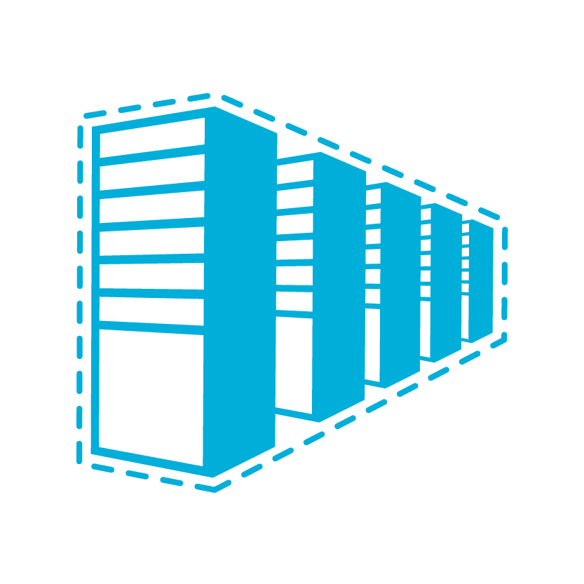
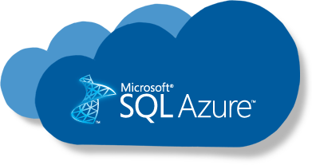


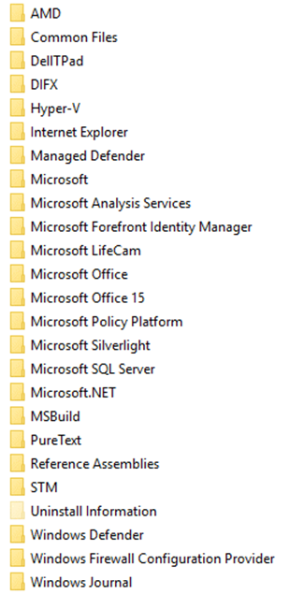
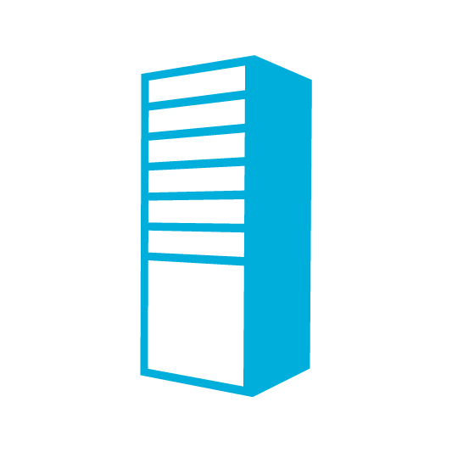
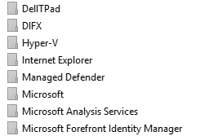

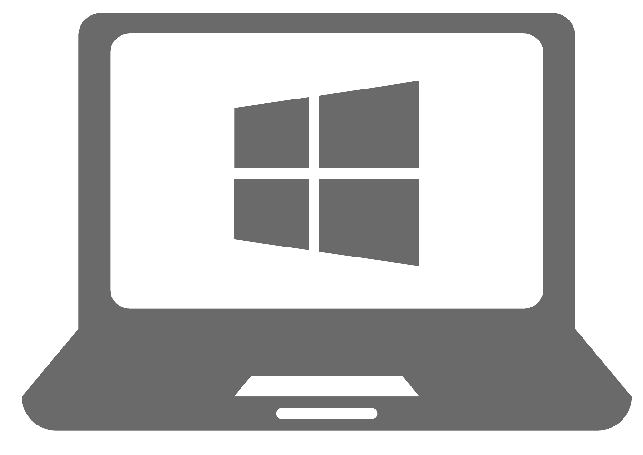

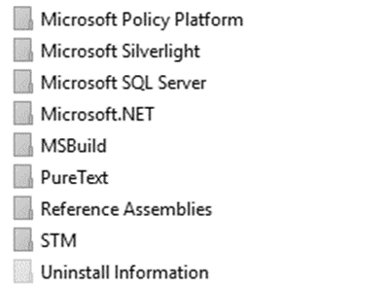
Azure File Sync
PaaS
Azure Backup Vault
3rd party data mngmt
Cloud Tiering
IaaS
SMB
REST
West US
Multi-site sync
File Share
Rapid file server DR
Direct cloud access
SMB
NFS
Work Folders
Users
Applications
Integrated cloud backup
Branch Office
New York
HQ
Seattle

Slide 24
Files - Best Practices
File Sync worth a look esp. for Windows File Servers
  Combine File Sync with Azure Backup of File Shares
Current use cases:
  Server side workloads including config distribution, FTP servers
  No ACL support yet (use Azure File Sync)
Future use cases: Many improvements in CY18
  ACLs natively in Azure Files
  Larger shares and higher perf for Standard Files
  High performance shared storage for HPC with Premium Files

Slide 25
File Share Roadmap
Protect against accidental deletion or application errors
Pay for incremental data stored
Create, list, view, or restore using Portal, PowerShell, CLI or REST API
GA 3/27
Browse Snapshots
Explore using previous versions on Windows
Restore from Snapshots
Restore using previous versions on Windows
Leverage familiar comparison tools
Take Snapshot
Create on demand or schedule with Backup

Slide 26
File Share Backups
Configure backup policies (Backups based on snapshots)
Retention up to 120 days
Restore shares or individual files
Pay per storage account backed up
Preview now (as of 2/21/18)
Create Backup
Browse
Explore restore points
Restore
Restore file or restore share
Configure backup policy

Slide 27

Azure Enterprise NFS Service Overview
Enterprise-Class Availability/Durability
ONTAP RAID-DP
ONTAP High availability
Scalability
Initial 100 TB per fileshare, 100s of shares per Azure subscription: Future multi-PB share
  1,000s of NFS clients per share
NFS as a Native Microsoft Azure Service, powered by NetApp
Rich Data Management (Add-On Services)
ONTAP snapshots/restore, clones
Cross Azure Region fileshare backup/restore, disaster recovery/business continuity
Hybrid Cloud mobility with NetApp Data-Fabric
Security
Data at rest encryption
ONTAP Secure Multi-tenancy, Kerberos/AD integration, export policies
Azure IAM policy for Control plane/API

Slide 28
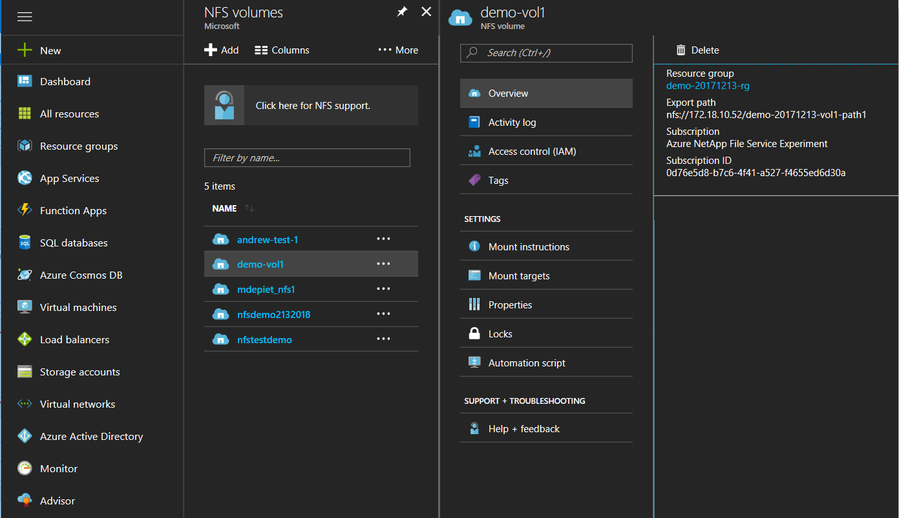
Azure NetApp File Service
Azure NFS file services Powered by NetApp
AZURE 1ST party experience
+ NetApp ONTAP
In Private Preview
  NFS v3
  Azure Portal CRUD Operations
Public Preview and Future
  NFS v4
  Snapshots, Remote Backup, CloudSync
  Clones, DR

Slide 29
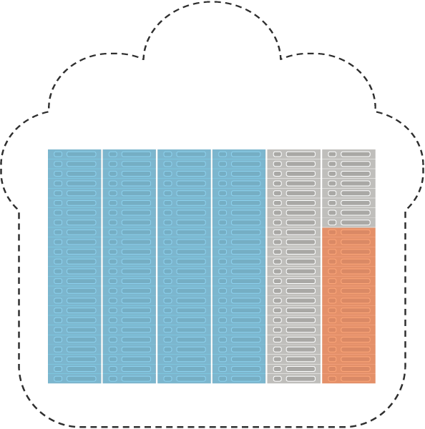
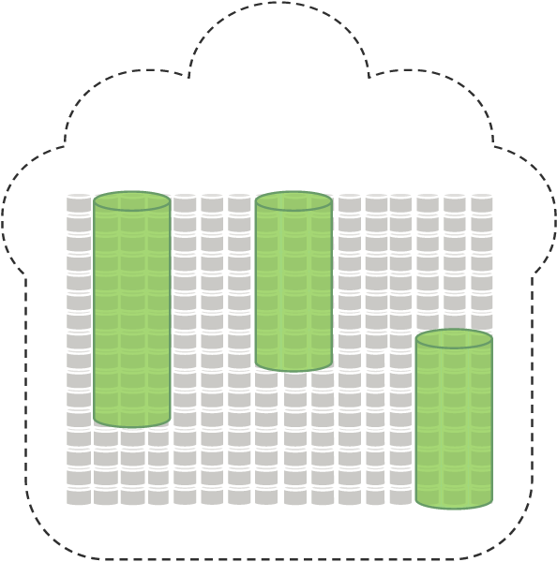
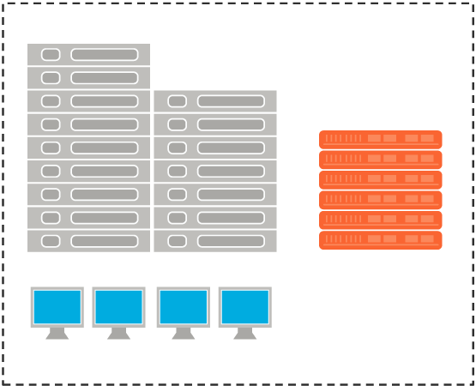
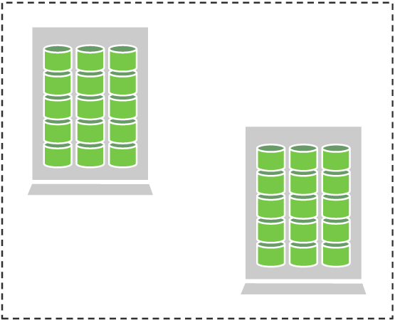
Avere Hybrid Cloud
Virtual Compute Farm
Bucket 1
Bucket 2
Cloud
Compute
Cloud
Storage
Cloud NAS
Cloud Bursting
Virtual FXT
Bucket n
Cloud Storage
Gateway
On-Prem
Compute
Object
On-Prem
Storage
NAS Optimization
Physical FXT
NAS
File System for
Private Object Storage

Slide 30
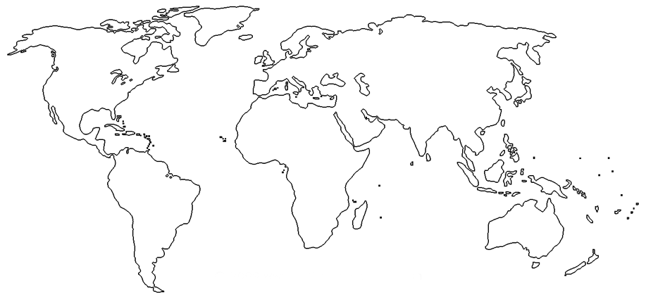
Archive Regional Availability @ GA
Geo | Region
EMEA | Europe West
 | Europe North
Geo | Region
KR | South
 | Central
IN | South
 | Central
Geo | Region
US | East 2
 | South Central
 | Central
 | West
 | West2
 | East
 | North Central
 | West Central
Blob-Level tiering will be available in all regions
6 more regions in Q4 CY18: Australia, Asia SE, Asia E, UK, Japan, US Gov

Slide 31
Azure Storage Durability
Zone 1
Zone 2
Zone 3
Typically >300mi
Typically >300mi
Async
Async
Primary
Secondary
Primary
Secondary
LRS
3 replicas, 1 region
Protect against disk, node, rack failures
Write is ack’d when all replicas are committed
Superior to dual-parity RAID
GRS
6 replicas, 2 regions (3/region)
Protects against major regional disasters
Asynchronous to secondary
RA-GRS
GRS + Read access to secondary
Separate secondary endpoint
RPO delay to secondary can be queried
ZRS V2
3 replicas across 3 Zones
Protect against disk, node, rack and zone failures
Synchronous writes to all 3 zones
Private preview now
GA – 3/30 in 6 regions

Slide 32
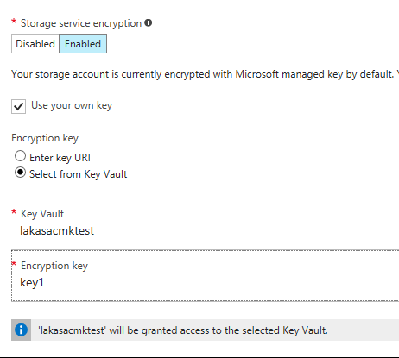
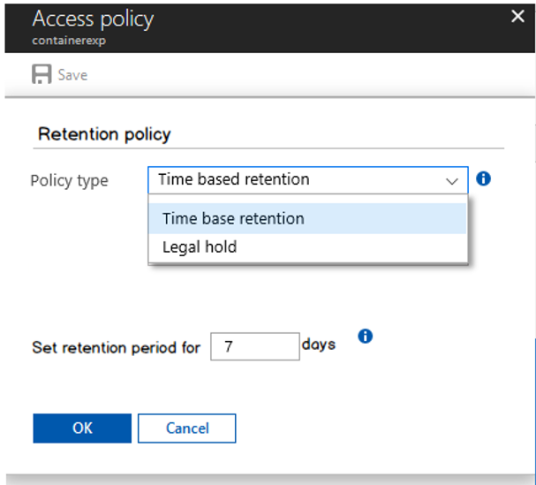
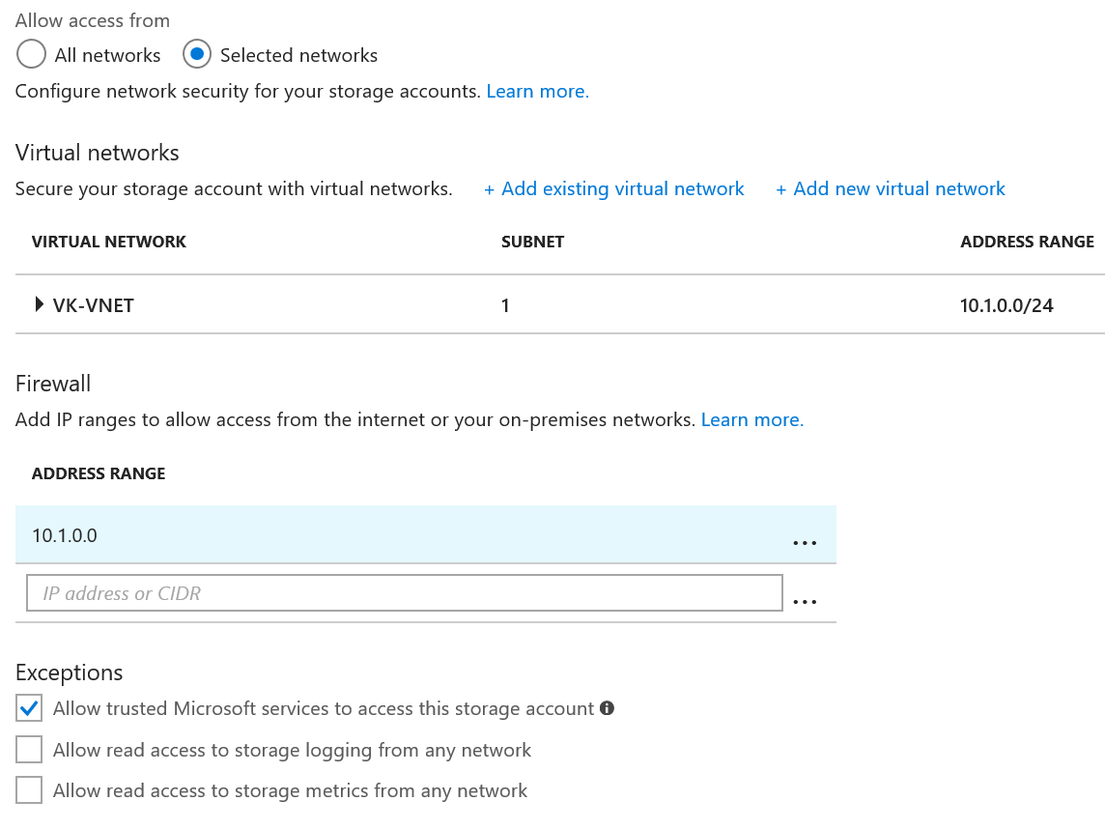
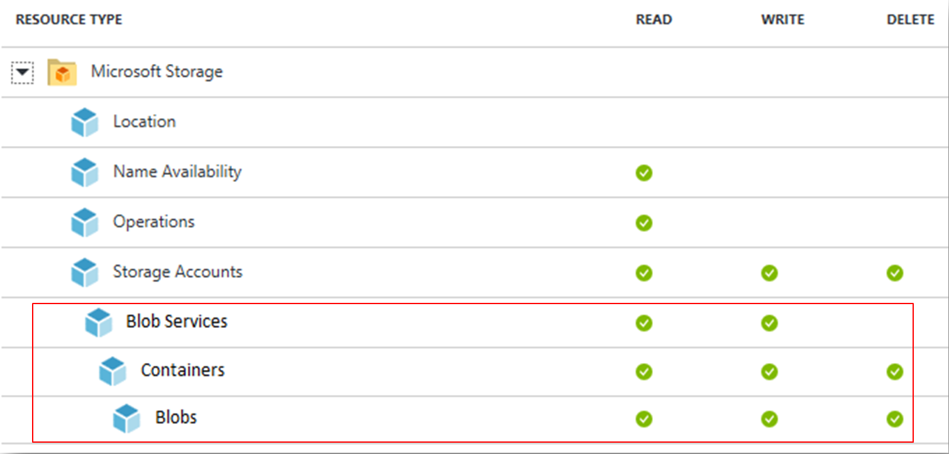
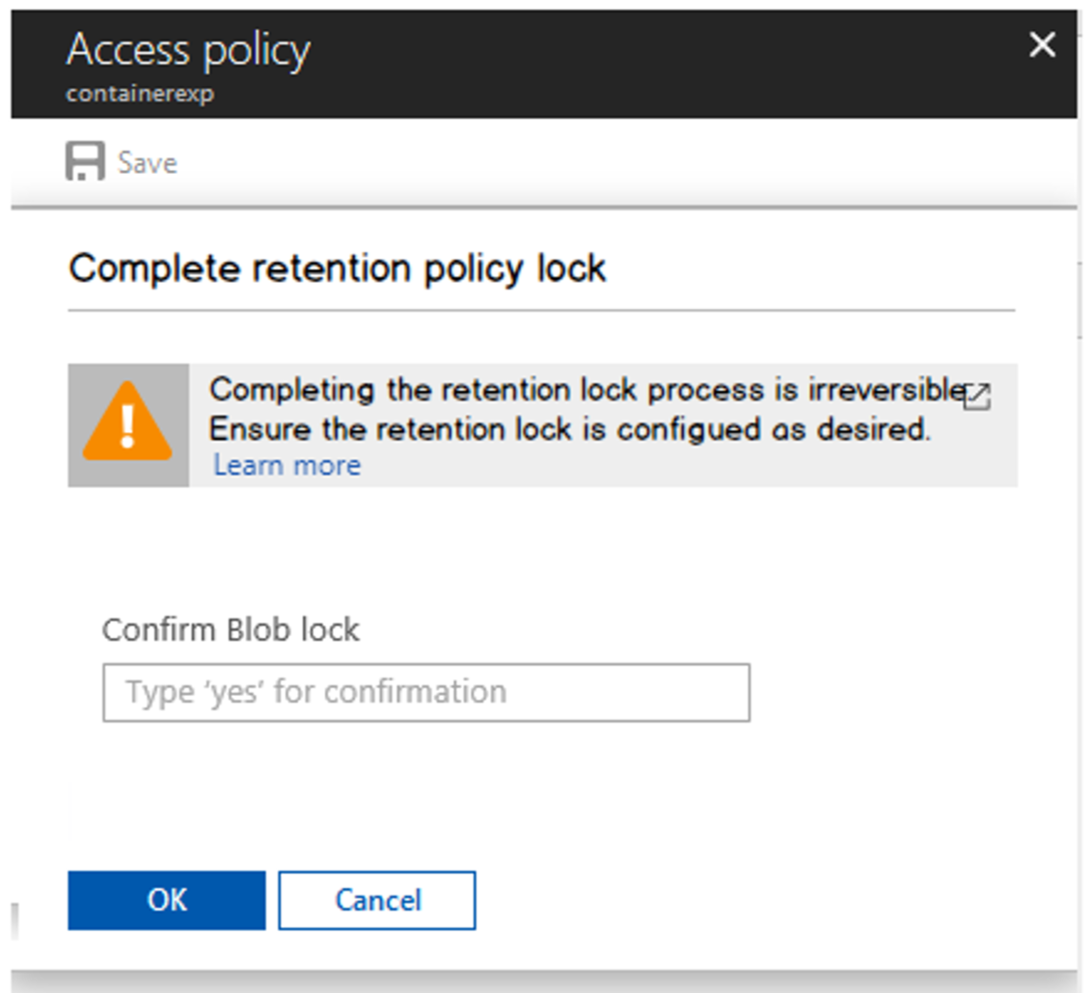
Azure Storage
Security & Compliance
Encryption at Rest
  Always on with MS keys
  Customer supplied keys – GA on 3/7
Firewalls and Virtual Networks
  Restrict access from public internet – GA 01/18
AAD, OAuth and RBAC
  AAD creds for Auth instead of Shared key/SAS
  Full RBAC at container level
  Preview H1 CY18; GA – H2 CY18
WORM
  SEC 17a-4(f) compliant
  Across all Storage tiers
  Preview – Q2 CY18, GA Q3 CY18

Slide 33
Azure Storage Architecture
Front End
  Stateless, front door for request handling (auth, request metering/throttling, validation)
Partition Layer
  Serves data based on partitions, enables batch transactions and strong consistency
Stream Layer
  Stores multiple replicas of the data, deals with failures, bit rot, etc.
FE 1
FE 2
FE 3
FE 4
FE 5
Partition 1
(A-C)
Partition 2
(D-E)
Partition 3
(F-J)
Partition 4
(K-T)
Partition 5
(U-Z)
Stream 1
Stream 2
Stream 3
Stream 4
Stream 5

Slide 34
Large Blob Writes - Current
Movie.mp4 (50 GB)
BL001
BL002
BL003
BLN00
BL001
BL003
BL005
BL007
BL009
BLN00
A single blob is served by a single partition server (Key = Account Name + Container Name + Blob Name)
Parallel writes to FE serialize on a single partition server
Writes to multiple streams helps, but not enough
FE 1
FE 2
FE 3
FE 4
FE 5
Partition 1
(A-C)
Partition 2
(D-E)
Partition 3
(F-J)
Partition 4
(K-T)
Partition 5
(U-Z)
Stream 1
Stream 2
Stream 3
Stream 4
Stream 5

Slide 35
High Throughput Block Blobs
Movie.mp4 (50 GB)
Each block has a unique id assigned to it
The block id range is pre-partitioned uniformly across all partition servers
A single blob’s writes can potentially be served by all partition servers
Theoretical write throughput: Storage account’s limit:
6.25GB/s → 12.5GB/s
BL001
BL003
BL005
BL007
BL009
BLN00
FE 1
FE 2
FE 3
FE 4
FE 5
Partition 1
(A-C)
Partition 2
(D-E)
Partition 3
(F-J)
Partition 4
(K-T)
Partition 5
(U-Z)
Stream 1
Stream 2
Stream 3
Stream 4
Stream 5

Slide 36




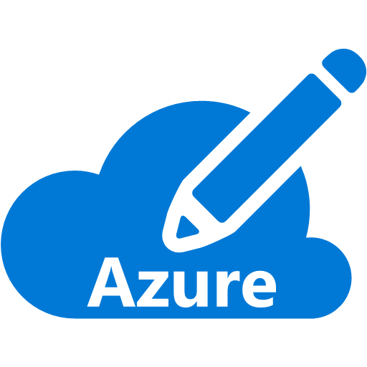




Blob Storage Serverless Compute
Event publishers
Azure Event Grid
Event handlers
Publish data change event notifications
PutBlob, PutBlockList, DeleteBlob
Future – Change Feed
Blob Storage
Azure Functions
Resource Groups
Logic Apps
Azure Subscriptions
Azure Automation
Event Hubs
WebHooks
Custom Events

Slide 37











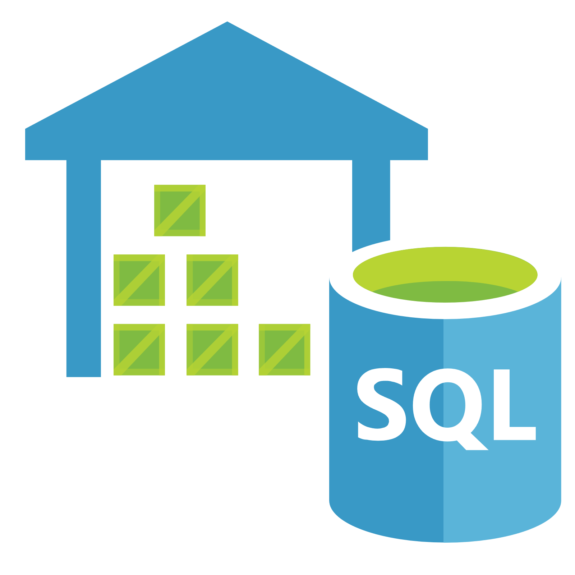














Contemporary Cloud Data Lake
Big Data Use Cases
Ingest & ETL | Streaming | Analytics & Machine Learning | Data Aggregation | Presentation
Monitor
Event Hubs
Functions
Container
Service
App Insights
Log Analytics
Stream Analytics
Machine
Learning
Search
Power BI
Data Lake Analytics
Data Warehouse
IoT Hub
CDN
Data Factory
Batch
Azure HDInsight
Blob Storage
Storage Qualities
Open & Interoperable | Manageable & Cost Efficient | Scalable & Performant | Secure & Compliant | Durable & Available

Slide 38
Azure Files vs. Disks
 | Azure Files | Azure Disks
Scenario | Life & Shift applications which leverage native file system | Persistent disks to Azure Virtual Machines
Protocol | SMB 2.1/3.0, REST | VHD, REST
Accessibility | SMB – Worldwide (requires Port 445) REST – Worldwide | VHD – Azure Data Center REST (Page Blob) – Worldwide
Durability | LRS, GRS | LRS, GRS, RA-GRS (for Page Blob)
Object Size | Up to 1 TB file | Up to 4 TB Disks (Can stripe up to 64 disks on G VM)
Max IOPS (8K) | 1000 | 5000 (Premium) 500 (Standard)
Throughput | Up to 60 MB/s per share | Up to 250 MB/s per disks (Premium) Up to 60 MB/s per disk (Standard)
 | Azure Files | Azure Disks
Scenario | Life & Shift applications which leverage native file system | Persistent disks to Azure Virtual Machines
Protocol | SMB 2.1/3.0, REST | VHD, REST
Accessibility | SMB – Worldwide (requires Port 445) REST – Worldwide | VHD – Azure Data Center REST (Page Blob) – Worldwide

Slide 39

Azure Table Storage Overview
Tables
Disks
“Persistent
disks for Azure IaaS VMs”
Files
“SMB Access to Azure Storage”
Tables
“Massive
auto-scaling NoSQL store”
Tables
“Massive auto-scaling NoSQL store”
User, device and service metadata, structured data
Schema-less entities with strong consistency
No limits on number of table rows or table size
Dynamic load balancing of table regions
Best for Key/value lookups on partition key and row key
Entity group transactions for atomic batching
Endpoint – http://mystorageaccount.table.core.windows.net
NOSQL storage
Access via REST
KeyValue Store

Slide 40

Azure Queues Overview
Queues
Disks
“Persistent
disks for Azure IaaS VMs”
Files
“SMB Access to Azure Storage”
Tables
“Massive
auto-scaling NoSQL store”
Queues
“Reliable messaging at scale for cloud services”
Queues
“Reliable messaging system at scale for cloud services”
Decouple components and scale them independently
Scheduling of asynchronous tasks
Building processes/work flows
No limits on number of queues or messages
Message visibility timeout to protect from component issues
UpdateMessage to checkpoint progress part way through
Endpoint – http://mystorageaccount.queue.core.windows.net
Reliable Messaging
Access via REST
Scheduling a sync tasks

Slide 41
Azure Blob Storage Overview
Blobs
Disks
“Persistent disks for Azure IaaS VMs”
Files
“SMB Access to Azure Storage”
Tables
“Massive
auto-scaling NoSQL store”
Queues
“Reliable messaging at scale for cloud services”
Blobs
“Highly scalable, REST based cloud object store”
Blobs
“Highly scalable, REST based cloud object store”
Data sharing, Big Data, Backups
Block Blobs: Read and write data in blocks. Optimized for sequential IO. Most cost effective Storage. Ideal for files, documents & media
Page Blobs: Optimized for random access and can be up to 8 TB in size. IaaS VM OS & data disks
are of this type.
Append Blobs: Similar to block blobs and optimized for append operations. Ideal for logging scenarios and total size can be upto 195GB
Endpoint – http://mystorageaccount.blob.core.windows.net/mycontainer/myblob.
Object storage
Access via REST
Streaming & random object access scenarios

Slide 42
Blob Tiered Storage
Two Tiers
  Hot – for commonly used data
  Cool – for rarely used data
  Archive – Cannot be read, copied, overwritten, or modified or snapshotted.
  Rehydration first (change tier to hot or cool) that take up to 15 hours to complete for blobs less than 50 GB.
  API is 100% identical; similar throughput and latency
  Durability options: LRS, GRS, RA-GRS
  Availability: Cool – 99%, Hot – 99.9%. Higher for
  RA – GRS reads
Pricing to match your workload
  Hot: Lower access prices for frequent use
  Cool: Lower storage prices for high volume
Switch account tiers as needed
  No charge for Hot to Cool switch
  Future – Object level switch with automatic policy
  based management
Blob REST API
Archive REST API
Blob Storage Account
Hot Tier
2.4₵/GB/mo
No R/W cost
Per Tx cost
Blob Storage Account
Cool Tier
1₵/GB/mo
1₵/GB Reads
0.25₵/GB Writes
2x per Tx cost
Archive Storage Account
Account level conversion
Future – Object level, policy
Future – lifecycle management policy
Notes:
Up level the text to emphasize sameness, cost, etc.
Don’t specify numbers

Slide 43
Types of Blobs
Block Blobs
Most object storage scenarios
Documents, images, video, etc.
Image.jpg
Block 1
Block 2
Block 3
Block 4
Append Blobs
Multi-writer append only scenarios
Logging, Big Data Analytics output
Block 1
Block 2
Block 3
Block 4
Page Blobs
Page aligned random reads and writes
IaaS Disks, Event Hub, Block level backup
Sparse File
512 byte aligned
512
1024
1536
2048
2560
Notes:
Block Blobs:
For most object storage needs
Optimized for sequential access
Each blob is made up of blocks
Append Blobs:
Similar to Block Blobs
Can only append blocks to the end of the blob
Optimized for multi-writer append scenarios (logging, etc.)
Page Blobs:
Optimized for random reads and writes
Collection of 512 byte pages
Support for sparse files
Focus of the rest of this talk is Block Blobs

Slide 44
Azure Storage Offerings
Queues
“Reliable messaging at scale for cloud services”
Tables
“Massive auto-scaling NoSQL data store”
Blobs
“Highly scalable, REST based cloud object store”
Disks
“Persistent disks for Azure IaaS VMs”
Files
“File share like access to Azure storage”
Code against (REST API)
Use on Windows & Linux VMs
Foundational building block of the Azure Cloud – Cloud – Azure Data Lake, Azure SQL Data Warehouse, Azure HDInsight, OneDrive, Skype, Xbox,…
All storage types are encompassed under the Storage Account service offering.
  General Purpose Storage (Magnetic Tape)
  Premium Storage (SSD/Low Latency/High IOPS/ Better performance)
Hyper Scale: >60 trillion objects, >7 million transactions per second
REST based API, multi-platform, open sourced client libraries for many languages (e.g. Java, Python, Node.js, PHP, Ruby, Android, etc.)
Strong hybrid story - Azure Stack support and integration with StorSimple, Azure Backup and 3rd party
storage vendors

Slide 45
Azure Storage Architecture
Import / Export
Client Libraries
(.NET, Java, C++, Android, Node.JS…)
SMB Client
REST
REST
REST
REST
SMB 2.1
Blob/Disk
Endpoint
Table
Endpoint
Queue
Endpoint
File Share
Endpoint
Front End Layer
Massive Scale Out & Auto Load Balancing
Index Layer
Partition Layer
Distributed Replication Layer
Stream Layer

Slide 46
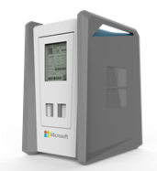
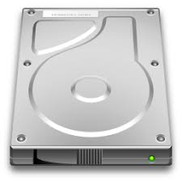
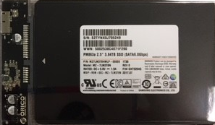
Azure Storage - Device Transport Options
Disk Import
Disk Rental
Data Box – 100 TB
Capacity: <10TB
Customer supplied disk
USB/SATA Interface
Ships in tamper resistant case
High capacity with Super Transport
Capacity: <10TB
Azure leased service
Tamper resistant
Low complexity - USB
Low cost
Capacity: 100TB
Human scale: < 50 lbs.
Ruggedized, tamper, water resistant
SMB Interface
Large Fleet Size
Automated Ordering and Managed Service in Azure
Specifications
Currently Available
Preview Mid-year ‘18
Currently in Preview
Availability

