Slide 1
Azure Compute Overview
Notes:
IMPORTANT NOTE:
Microsoft Ready will utilize Windows 10 and the new PowerPoint 2016, as well as PowerPoint 2013 on all event machines. Please build your slides utilizing the appropriate Template and utilize the version of PowerPoint that works best.
Windows 10 devices now connect remotely through VPN using the PIN with Passport for Work. Speakers needing to use VPN in a demo, will need to have registered for Phone Authentication at https://phoneregistration.microsoft.com. Additional details are also available here: https://microsoft.sharepoint.com/sites/itweb/securelogon/Pages/FAQ.aspx

Slide 2

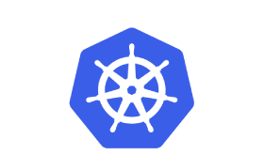
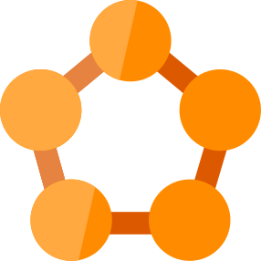
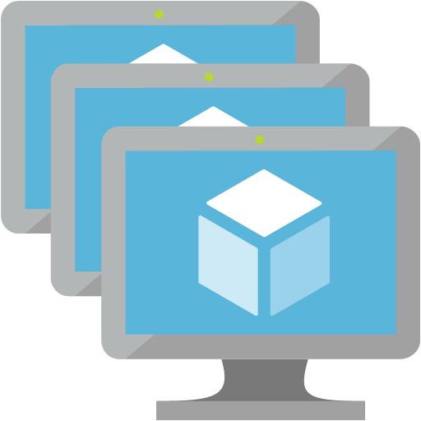
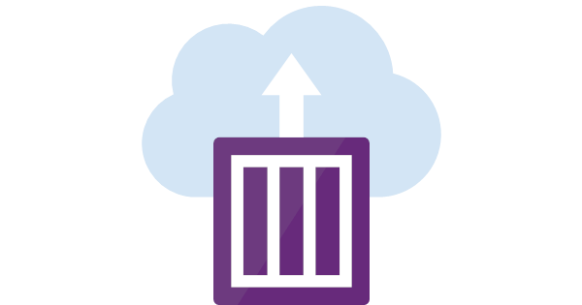
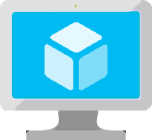
Infrastructure
Functions
Clusterless & Serverless
App Service
Logic Apps
Managed Containers
Service Fabric
Kubernetes
VM
Scale Set
Container
Instances
VMs

Slide 3
Infrastructure

Slide 4



Infrastructure as a Service
VM
VM Scale Set
Containers
Marketplace
Legacy applications, no change
Scale out
Efficiency and speed
Flexibility
Lift and shift
Elasticity
Improved
DevOps
Managed Service

Slide 5
Virtual Machines
Multiple families and sizes, GPUs
HDD/SSD, Managed/Unmanaged Disks, Accelerated Networking
Availability Sets, scheduled events, planned maintenance
Ubuntu, Red Hat, Windows, SUSE, CoreOS
VM Extensions
DevOps Extensions with Chef and Puppet
Notes:
Really the basic building block of all other compute services
Valuable for cases where you’re simply lifting-and-shifting an existing workload to the cloud and want to maintain the existing topology.
Huge variety of OS images available, including all the popular Linux distros
Support for many popular configuration tools, including Chef and Puppet.
Available in many different sizes to fit your workload, including the recently announced N-series which offer Nvidia GPUs for graphically intense workloads.
And of course, since VMs make up the basic building blocks in our Compute story, many people have built interesting things out of them, which are available in the marketplace…

Slide 6

Latest VM Sizes
Intel Haswell E5-2673 v3
Lowest cost, flexible CPUs
Up to 8vCPUs, 32GB RAM
Intel® Xeon® Platinum 8168 processor (Skylake)
Entry level
Burstable
General Purpose
Compute Intensive
Storage Optimized
A
Av2
B
D
Dv2
Dv3
F
Fv2
L
Lv2
(coming soon)
Intel Broadwell E5-2673 v4
Hyper-Threaded CPUs
Up to 64 vCPU’s, 256GB RAM
AMD EPYC™7551 processor
8x1.9 TB SSDs
Notes:
JB-Updates – 1/26/2018:
Add Lv2 (Coming soon) to storage, new AMD Epyc processor adding - done
B-series:
Build credits on your vCPU usage
Web servers, small DBs, and dev/test
Dv3
Hyper-Threaded CPUs unlock full potential of latest processors
First wave for Nested virtualization and Hyper-V containers
Fv2:
For HPC scenarios: Scientific modeling, cluster computing, gaming and analytics
Coming by end of 2017

Slide 7

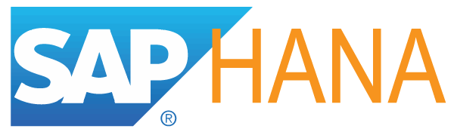
Latest VM Sizes
Intel Xeon E5-2673 v4 (Broadwell)
Hyper-Threaded CPUs
Up to 64 vCPUs, 432GB RAM
Nvidia M60
High Performance Computing
HANA optimized
Memory Optimized
Graphics Intensive
G
Ev3
M
NC
NCv2
NV
ND
H
NCv3
NVv2
NDv2
Hv2
‘
‘
‘
(coming soon)
(coming soon)
(coming soon)
Intel Xeon E7-8890 v3 (Haswell)
Largest VMs in Azure
Up to 128 vCPUs, 4TB RAM
V100 PCIe
Nvidia V100 SXM GPU
Deep learning, AI
Skylake Processor
Notes:
JB-Updates – 1/26/2018:
Graphics:
NDv2 (Coming soon) V100 SXM
NCv3 (Preview), V100 PCIe
NVv2 (Coming soon) M60
High Performance:
Hv2 (Coming soon) Skylake processor
Memory Optmized:
Ev3
Hyper-Threaded CPUs unlocking full potential of latest processors
Great for nested virtualization and Hyper-V containers
M-series:
For large in-memory workloads like SAP HANA
Graphics Intensive:
Ncv2:
For High performance scenarios
ND:
P40 is fastest GPU and ideal for machine learning scenarios
Offering 21x Inference throughput gain vs. K80
Azure is the only cloud delivering P40’s and P100’s
We continue to nearly double our VM sizes every year and we are committed to continual evolution of our fleet as hardware advances

Slide 8
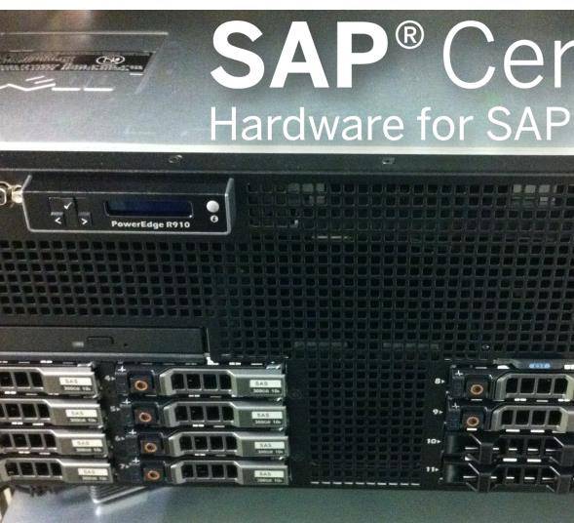
Largest SAP HANA systems in cloud
20 TB single-node
960 CPUs
60 TB multi-node
Bare metal perf

Slide 9

No-compromise HPC and AI VMs
H
Up to 16 cores, 3.2 GHz E5-2667 V3 Haswell processor
Up to 224 GiB DDR4 memory
FDR InfiniBand (56 Gbps, 2.6 microsecond latency)
2 TB of local SSD
ND
Up to 4 NVIDIA Pascal P40 GPUs
Up to 24 cores
Up to 448 GiB memory
Up to 3 TB of local SSD
FDR InfiniBand
NC
Up to 4 NVIDIA Tesla K80 GPUs
Up to 24 cores
Up to 224 GiB memory
Up to 1440 GiB of local SSD
FDR InfiniBand
NCv2
Up to 4 NVIDIA Pascal P100 GPUs
Up to 24 cores
Up to 448 GiB memory
Up to 3 TB of local SSD
FDR InfiniBand
NV
Up to 4 NVIDIA Tesla M60 GPUs
Up to 24 cores
Up to 224 GiB memory
Up to 1440 GiB of local SSD
NCv3
Up to 4 NVIDIA Volta V100 GPUs
Up to 24 cores
Up to 448 GiB memory
Up to 3 TB of local SSD
FDR InfiniBand

Slide 10
VM Scale Sets
High performance provisioning of 1000+ VMs
Auto-configuration at scale
Auto-scale based on schedule and resource metrics
Easy updates at scale
Simple Portal Integration
Notes:
So, VMs are great… but managing a lot of them individually can be hard. That’s where VM scale sets comes in..
The goal here is to enable management of like VMs as a group and make it easy to scale them in/out based on demand.

Slide 11
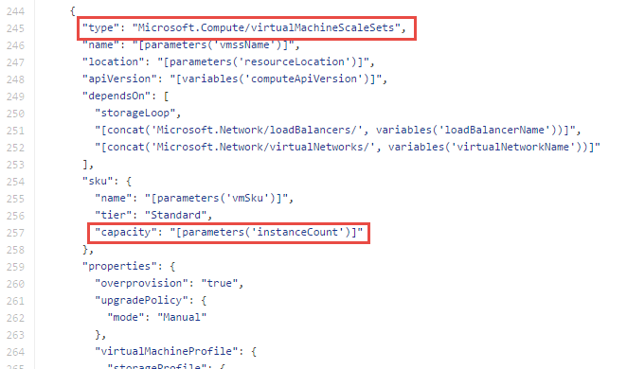
Why VM Scale Sets?
Manually scale with ‘capacity’ property
Autoscale with host metrics (MDM pipeline) or diagnostic extensions​
Small buy-in: Deploy/manage sets of 0->100 identically configured VMs ​
Guest OS patching: Patching primitives allow manually triggered rolling upgrades​​
High-availability – implicit availability set with 5 FDs/5 UDs​
Availability Sets vs Scale Sets
Avail Set: Multiple different VMs (image, size, etc); managed separately
Scale Set: Large count of the same VMs; managed together
Scale set: Reliable rapid provisioning and scale utilizing similarity of the VMs

Slide 12
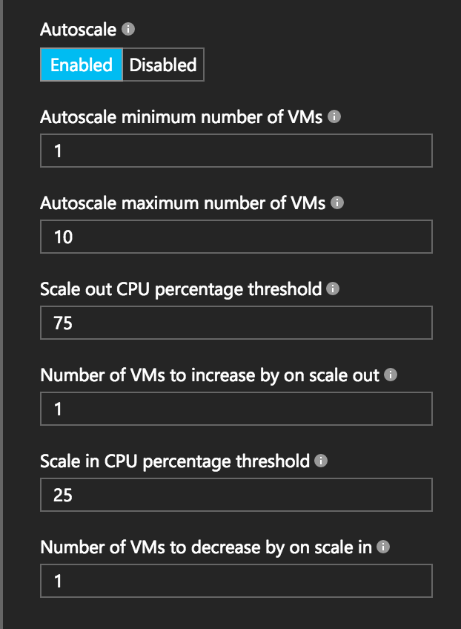
Autoscale with VM Scale Sets
Define Max – Min VMs
Define trigger and action rules
Standard audit / email notifications
Define webhooks for custom notifications and actions (e.g. runbooks)
Notes:
Metrics emitted by Azure Diagnostic Extension
Triggers can be basic performance metrics, and also schedule based, queue length based.

Slide 13
VM scale set app deployment models
Model | When to use
Marketplace | Off the shelf solutions.
VM Extensions | Full control over app lifecycle management.
Custom data/unattend | Install custom app independently of external network.
Configuration manager | Centrally managed app installation, credentials & maintenance.
Containerized | Abstract app management from infrastructure. Cloud/DC agnostic.
Custom image | Small self-contained apps. Fast deploy. Immutable build, test, deploy pipelines.
Notes:
There are many different ways to deploy software to VM scale sets. I won’t go into any great detail here, but just to give you a flavor…
If you’re simply looking to deploy an existing application off-the-shelf, you can use the Azure marketplace
Alternatively, you can use what we call a VM extension, which is a task triggered inside the VM after the base image has booted, where you can run arbitrary scripts.
You can also deploy a custom VM image that you’ve created with a tool like Packer

Slide 14




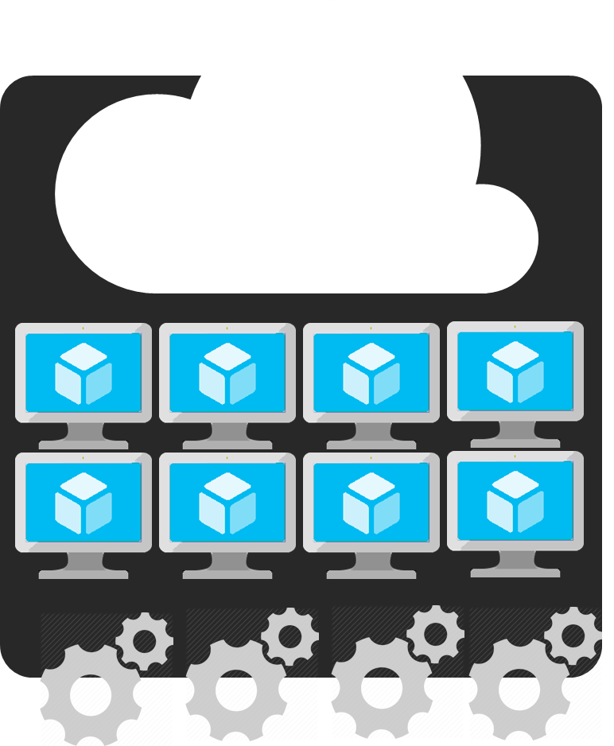
Azure Batch
APIM
Mobile
apps
Logic
apps
API apps
Notification
hubs
Azure
functions
Compute pools for job processing
Automatic scaling and regional coverage
Linux and Windows
Automatically recover failed tasks
Input/Output handling
Low-Pri (discounted) option
Notes:
So with that little bit of context on VM scale sets, let’s start slowly moving up the stack…
While you can use VMSS directly, we expect most customers will interact with them through a higher-level abstraction.
One of those is Azure Batch, which enables highly-parallelizable job processing. You provide it with your job, configure the amount of compute you want to throw at it, and Batch will both schedule it efficiently and restart failed tasks as required.
Common scenarios include financial risk modeling, climate analysis, and media encoding

Slide 15
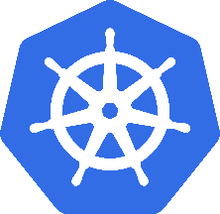
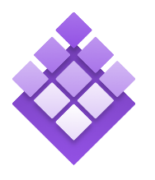
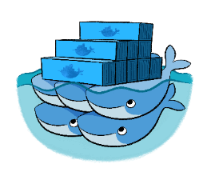
Azure Container Service
Azure Container Service
Standard Docker tooling and API support
Streamlined provisioning of DCOS and Docker Swarm
Linux and Windows Server containers
Azure and Azure Stack
Kubernetes
DC/OS
Swarm
Notes:
Running alongside excitement in containers has been excitement about container orchestrators.
The core job of the orchestrator is to take your containers and deploy them within a pool of compute infrastructure, then monitor their health and resource usage as they run, restarting or load balancing them as required.
Two popular OSS orchestrators are DC/OS and Swarm. DC/OS is developed by Mesosphere and is based on the Apache Mesos scheduler, whereas Swarm is built by Docker Inc.
So what is the role of ACS relative to the orchestrators? Well, historically they’ve been a pretty big pain to set up since each has a set of specific dependencies and expects a particular topology, including the deployment of a master node alongside a set of workers. ACS provides an easy way to configure an Azure environment that covers all of that and creates an environment that incorporates a number of best practices.
One important thing to note here is that EVERYTHING is OSS. You could easily take apps running on ACS and move them to another environment without changing anything you do.

Slide 16
Azure Container Instances
Simplest and easiest way to run individual containers in the cloud
No VM management
Per-second billing with customized resource requests
Linux and Windows Server containers
Notes:
Running alongside excitement in containers has been excitement about container orchestrators.
The core job of the orchestrator is to take your containers and deploy them within a pool of compute infrastructure, then monitor their health and resource usage as they run, restarting or load balancing them as required.
Two popular OSS orchestrators are DC/OS and Swarm. DC/OS is developed by Mesosphere and is based on the Apache Mesos scheduler, whereas Swarm is built by Docker Inc.
So what is the role of ACS relative to the orchestrators? Well, historically they’ve been a pretty big pain to set up since each has a set of specific dependencies and expects a particular topology, including the deployment of a master node alongside a set of workers. ACS provides an easy way to configure an Azure environment that covers all of that and creates an environment that incorporates a number of best practices.
One important thing to note here is that EVERYTHING is OSS. You could easily take apps running on ACS and move them to another environment without changing anything you do.

Slide 17
VM Scale Sets
A single resource to provision up to 1000 VMs
Auto-configuration at scale
Auto-scale based on schedule and resource metrics
NEW: Span AvailabilityZones
PREVIEW: Low-priority scale set with up to 80% discount
Notes:
WHY
Unlock the benefits & saving of elasticity in the cloud
Manually scale with ‘capacity’ property
Autoscale with host metrics (MDM pipeline) or diagnostic extensions​
Small buy-in: Deploy/manage sets of 0->100 identically configured VMs ​
Guest OS patching: Safely roll out OS updates
High-availability – implicit availability set with 5 FDs/5 UDs​ or spread VMSS across zones
So, VMs are great… but managing a lot of them individually can be hard. That’s where VM scale sets comes in..
The goal here is to enable management of like VMs as a group and make it easy to scale them in/out based on demand.

Slide 18
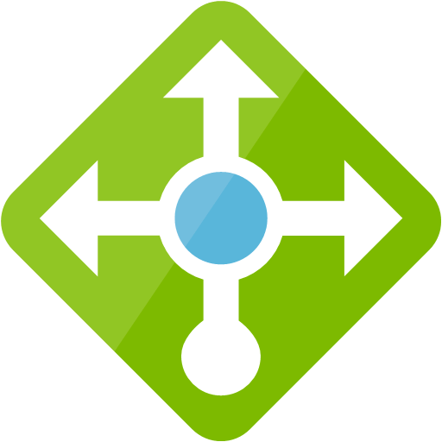
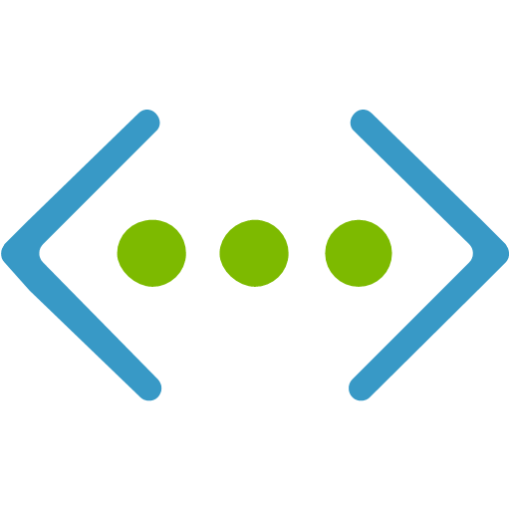
PREVIEW: Low Priority VMs in VM Scale Sets
Take advantage of unutilized capacity in Azure
Significant cost savings : 60%-80% discounted
Fixed, published price
Ideal for any workloads that can handle interruptions
HOWEVER:
  No Availability SLA: 1 Fault Domain, No service healing
  Capacity is not guaranteed
  Instances will be evicted when capacity is required or after some time.
Eviction policies
Stop/Deallocate (default) : VM is deallocate, underlying disk(s) are kept (and paid for).
Delete: VM and underlying disks are deleted
Notifications prior to Eviction (using scheduled events)
‘Hybrid’ VM Scale Set
On-demand
VMSS
Low-priority
VMSS
Notes:
*Public cloud only
**Exclude B and promo Dv2

Slide 19
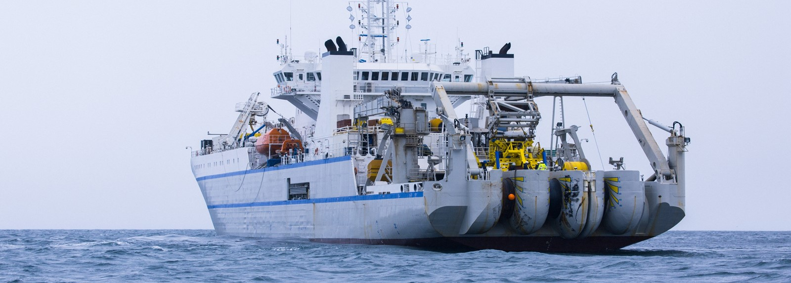
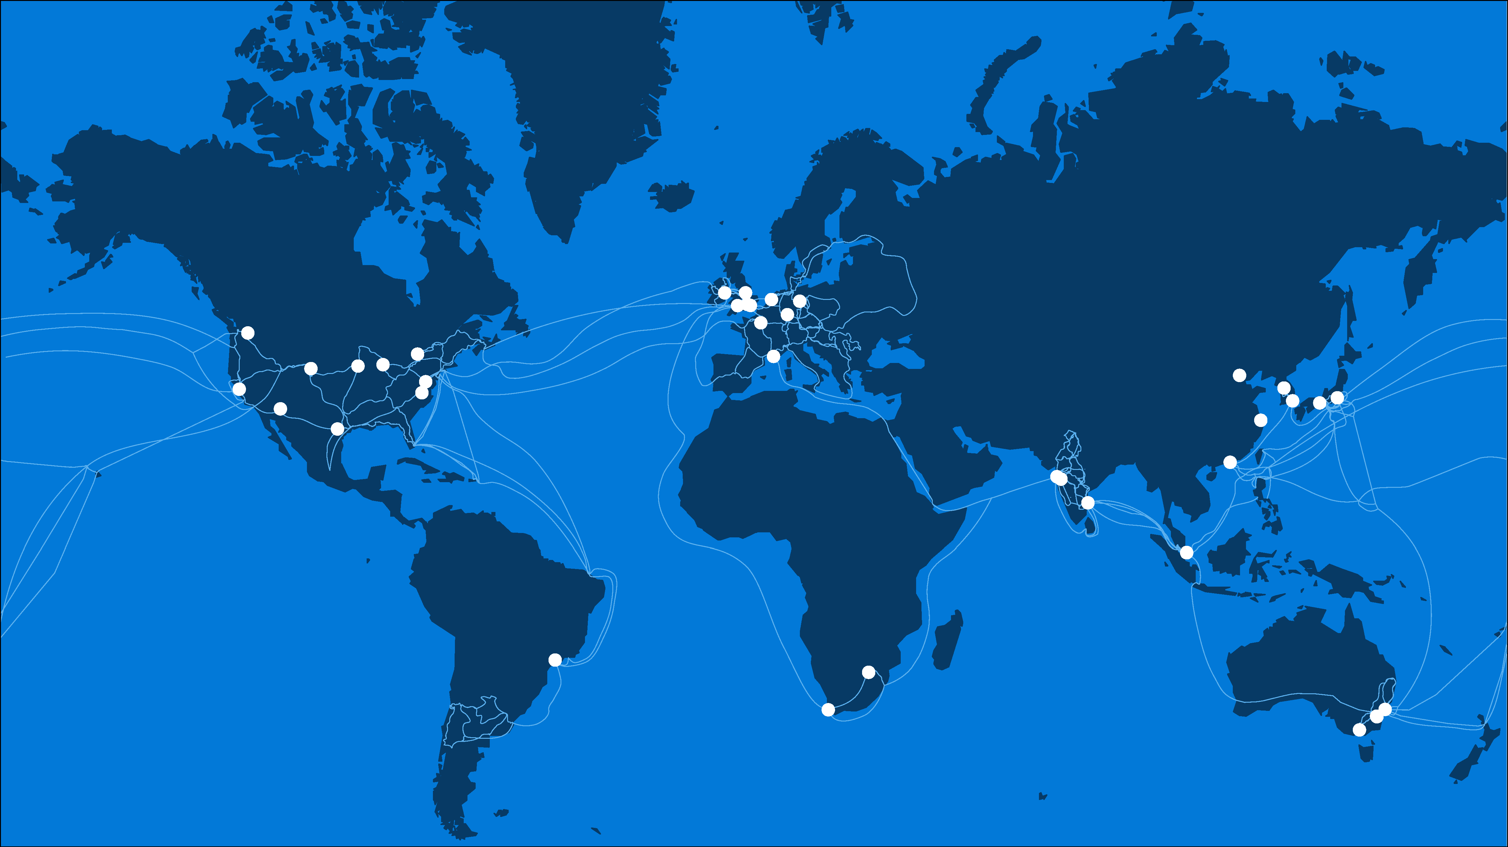
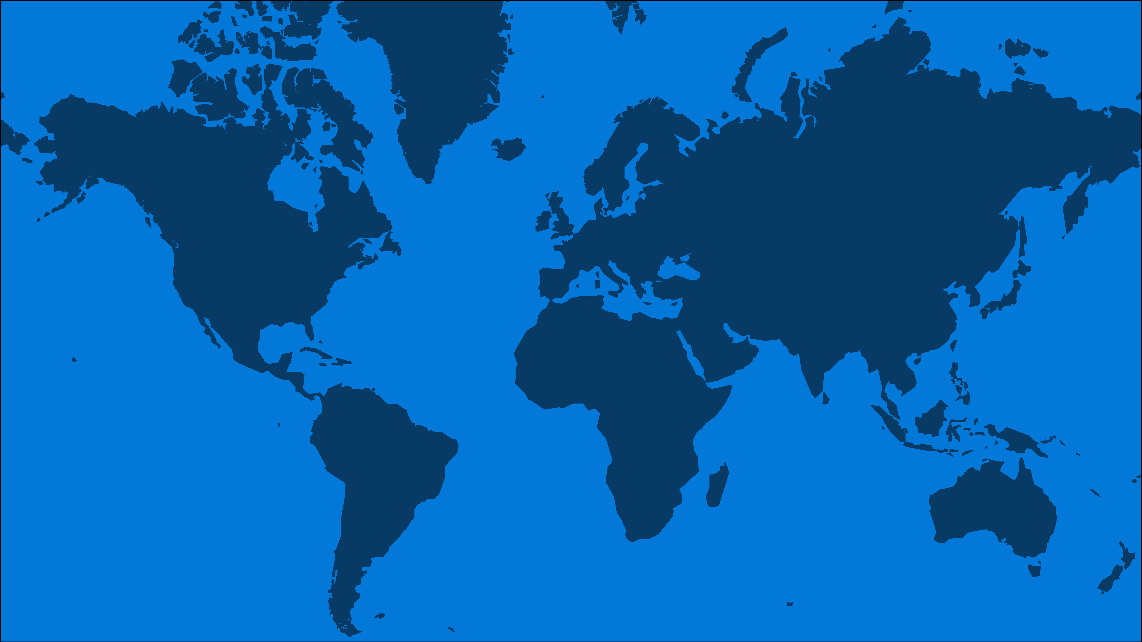
50
4500+
130+
AZURE
REGIONS
PEERING
LOCATIONS
EDGE
SITES
Notes:
Our first stop is our global WW presence
As you saw in Scott’s keynote Azure has 42 regions WW which is more than any other cloud provider
These regions are actually comprised of hundreds of DCs
We also operate one of the most robust and reliable networks in the world with:
over 4500 points of presence
And more than 130 Edge sites

Slide 20
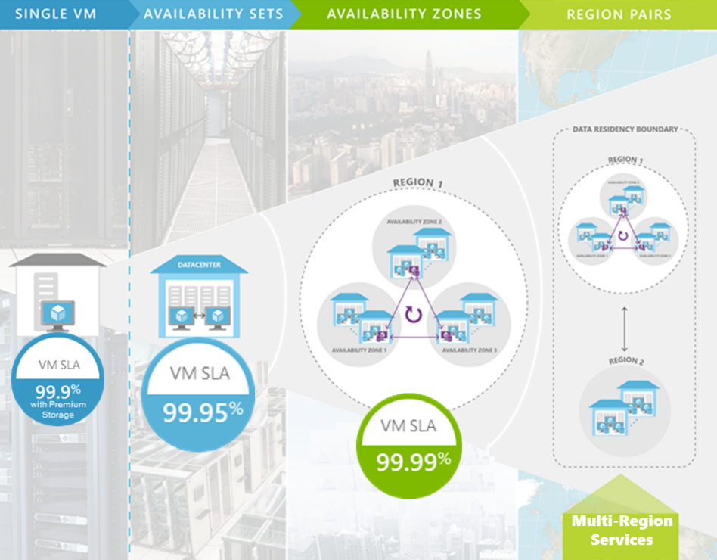
Disaster Recovery
High Availability
Availability Spectrum
Notes:
Physically separated locations within a region
Redundant power, network, and cooling
Reduce single points of failure in the platform
At GA, offer 99.99% High Availability

Slide 21
Azure Batch
APIM
Mobile
apps
Logic
apps
API apps
Notification
hubs
Azure
functions
Compute pools for job processing
Automatic scaling and regional coverage
Linux and Windows
Automatically recover failed tasks
Input/Output handling
Low-Priority (discounted) option
Notes:
So with that little bit of context on VM scale sets, let’s start slowly moving up the stack…
While you can use VMSS directly, we expect most customers will interact with them through a higher-level abstraction.
One of those is Azure Batch, which enables highly-parallelizable job processing. You provide it with your job, configure the amount of compute you want to throw at it, and Batch will both schedule it efficiently and restart failed tasks as required.
Common scenarios include financial risk modeling, climate analysis, and media encoding

Slide 22
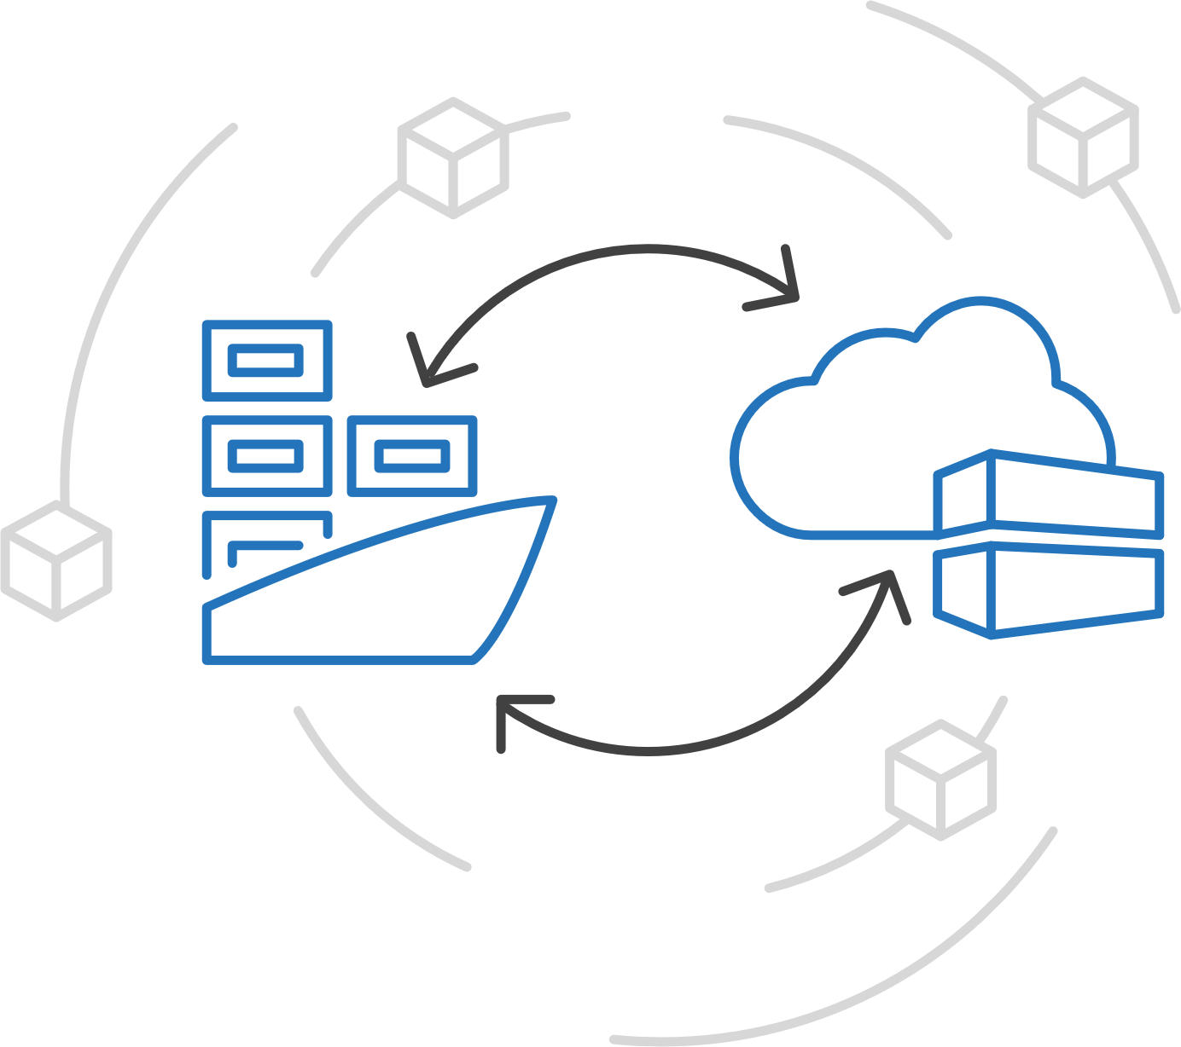
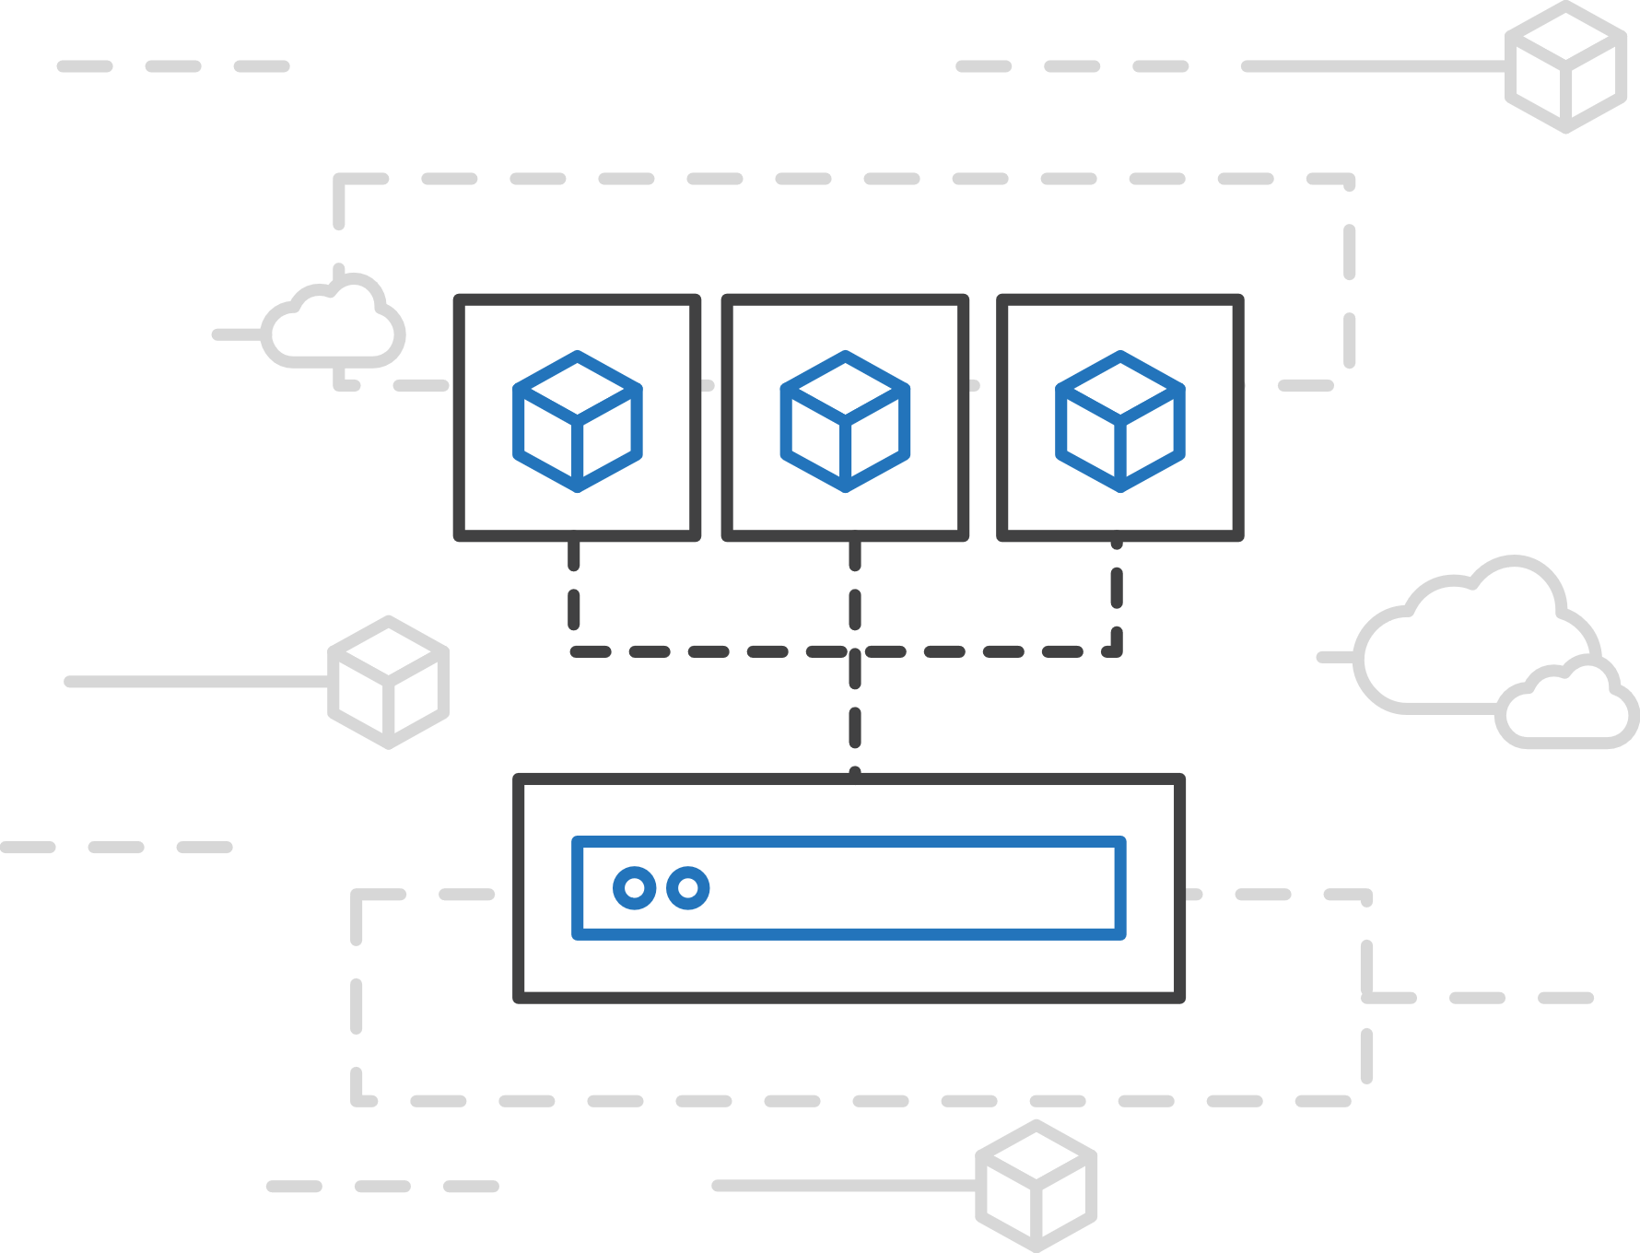
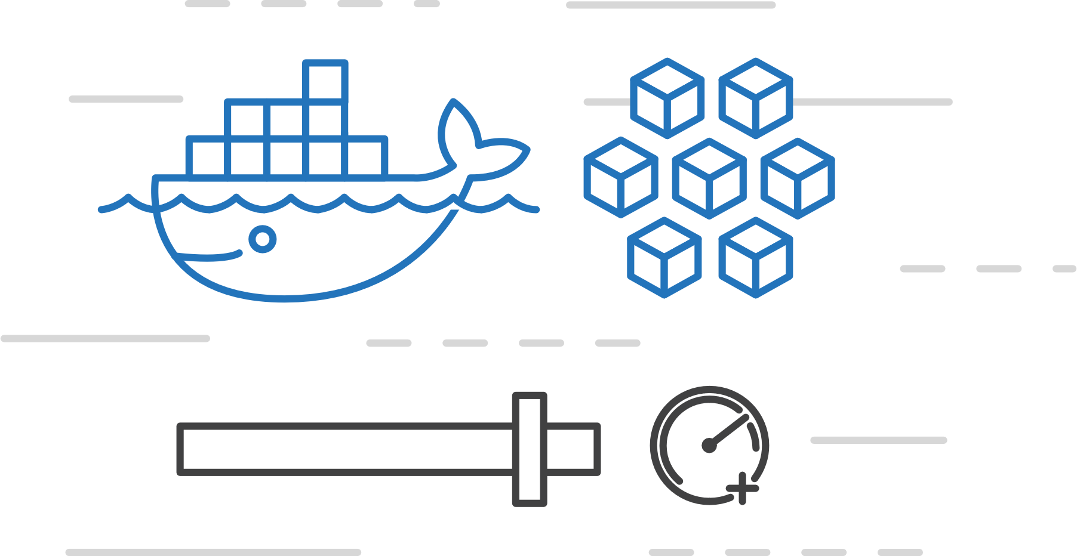
Azure Container Instances (ACI)
Easily run containers on Azure with a single command
Start using
containers right away
Cloud-scale container capacity
Hyper-visor isolation
Notes:
Today you need to create a VM or to adopt a higher level orchestrator .. We decided to provide containers as top level resource in Azure
Fun fact .. Cloud shell is actually running a container instance
DEMO!
Beside Demo :
You can integrate it with ARM template , use private registry, use keyVault for creds.
For additional scale, DevOps scenarios , you will need to connect this to kubernetis (or other orchestrator)
Per second billing: When creating container – initial cost , we charge on per second based on the resources (CPUs and memory) .
Use cases:
Getting started
Short lived – testing
Hybrid – you have your cluster of containers and you don’t want to scale VMs .. If you have a spike you can spin them with ACI

Slide 23
Managed Containers

Slide 24
The elements of orchestration
Scheduling
Affinity/anti-affinity
Health monitoring
Failover
Scaling
Networking
Service discovery
Coordinated app upgrades
MICROSOFT CONFIDENTIAL – INTERNAL ONLY

Slide 25
Kubernetes: the de-facto orchestrator
Portable
Public, private, hybrid, multi-cloud
Extensible
Modular, pluggable, hookable, composable
Self-healing
Auto-placement, auto-restart, auto-replication, auto-scaling

Slide 26
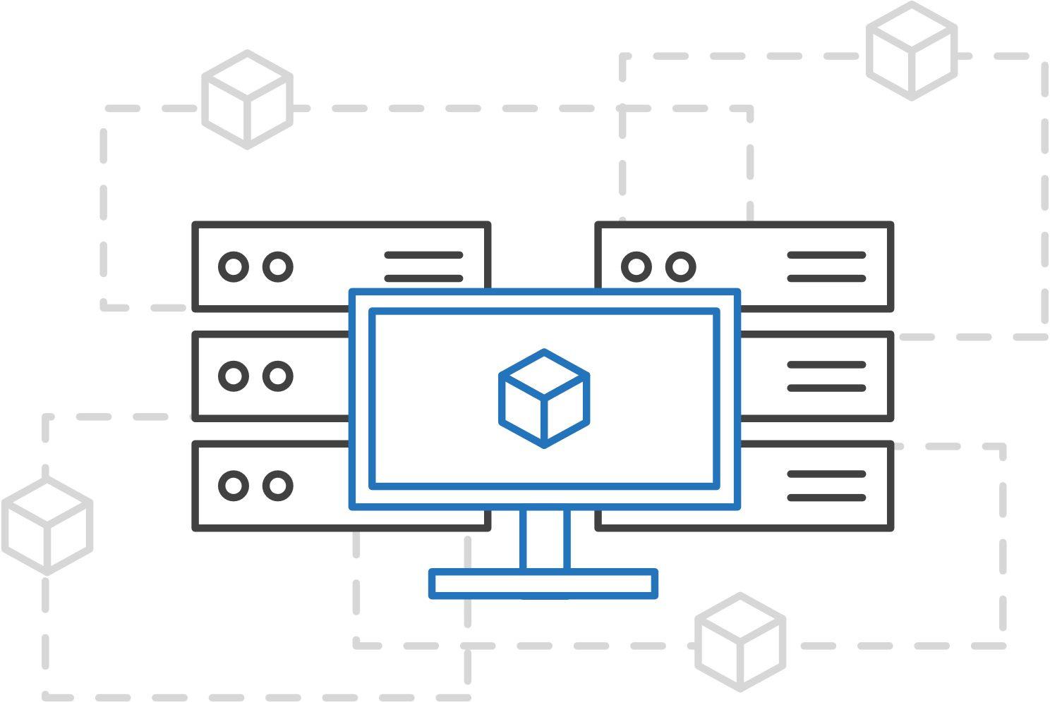
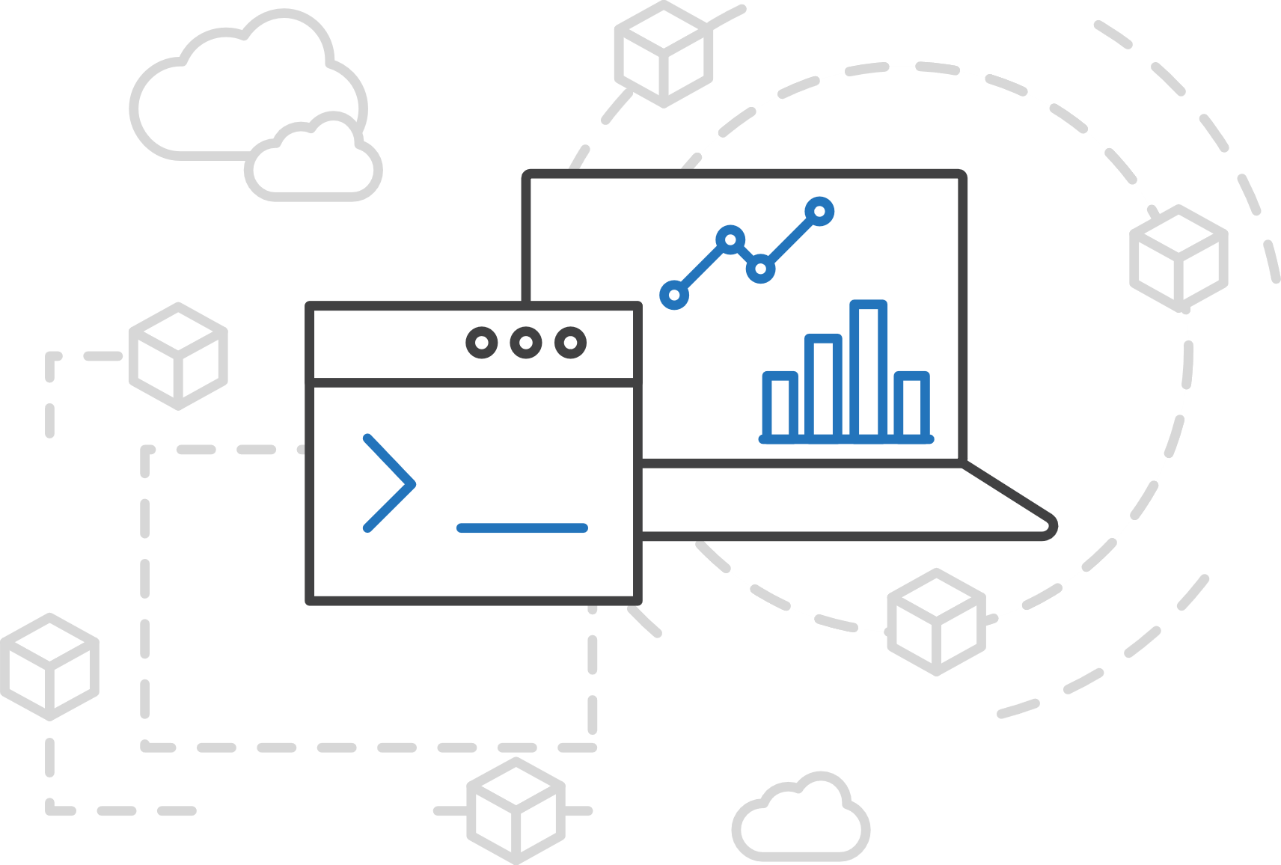
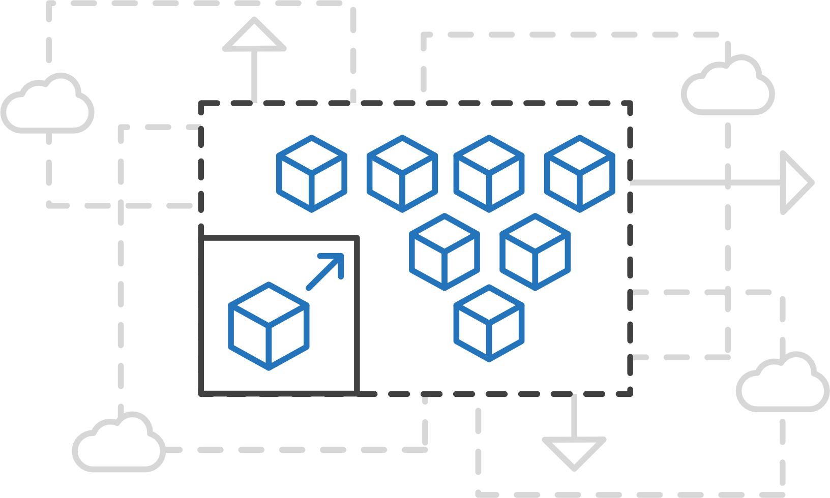
Azure Container Service (AKS)
Simplify the deployment, management, and operations of Kubernetes
Focus on your containers not the infrastructure
Work how you
want with open-source APIs
Scale and run applications with confidence
Notes:
Customers asked for more of a managed service with kubernetis
Easy to use : 3 commands to set a cluster
Easy to manage: auto patching and scaling . Self healing for control plane
100% open source
AKS is free : the control plane is for free . You pay just for the compute node that your code actually require
Default agent pool is of 3 .. You can run 1 to 100s

Slide 27
Azure Container Service (AKS)
A fully managed Kubernetes cluster
Managed control pane
Automated upgrades, patches
Easy cluster scaling
Self-healing
Cost savings
Managed
Application architect
Applications
Operations
Kubernetes
Infrastructure architect
Docker
Azure infrastructure services

Slide 28

Azure Container Service (AKS)
Azure Container Service (AKS)
Get started easily
Azure Container Instances (ACI)
$ az aks create -g myResourceGroup -n myCluster --generate-ssh-keys
\ Running ..
$ az aks install-cli
Downloading client to /usr/local/bin/kubectl ..
$ az aks get-credentials -g myResourceGroup -n myCluster
Merged "myCluster" as current context ..
$ kubectl get nodes
NAME STATUS AGE VERSION
aks-mycluster-36851231-0 Ready 4m v1.8.1
aks-mycluster-36851231-1 Ready 4m v1.8.1
aks-mycluster-36851231-2 Ready 4m v1.8.1
Azure Container Registry
Open Service
Broker API (OSBA)
Release
Automation Tools

Slide 29
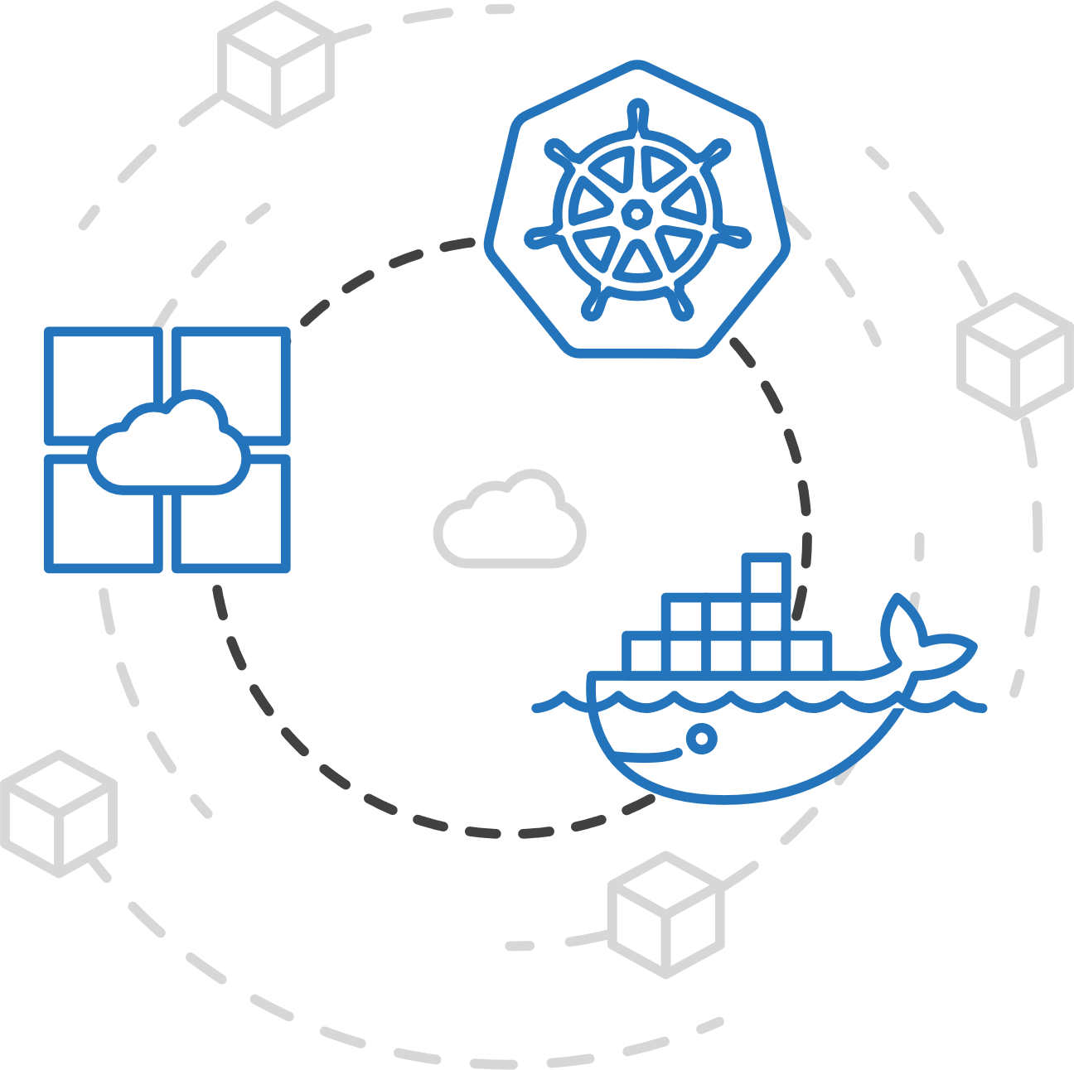
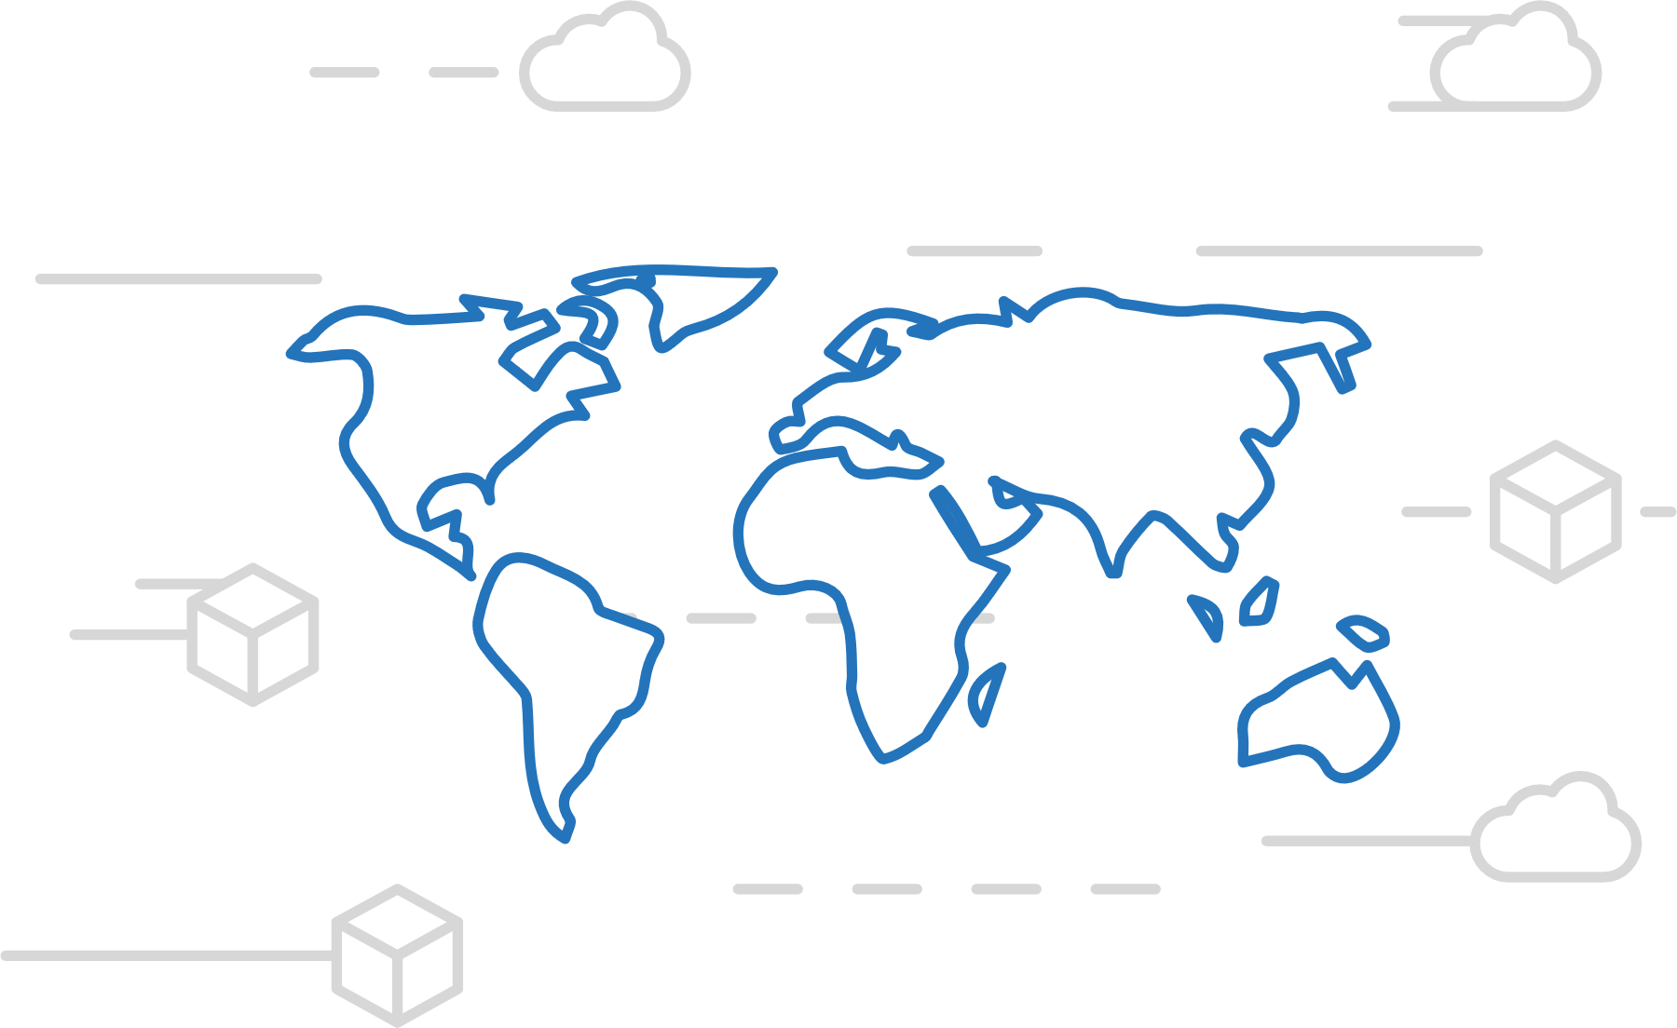
Azure Container Registry
Azure Container Service (AKS)
Manage a Docker private registry as a first-class Azure resource
Azure Container Instances (ACI)
Azure Container Registry
Open Service
Broker API (OSBA)
Manage images for all types of containers
Use familiar, open-source Docker CLI tools
Azure Container Registry geo-replication
Release
Automation Tools

Slide 30
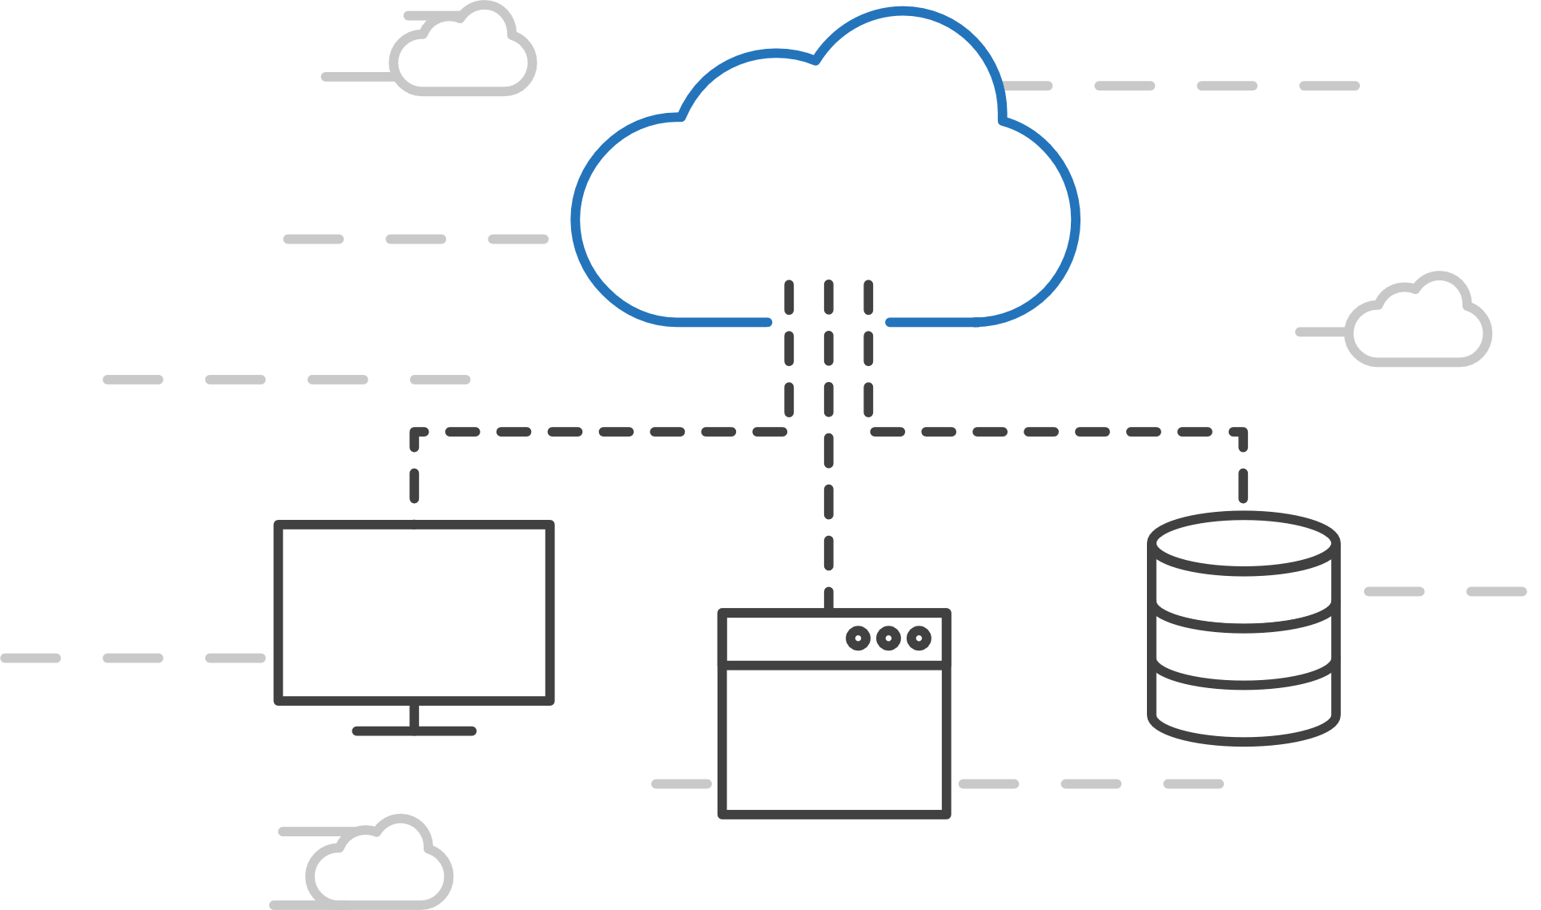
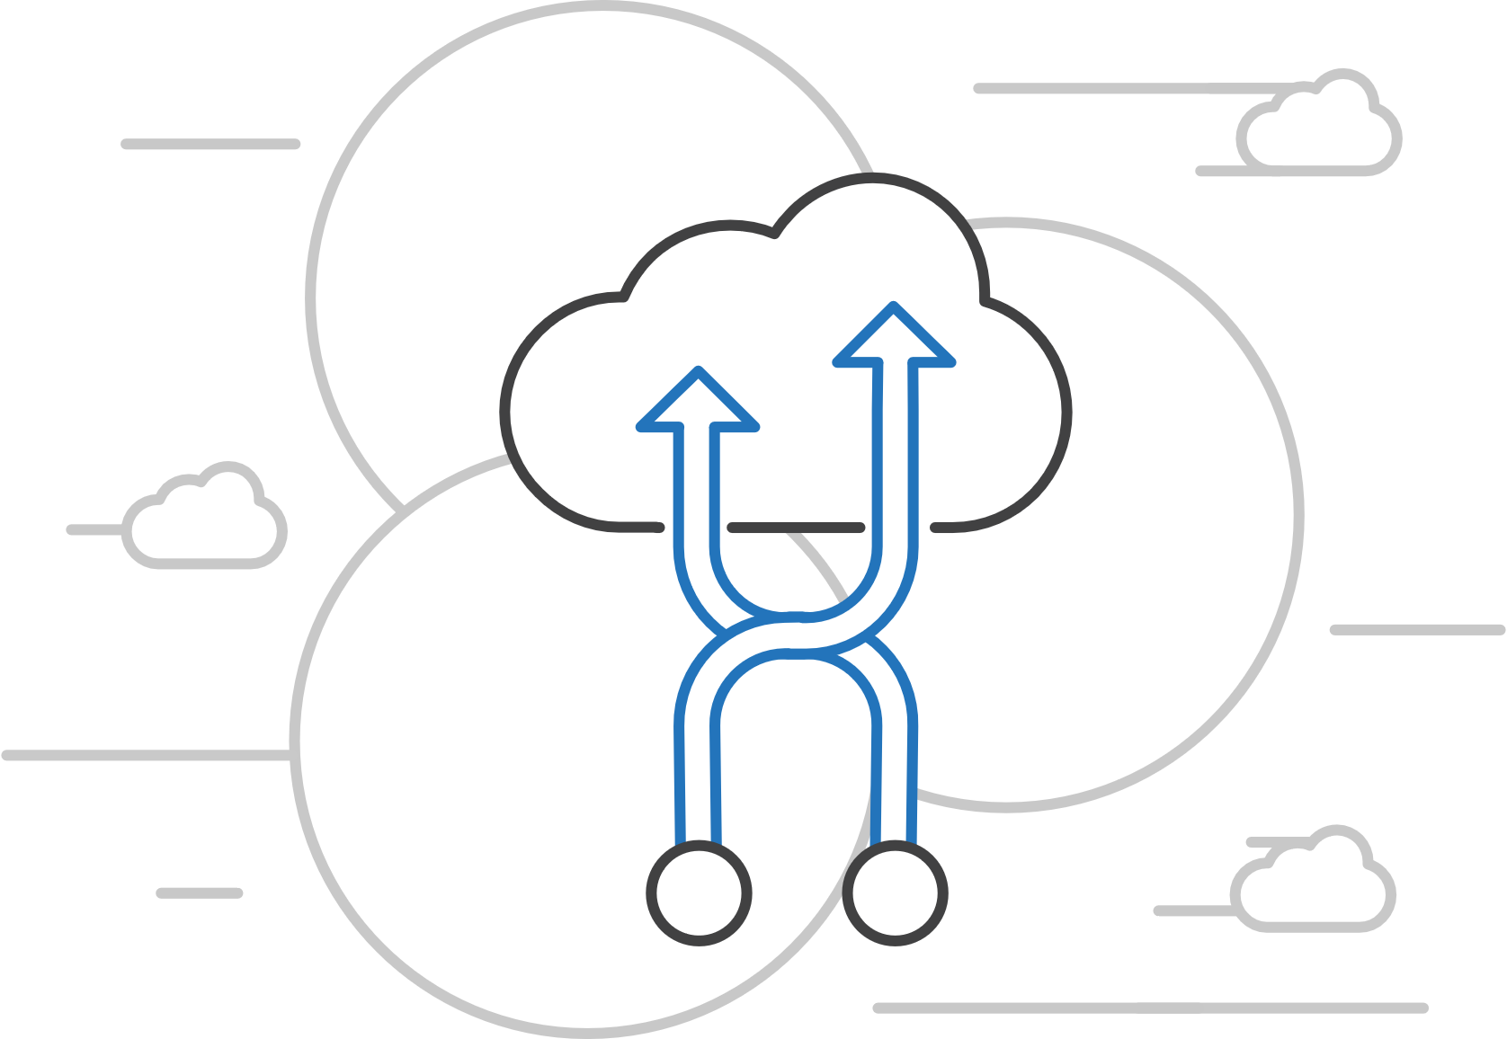
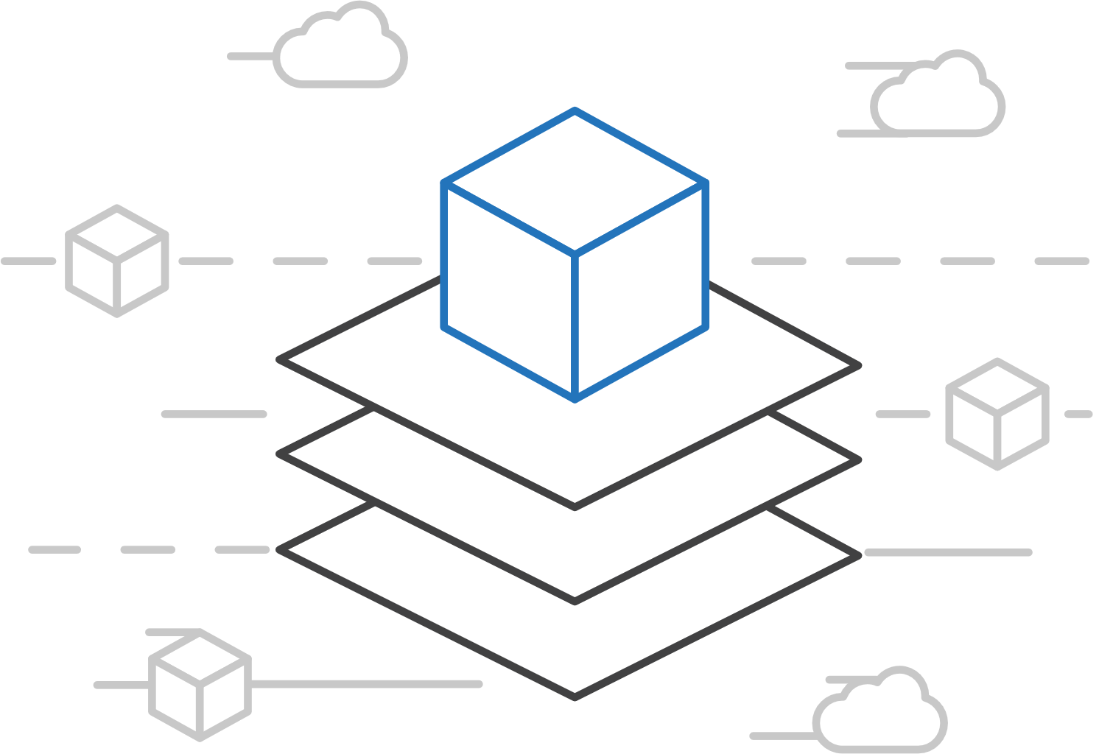
Open Service Broker for Azure (OSBA)
Azure Container Service (AKS)
Connecting containers to Azure services and platforms
Azure Container Instances (ACI)
Azure Container Registry
Open Service
Broker API (OSBA)
A standardized way to connect with Azure services
Simple and flexible service integration
Compatible across numerous platforms
Release
Automation Tools

Slide 31
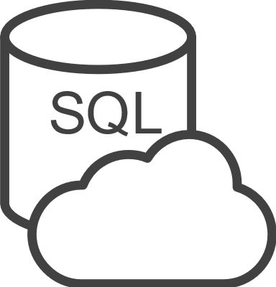





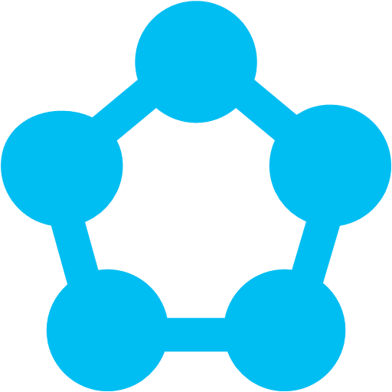
Open Service Broker for Azure (OSBA)
Azure Container Service (AKS)
An implementation of the Open Service Broker API
Azure Container Instances (ACI)
Azure SQL Database
Redis Cache
CosmosDB
And more!
Azure Container Registry
Open Service Broker for Azure (OSBA)
Open Service
Broker API (OSBA)
Release
Automation Tools
OpenShift
Cloud Foundry
Service Fabric (Coming soon)
Kubernetes
(AKS)

Slide 32

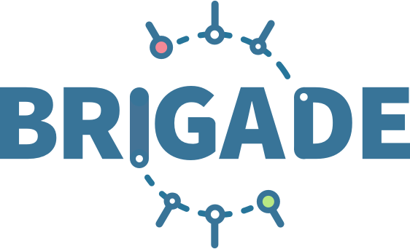


Release automation tools
Azure Container Service (AKS)
Simplifying the Kubernetes experience
Azure Container Instances (ACI)
Azure Container Registry
Open Service
Broker API (OSBA)
Streamlined Kubernetes development
The package manager for Kubernetes
Event-driven scripting for Kubernetes
Visualization dashboard for Brigade
Release
Automation Tools

Slide 33

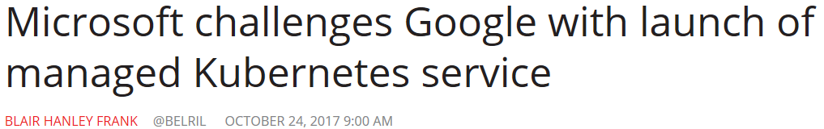

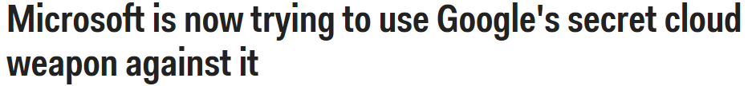


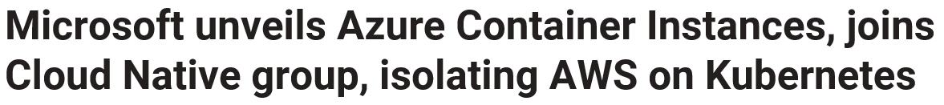
K8s on Azure: Since last year…
Dev tools: Launch of Draft, Brigade, Kashti – focused on K8s native developer experience
Azure Container Instances: first among cloud providers
Managed Kubernetes Service (AKS) Preview
Launched next-generation Open Service Broker for Azure (OSBA)
Doubled K8s footprint on Azure
Joined CNCF as Platinum Member
Notes:
CNCF - Cloud Native Computing Foundation : with AWS, Messisphere, Google, Docker, SAP, RedHat. Sansung,Cisco, Oracle, IBM, Docker and more

Slide 34



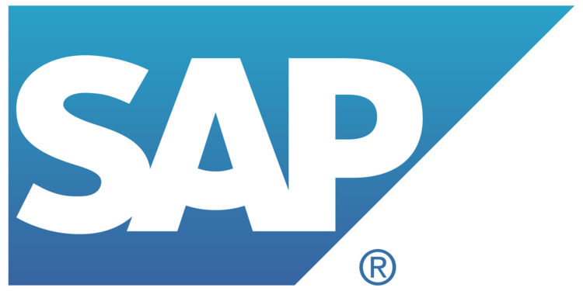



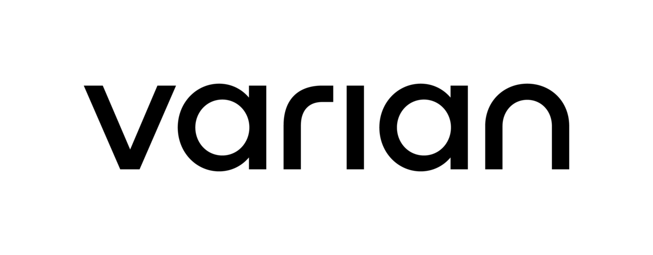

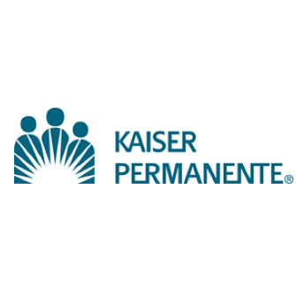









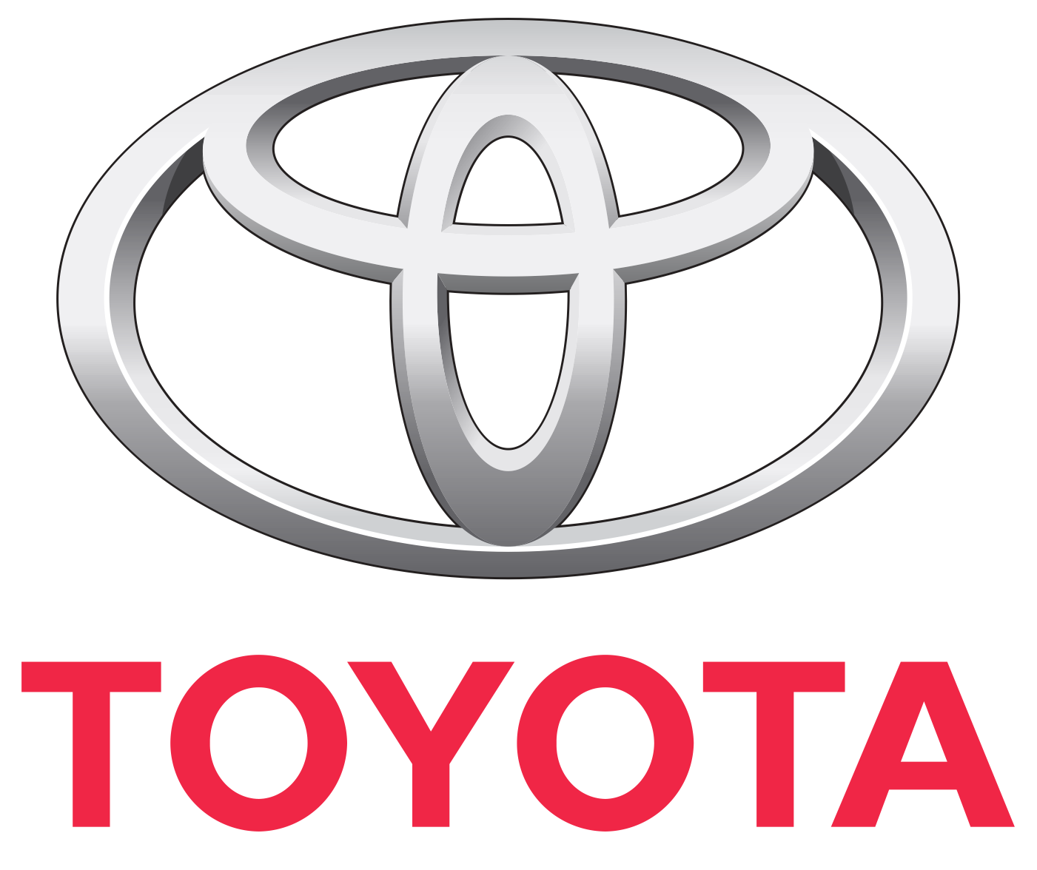








K8s on Azure - Customer momentum

Slide 35
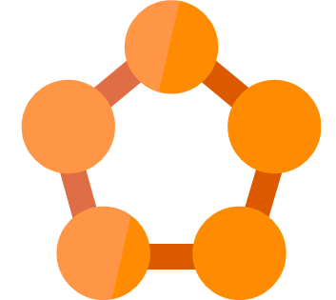
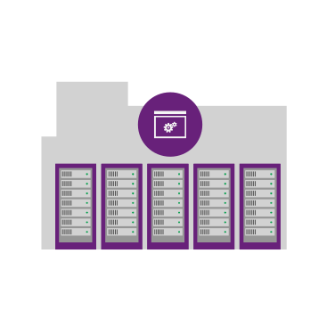
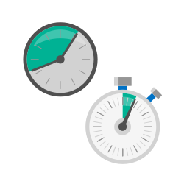


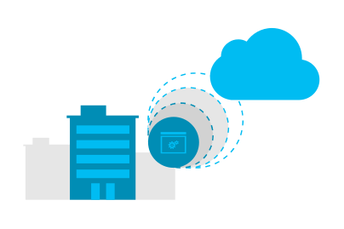

Azure Service Fabric
Hyperscale Microservices
platform
Managed platform
High productivity development
Built-in auto scale
and load balancing
High availability
with auto-patching
Simple
Programming models for
.NET, Java
Stateful
microservices
Highly scalable
24 X 7 availability
Health &
Monitoring
Available on
Private cloud,
Public Cloud &
Hosted Cloud
Learn easily using
Party clusters
Simple tooling with
Visual Studio,
Eclipse &
Yeoman
Windows and Linux
Container
Orchestration
DevOps and
Lifecycle management

Slide 36
Service type
Services types are composed of code/config/data packages
  Code packages define an entry point (dll or exe)
  Config packages define service specific config information
  Data packages define static resources (eg. images)
Packages can be independently versioned
<ServiceManifest Name="QueueService" Version="1.0">
<ServiceTypes>
<StatefulServiceType ServiceTypeName="QueueServiceType" HasPersistedState="true" />
</ServiceTypes>
<CodePackage Name="Code" Version="1.0">
<EntryPoint>
<ExeHost>
<Program>ServiceHost.exe</Program>
</ExeHost>
</EntryPoint>
</CodePackage>
<ConfigPackage Name="Config" Version="1.0" />
<DataPackage Name="Data" Version="1.0" />
</ServiceManifest>
Service Type 1
Code
Config
Data

Slide 37
Application type
Declarative template for creating an application
Based on a set of service types
Used for packaging, deployment, and versioning
Application Type A
Service Type 1
Service Type 2
Service Type 3
Code
Config
Data
Code
Config
Data
Code
Config
Data

Slide 38



Azure App Service
Enterprise-grade apps
Fully managed platform
High productivity development
Global data
center footprint
Hybrid support
Built-in auto scale
and load balancing
High availability
with auto-patching
.NET, Java, PHP,
Node, and Python
Staging and
deployment
AAD integrated
Secure + compliant
Reduced
operations costs
Backup and
recovery
Source code control integration
App gallery
marketplace

Slide 39
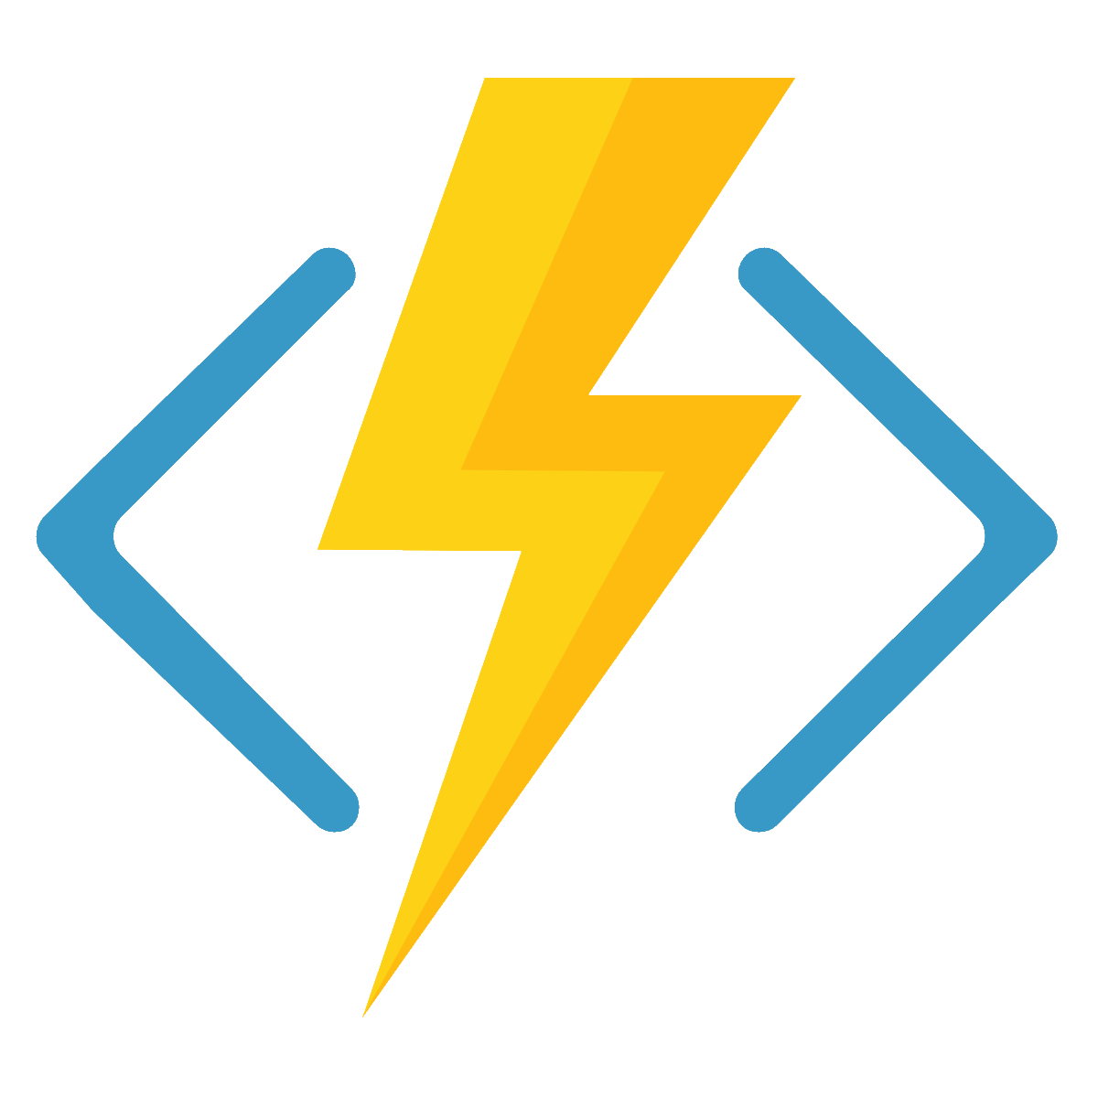
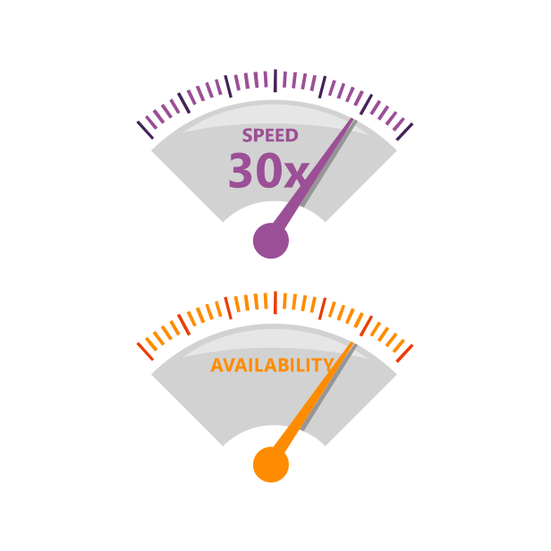







Azure Functions
Serverless
Accelerate development
Bind into services
Azure
Service Bus
Azure
Event Hub
Azure
Storage
</>
Dropbox
Sendgrid
AzureDocDb
Event-driven
scale
Reduced
Dev Ops
Develop
your way
Local
development
OneDrive
Box
Twilio

Slide 40
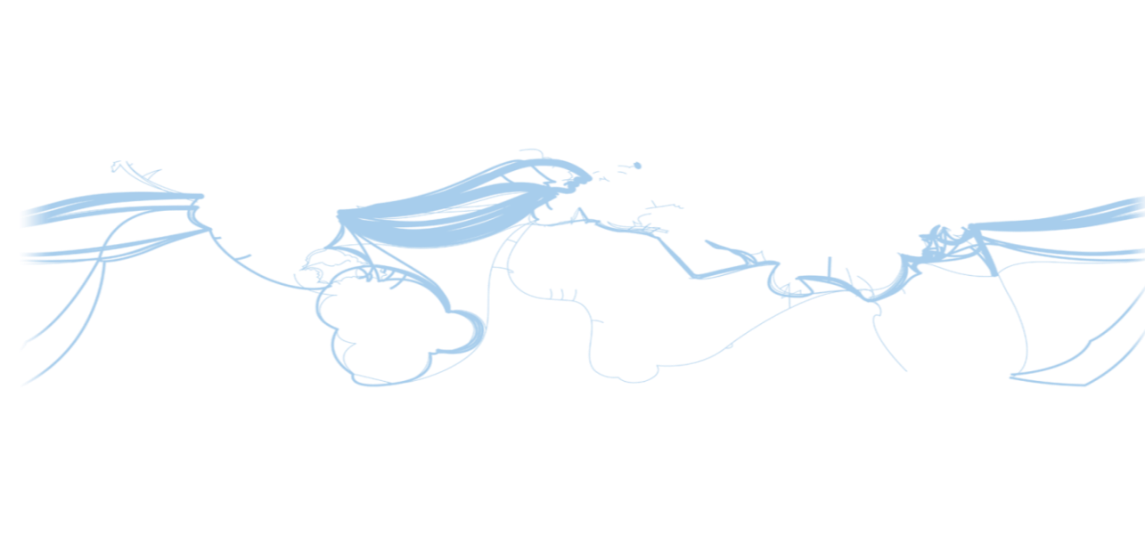
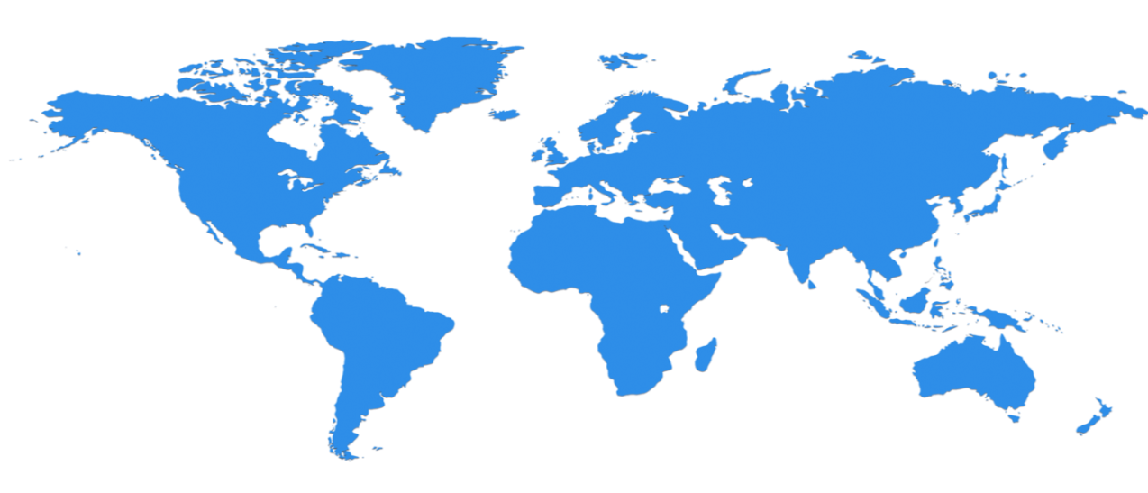

Hyper-scale infrastructure:
100+ Datacenters across 40 Regions (36 Generally Available) Worldwide.
UK West
Cardiff
UK South
London
North Central US
Illinois
Germany Central **
Frankfurt
West US 2
TBA
North Europe
Ireland
West Europe
Netherlands
Korea Central
Central US
Iowa
Canada Central
Toronto
Canada East
Quebec City
Korea South
China North *
Beijing
US Gov
Iowa
Germany South **
Magdeburg
China South *
Shanghai
Japan East
Saitama
West US
California
East US
Virginia
France
TBA (x2)
India Central
Pune
Japan West
Osaka
West Central US
TBA
East US 2
Virginia
US Gov
Virginia
India West
Mumbai
India South
Chennai
East Asia
Hong Kong
US DoD West
TBA
US DoD East
TBA
SE Asia
Singapore
South Central US
Texas
Australia East
New South Wales
  Top 3 networks in the world
  2x AWS, 6x Google DC Regions
  Largest VM in World
  (large instances, M Series)
Brazil South
Sao Paulo
S. Africa
North
Australia South East
Victoria
S. Africa
West
Operational
Announced/Not Operational
  *Operated by 21Vianet **Data Stewardship by Deutsche Telekom
Notes:
$15b investment – more than Amazon and Google combined
* We have 40 Azure regions worldwide today, representing over $15B in investments setting up infrastructure across the globe * That’s 2X the number of regions AWS has. This means you have more choice for where you deploy your applications for lowest latency to your own datacenters or customers
What is value of Infra
Global Scale
Azure operates at global scale.
Global scale is about enabling you to reach way beyond your datacenter or even the region where you operate in. It’s about providing your (and your customers) applications global scale. And it’s about providing you as much compute performance as necessary to scale out or scale up your applications.
At the core of Azure is its global infrastructure that spans 34 regions worldwide, 30 that are operational. Designed to address the data privacy, sovereignty and compliance needs of our customers and partners around the globe.
We have the largest footprint of any cloud provider—more countries and regions than Amazon Web Services and Google Cloud combined.
Azure is also the first multinational cloud provider in mainland China. Only multinational cloud vendor with a license to operate in China.
You may have heard that we just announce 2 new regions in the US and South Africa recently.
Azure runs on a worldwide network of Microsoft-managed datacenters across 34 regions—more countries and regions than Amazon Web Services and Google Cloud combined. This fast-growing global footprint gives you lots of options for running applications and ensuring great customer performance. Azure is also the first multinational cloud provider in mainland China.

Slide 41
50
4500+
130+
AZURE
REGIONS
PEERING
LOCATIONS
EDGE
SITES
Notes:
Our first stop is our global WW presence
As you saw in Scott’s keynote Azure has 42 regions WW which is more than any other cloud provider
These regions are actually comprised of hundreds of DCs
We also operate one of the most robust and reliable networks in the world with:
over 4500 points of presence
And more than 130 Edge sites

Slide 42
Azure Regions – Europe
Region | Location
North Europe | Ireland
West Europe | Netherlands
France Central | Paris
France South | Marseille
UK West | Cardiff
UK South | London
Germany Central | Frankfurt
Germany Northeast | Magdeburg
Newly announced
Germany North | Germany North
Germany West Central | Germany West Central
Switzerland North | Zurich
Switzerland West | Geneva

Slide 43
Functions
Serverless, Event-based platform
App Service
Web, Mobile, or API PAAS
Serverless, “Code-less”, Event-based platform
Logic Apps
Microservices .NET based platform
Managed containers Infrastructure
Service Fabric
Kubernetes (AKS)
Lift-and-shift
Scale identical VMs
& Elasticity
Individual containers with no overhead
Or burst your AKS
Container
Instances
VMs
VM
Scale Set

Slide 44
Key recommendations for choosing a service
Target the highest acceptable level of abstraction
  If you don’t need control of something, let Microsoft handle it
  Just make sure you’re ok with the restrictions, including portability
Don’t fall victim to ‘analysis paralysis’
  For most customers, every option offers value over what they have today
  Torn between two options? Flip a coin and get started

